Slide 1

New Director Training
Virtual Format

Slide 2

MODULE THREE
For
Compliance to
WIOA
Accountability &
Implementation

Slide 3

Purposes of Adult Education
Develop/expand skills and knowledge needed to transition to postsecondary and/or employment
Integration of AE activities with occupational training
Collaboration
Notes:
WIOA recognizes that the core purpose of adult education is to prepare individuals with the skills and knowledge needed to succeed in postsecondary education and the workforce.
1) The Act expands the purpose of adult education to emphasize that activities should increase an individual’s ability to transition to postsecondary education and obtain employment.
2) Promotes the integration of adult education with occupational education and training, as well as development of career pathways systems; authorizes the use of funds for “integrated education and training” and “workforce preparation activities”; and clarifies that integrated English literacy and civics education programs may provide workforce training.
3) Encourages activities provided in collaboration with employers."

Slide 4


WY AE Program Concept
Implementation of
Rules/Regulations
OCTAE
State
Implementation
Professional
Development
SEA
LINCS /
WYLLA
Notes:
AEFLA funded grants are guided by WIOA legislation, but the governing body for Adult Education is the Office of Career, Technical, and Adult Education, commonly called OCTAE. OCTAE falls under the U.S. Department of Education who works hand in hand with the U.S. Department of Labor to implement WIOA legislation across the United States
OCTAE establishes the policies and protocols for all AEFLA programs across the United States. The National Reporting System (NRS) is the agency that establishes the rules and regulations on how data is to be collected and how standardized reporting for AEFLA grants in the U.S.A. is to be done.
The Wyoming Community College Commission is the State agency tasked with overseeing all aspects of federally funded AEFLA grant programs.
LINCS is a professional learning space that brings together adult education teachers, program managers, and professionals worldwide who are working toward one common goal—to provide high quality, evidence-based learning opportunities to students. LINCS is a free PD resources that is supported by OCTAE and has a wide variety of materials and resources available on their website at no cost. Most AE directors in Wyoming require that instructors complete courses from the LINCS website. This is a great PD resource and programs are encouraged to use it freely.
WYLLA is the professional development arm of the Adult Education programs in Wyoming. Each AE program is encouraged to participate on the WYLLA board as WYLLA helps to establish, promote, and offer professional development opportunities throughout the State, especially the State AE Institute. The State Institute is typically held in August of each year and every program is required to send at least 80% of all program staff. Programs which do not meet this requirement are subject to State imposed Action Plan that mandates the local program provide 24 hours of program self-funded, professional development to replace the training hours missed by non-attending instructors.
Professional Development is discussed in Module 7 in more detail.

Slide 5




OCTAE Initiatives for AE
Administering the AE formula grant program to the States
Providing assistance to States to improve quality, accountability, and capacity
Establishing national leadership activities to enhance the quality of adult education
Notes:
The Office of Career, Technical, and Adult Education (OCTAE) administers, coordinates programs that are related to adult education and literacy, career and technical education, and community colleges.
OCTAE’s initiatives are designed to:
Administering the AE formula grant program to the States
Providing assistance to States to improve quality, accountability, and capacity
Establish national leadership activities to enhance the quality of adult education.

Slide 6
OCTAE Division of Adult Education & Literacy (DAEL)
Program
Memorandums
Leadership Activities
Funding AEFLA Grants
Monitoring
Notes:
OCTAE’s Division of Adult Education and Literacy is the federal agency which oversees AELFA grants.
DAEL administers the AEFLA formula grant program to States using a formula that is based, in part, upon Census data.
To help implement WIOA legislation in AEFLA programs, OCTAE provides guidance through Program Memorandums. (Click on link shown on slide to access these Program Memorandums)
Periodically, OCTAE will conduct audits (monitoring visits) of individual States to verify that the State is in compliance with WIOA legislation. Because accountability is so critical to AEFLA grant, Wyoming’s AE programs have set in place many components to verify WIOA compliance. This includes multiple types of monitoring(s) and technical assistance and training.
Throughout any given year, OCTAE also establishes multiple national leadership activities to enhance the quality of adult education throughout the United States.

Slide 7

NRS
Performance Indicators
Outcome Measures
Data Collection
Definitions, Clarifications, Regulations
Reporting Procedures
Notes:
The National Reporting System for Adult Education (NRS) is the accountability system for the federally funded adult education program, authorized by Section 212 of the Workforce Innovation and Opportunity Act (WIOA).
The NRS has defined & outlined the WIOA primary indicators of performance, measures that describe adult education students and their program participation, methodologies for collecting performance data, and program reporting procedures. For more detailed information about the NRS, please refer to their website at: https://nrsweb.org/
The NRS provides definitions, clarifications, and the regulations needed to implement WIOA in Adult Education programs.

Slide 8




NRS
NRS Technical Assistance Guide can be found here.
Self-paced online learning courses can be found here.
In-person training
Other resources
Notes:
To help local providers and States understand the protocols associated with implementing AEFLA grant, they have provided a Technical Assistance Guide available on their website. (Hyperlink available on slide).
A wealth of professional development and learning opportunities are also available through the NRS. These self-paced online courses offer educational practitioners an opportunity to learn about NRS and WIOA requirements and provides strategies to improve the collection and validation of NRS data.
In addition to the online courses, the NRS also conducts face to face trainings in various locations around the United States. Typically, these are attended by the State director but on occasion, local directors are also invited to participate at no cost to their program.
The NRS also offers a wealth of other online resources on its homepage to local providers, such as WIOA & NRS resources, Statewide performance reports, State snapshots and data highlights.

Slide 9
NRS: Implementation Guidelines
NRS History
Overview: NRS Measures
Overview: NRS Methods
Performance Indicators, MSG’s, & other Measures
Definition of Terms for Data Collection
Data Matching
Data Flow Framework
Data Collection Policies & Procedures
Quality Control
Reporting
Notes:
Every program director should take the time to read the NRS Implementation Guidelines for Adult Education programs funded under WIOA. These guidelines provide all of the rules and regulations that govern how adult education programs must operate and collect data for reporting purposes.

Slide 10

NRS Definitions & Regulations for Adult Education
Types of Individuals
Educational Functioning Levels
Measuring Gain for Performance
Periods of Participation
Outcome Measures
Notes:
As mentioned on the previous slide, the NRS guidelines provide a wealth of information, but perhaps the most important for new directors is the definitions and guidelines for specific terms. The State has extrapolated several key terms to draw attention to their importance to your new role as an AE director in Wyoming.

Slide 11
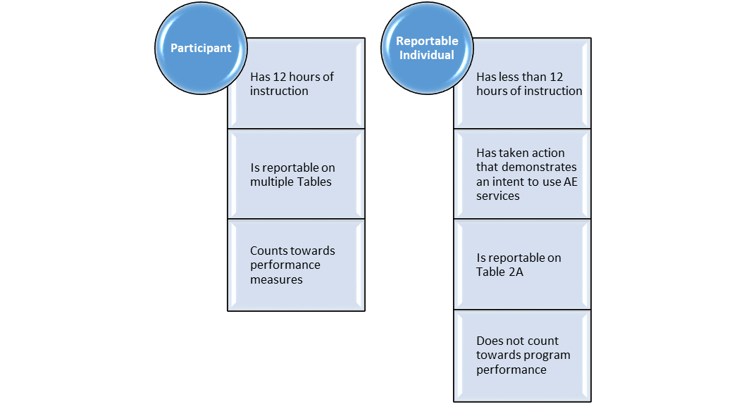
Participant vs. Reportable Individual
Reported on all Tables except 2A.
Reported on Table 2A
Notes:
Every student who walks through the door and completes an application must be reported on. Determining how this is completed is based entirely upon the number of hours a participant has with the program. There are two types of individuals that AE centers must report on. These are defined in the slide.
Each program is required to report on both types of individuals through the various NRS tables.

Slide 12
Types of Learners
Traditional Learner
51% or more of instruction is face-to-face (F2F)
Distance Learner
Blended Learner
A combination of F2F & distance
Virtual Learner
51% of instruction is through approved DL curricula
Instruction is delivered through virtual classrooms (contact hours) and a combination of F2F and/or through the use of approved DL curricula

Slide 13
Distance Learning Curriculum Models
Clock Time
Teacher Certification
Learner Mastery
Notes:
To determine a participant’s proxy contact hours, a program must use an approved distance learning curriculum that employs one of the following models:
Clock Time Model: Assigns proxy contact hours based on the time that a participant is connected to or engaged in an online or stand-alone software program that tracks time.
Clock time model curricula electronically track the time the participant spends interacting with instructional material and stops counting idle time after a preset period of inactivity.
Teacher Certification Model: Assigns a predetermined number of proxy contact hours for each activity completed at an acceptable level of quality, as verified by the instructor.
Proxy contact hours for teacher certification model curricula are awarded based on the teacher’s certification of participant’s completion of assignments. Teachers may award full proxy hour credit if the assignment is completed and demonstrates competence in the teacher’s professional judgment. Teachers may award half of the full proxy hour credit if the assignment is only partially completed but still demonstrates competence in the teacher’s professional judgment. Assignments that do not demonstrate competence must be resubmitted by the participants to be counted for proxy hour credit.
Learner Mastery Model: Assigns a predetermined number of proxy contact hours based on learner mastery of each lesson or unit in the distance curriculum.
Proxy contact hours for learner mastery model curricula are awarded based on a passing score on a content test for a particular assignment, lesson, or unit. The passing rate is set at a minimum of 70 percent unless otherwise recommended during the curriculum approval process.
The State distance learning policy outlines approved models and the protocols involved for requesting curricula approval for distance learning in Wyoming.

Slide 14
Educational Functioning Levels
Notes:
There are twelve Educational Functioning Levels that all AE programs are required to report on. These are defined in detail in Exhibit B at the end of this module. The table below depicts the naming convention and placement levels into which all participants must be placed when entering a program of study in an Adult Education program. Unless specifically requested, students are placed into an EFL based upon their lowest score earned on a specific assessment. For instance, if a student takes the Reading, Writing, and Mathematics test and scores the lowest in Language, their placement on these levels would be in Language. However, if the student or program director specifically requests that Reading be tracked, this can be done, but a note must be made in the student file and the data base must be updated accordingly.

Slide 15

Periods of Participations (PoP’s)
Notes:
A period of participation begins each time a participant enrolls in adult education—even when multiple enrollments occur during the same program year. Subsequent enrollments during a program year result in a new period of participation. Therefore, a participant may have more than one period of participation in a program year.
Exit date is the last day of service for participants, but this date cannot be determined until 90 days have elapsed since the person last received services and there are no future services planned. Services do not include self-service, information-only services, activities, or follow-up services
For example, a student who enters an adult education program in September, exits in December, and re-enrolls in May has two periods of participation for the purpose of reporting MSG, and only one POP for the purpose of reporting exit-based indicators because only one exit is reported. A participant who enters an adult education program only once within a program year has one period of participation for the purpose of reporting both MSG and exit-based indicators (upon their exit). For all performance indicators, each period of participation is counted separately, resulting in duplicate reporting of individual participants with more than one period.
How are periods of participation used for calculating performance indicators?
State performance on all core outcome measures under WIOA, excluding median earnings, is calculated as a percentage of the total number of outcomes achieved by the total number of periods of participation.
Do the WIOA performance measures apply for each period of participation?
Every period of participation is treated as a separate event for a participant and performance indicators apply separately to each period. This means that for each period of participation, the state must report measurable skill gains and conduct follow-up on the participant after exit from each period to collect data on the appropriate post-exit indicators. Each exit date from a period of participation is used to determine the follow-up time. For example if a student exits in December, reenrolls in April, and exits again in June, the state would report on appropriate post-exit indicators for both exits. The second-quarter employment outcome, for example, would be reported in the April through June quarter for the December exit, and in the following October through December quarter for the June exit.
How do periods of participation affect pre- and post-testing of participants?
At entry into each period of participation, a participant must be placed in an NRS educational functioning level (EFL) on the basis of an approved NRS assessment. EFL placement in a new period of participation can carry over from a prior period, or a new placement test may be administered. However, it is important to note that policy and procedures for assessing students should not change because of periods of participation. Proper assessment practices should always be followed.
Policies and procedures regarding the assessment of individuals who return after an exit or an extended absence must be detailed in the state’s assessment policy, and those policies and procedures must follow test publishers’ guidelines, when available.
If the test publisher does not have retesting guidelines for returning students, the state must establish a policy for retesting that local programs must follow. These procedures will provide uniformity to testing practices within the state. After a participant is placed in an EFL in the new period of participation, either by a new assessment or carryover from a prior assessment, an EFL gain (via pre-/ post-testing) in the new period of participation requires that a new posttest be given. A posttest used in the additional period of performance may not be used to also reflect a gain in a prior period of performance.

Slide 16
Periods of Participation
Participants with more than one entry have multiple periods of participation in a program year
Every period of participation is a new service period and treated as if the participant is a NEW participant (follow-up, MSG, etc)
A new intake process is required for each period of participation
Notes:
A period of participation starts at the beginning of a fiscal year, after determining the student’s entry EFL AND 12+ hours of instruction OR within a fiscal year after a 90 day gap in attendance in which the student has earned 12+ hours since returning to study. PoP’s are very difficult to understand, so it would be advisable to talk to your program director about them.
For the purposes of reporting measurable skill gain, each program entry per participant during the reporting period is considered a period of participation.
For the purposes of reporting on Employment 2nd Quarter, Employment 4th Quarter, Median Earnings, and the Credential indicators, each program entry and exit per participant during the reporting period is considered a period of participation.
A new period of participation is counted each time a participant exits and reenters again, even if it occurs during the same program year.

Slide 17
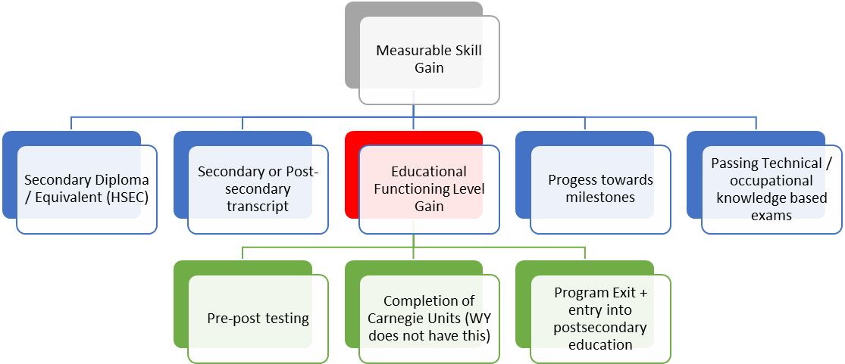
Performance: MSG
Notes:
The MSG indicator, as defined by the NRS, represents the percentage of participants who, during a program year, are in an education or training program that leads to a recognized postsecondary credential or employment and who are achieving measurable skill gains, defined as academic, technical, occupational, or other forms of progress, towards such a credential or employment. This definition provides for five ways in which AE programs are allowed to report MSG gains.
Most AE programs in Wyoming typically utilize only two of the aforementioned methods for calculating gain: Secondary Diploma/ Equivalent or EFL gains.
Secondary Diploma/Equivalent: Students who earn a high school equivalency are automatically counted as achieving a MSG if the last test on record is the high school equivalency test. If a student post tests after earning the HSEC, then the HSEC credential would not count for reporting purposes. It is for this reason that instructors develop a complete understanding of the progression in which assessments must occur. (outlined in module 1). Completing a HSE is limited to participants who did NOT previously possess a high school equivalency/diploma AND entered the AE program at or above the 9th grade level OR who advanced to the 9th grade or higher level during a period of participation AND exited from the program.
Secondary or postsecondary transcript/report card: Credit hours earned towards the State unit’s academic standards. (Wyoming does not utilize this method)
Educational Functioning Level Gain: The NRS has outlined three ways in which educational functioning level gains may be made.
Comparing the participants’ initial educational functioning level, as measured by a pre-test, with the participant’s educational functioning level, as measured by a post test.
States that offer adult high school programs that lead to a secondary school diploma or its recognized equivalent may measure and report educational gain through the awarding of credits or Carnegie units. (Wyoming does not have this)
States may report an educational functioning level gain for participants who exit the program AND enroll in postsecondary education/training during the program year. This indicator is limited to participants who were enrolled in a postsecondary education/training program, including an IET AND exited from the postsecondary/training program in the program year.
Progress Towards Milestones: A satisfactory or better progress report, towards established milestones, such as completion of OJT or completion of 1 year of an apprenticeship program or similar milestones, from an employer or training provider who is providing the training.
Passing Technical/occupational Knowledge Based Exams: Successful passage of an exam that is required for a particular occupation or progress in attaining technical or occupational skills as evidenced by trade-related benchmarks such as knowledge-based exams.

Slide 18
Performance: Outcome Measures for Post-Exit Indicators
Post Exit Indicators
Employed 2nd Quarter after exit
Median Earnings in 2nd quarter after exit
Employed 4th Quarter after exit
Credential Attainment
Earned HSEC AND was exited
Earned a PS credential and was exited from that program
Notes:
In addition to measurable skill gain, Adult Education programs have several other areas in which performance must be reported. The indicators are collected on exited participants only and are collected for participation in each PoP. The collection of post-exit data has specific timeframes on which data must be collected and reported on for participants.
In Wyoming most of this data is collected through a data-match system at the State level, so local instructors are not overwhelmed by the burden this reporting requirement entails. However, there are instances when instructors will be required to collect this information through what is known as surveying.
The post-exit indicators in which data must be collected on include:
1) Unsubsidized employment in the 2nd quarter after exit: The number of qualified participants who were employed at any point in the second quarter after exit.
2) Unsubsidized employment in the 4th quarter after exit: The number of qualified participants who were employed at any point in the fourth quarter after exit.
3) Median Quarterly Earnings in the 2nd quarter after exit: The median quarterly wage earned by each qualified participant during the second quarter after exit. Students who are surveyed for this information and are not willing to disclose earnings, should be recorded as $1 median quarterly wage.
4) Credential Attainment: There are two components of the credential attainment indicator:
a) Secondary credential attainment-The Secondary credential component is limited to participants who DID NOT previously possess a high school equivalency AND entered an AE program at or above the 9th grade level OR who advanced to the 9th grade or higher level during a period of participant AND was exited from the secondary education program.
b) Postsecondary credential attainment- The postsecondary education component is limited to participants who were enrolled in a postsecondary education/training program, including an IET AND exited from that program.

Slide 19

Performance Accountability
Measure | 20/21 Targets | 2021/22 Targets
Measurable Skill Gains | 47% | 48%
Employment Rate (Q2) | 44.7% | 45%
Employment Rate (Q4) | 43% | 43.5%
Median Earnings | $3,566 | $3,570
Credential Rate | 41% | 41.5%
Targets
Performance Accountability Targets for Wyoming
Notes:
Performance accountability measures are used to assess State and program effectiveness in achieving positive outcomes for learners. Based on past performance and continuous improvement requirements, the U.S. Department of Education's Office of Career, Technical, and Adult Education (OCTAE) negotiates with the Wyoming Community College Commission’s Office of Adult Education Initiatives annually to establish performance accountability targets for each EFL and all outcome measures.
Once negotiations are completed, targets are shared with all local providers AND a copy is available on the Commission’s website.

Slide 20
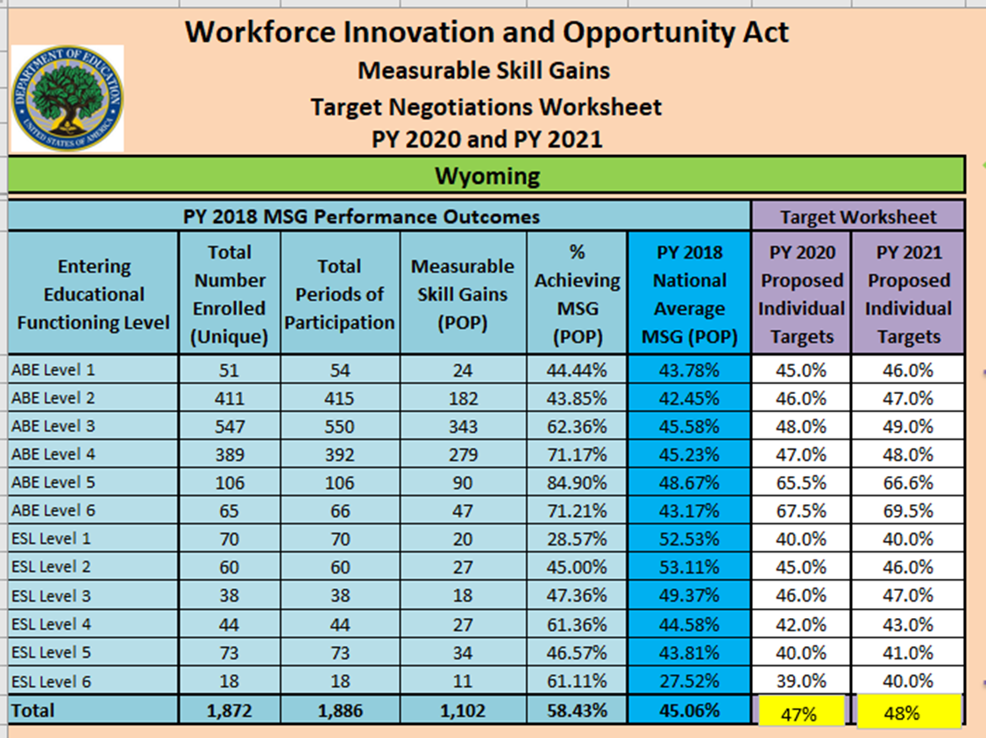
WY Performance Targets by EFL (FY 20/21 & 21/22)
Notes:
Targets for Table 4: Measurable skill gain

Slide 21
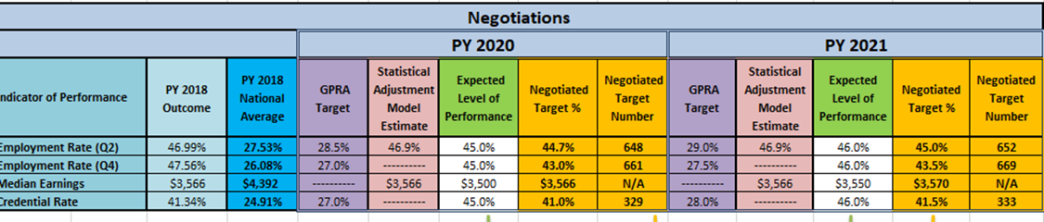
Performance Targets
PY 20/21 AND 21/22 Table 5 Performance Targets (Targets are in Gold)
Notes:
In addition to the EFL targets are the targets for the outcome measures for employment and credential attainment rates.

Slide 22


Performance & Sanctions
State Failure to Meet Targets within 90%
Failure to Report
OCTAE Program Memorandum 20-2
Notes:
There are two types of failure that can lead to sanctions: failure to report and failure to
meet adjusted levels of performance.
In the event of failure to report timely or completely or if all core partners in the State fail to meet adjusted levels of performance, the Governor’s discretionary funds provided under section 128(a) of WIOA will
be reduced by five percent of the maximum available allotment in the immediately succeeding program year.

Slide 23
Exclusions to Performance
Medical of More
Than 90 days
Incarceration
Deceased
Armed Forces Duty
OCTA Program Memorandum 17-2
Notes:
There are instances in which a participant can be excluded from performance reporting. OCTAE Program Memorandum 17-2 specifically details these instances as:
The participant exits the program because s/he has become incarcerated into a correctional facility or has become a resident of an institution or facility providing 24 hour support such as a hospital or treatment enter during the course of receiving services as a participant.
The participant exits the program because of medical treatment and that treatment is expected to last longer than 90 days and precludes entry into unsubsidized employment or continued participation in the program.
The participant is deceased.
The participant exits the program because the participant is a member of the National Guard or other reserve military unit of the armed forces and is called to active duty for at least 90 days.
In the event that one of your student’s meet the aforementioned exclusion criteria, it is critical that this information be relayed to the local director.

Slide 24

Wyoming College
Adult Education
Leave of Absence Form
Name of Student: Site: ___________________________
This leave of absence form serves to notify the Adult Education program at Wyoming College that I will be absent from classes from:
until ____________________________________
(Beginning date of absence) (ending date of absence)
The reason for this absence is:
Signed: Date: ___________________
Notes:
Whenever a program knows that a student will be absent for a period of 90 days or more BUT will return to study in the same fiscal year a ‘Leave of Absence Form’ should be completed by the student (and placed in their file). This document serves as ‘evidence’ for the exclusion from performance.
A sample of what this form should look like is presented on this slide.

Slide 25

Outcome Measures for IELCE (Table 9)
Achieved Citizenship Skills/Voted or Registered to Vote
Increased Involvement in Community Activities
Can be tracked for any student who indicates having this as a goal BUT
Is required to be tracked for IELCE students
Can be tracked for any student who indicates having this as a goal BUT
Is required to be tracked for IELCE students
Must have ‘Evidence’ of achieving citizenship/Voting/Registered to Vote.

Slide 26

Statistical Adjustment Model
Adjusts targets for:
Fluctuations in State economic conditions
Changing characteristics of program participants (as identified through the colletion of data for Barriers to Employment)
Notes:
The Statistical Adjustment Model is a model applied to levels of performance as required by WIOA Section 116. It was first used to calculate performance targets for FY 20/21 & FY 21/22 and will continued to be used in each subsequent negotiation with OCTAE.
Was/is used for Table 4 (all EFL levels) and Table 5 (2nd quarter after exit AND median earnings.
Next negotiation will also include 4th quarter after exit and credential rate.
It is used to adjust levels of performance to account for:
Economic conditions
Characteristics of program participants

Slide 27

Why Use the Statistical Adjustment Model?
Allows for an accurate assessment of a state’s performance
  -States are given credit for harder-to-serve populations and/or those facing challenging economic conditions
Can compare performance over time within a state
Will allow for increases/decreases in performance targets over time
Notes:
The NRS has provided States with reasons/justifications for the use of the Statistical Adjustment model in negotiating performance level targets as outlined on this slide. In times of economic distress the model can lower the negotiated targets so that States may have an easier time in meeting targets and may not face sanctions.
It is because of this model that the collection of data for Barriers to Employment is so critical to adult education programs.

Slide 28




Low income (Economic Disadvantaged)
Migrant & seasonal farmworker
Displaced homemaker
Exiting TANF within 2 years
Homeless or runaway youth
English language learner
Long term unemployed
Foster care youth
Cultural Barriers
Low Literacy
Disabled
Ex-offender
Single parent
Notes:
Barriers to Employment Defined:
Cultural: an individual who perceives him or herself as possessing attitudes, beliefs, customs or practices that influence a way of thinking, acting or working that may serve as a hindrance to employment.
Disabled: a person who has any "disability” as defined in the Americans with Disabilities Act. A "disability" is a physical or mental impairment that substantially limits one or more of the person's major life activities.
Displaced homemaker: a person who has been providing unpaid services to family members in the home and who: has been dependent on the income of another family member but is no longer supported by that income; or is the dependent spouse of a member of the Armed Forces on active duty and whose family income is significantly reduced because of a deployment, or a call or order to active duty, a permanent change of station, or the service-connected death or disability of the member; and is unemployed or underemployed and is experiencing difficulty in obtaining or upgrading employment.
English language learner: a person who has limited ability in speaking, reading, writing or understanding the English language and also meets at least one of the following two conditions (a) his or her native language is a language other than English, or (b) he or she lives in a family or community environment where a language other than English is the dominant language.
Exiting TANF within 2 years: if the participant, at program entry, is within 2 years of exhausting lifetime eligibility regardless of whether receiving these benefits at program entry.
Ex-offender: a person who either (a) has been subject to any stage of the criminal justice process for committing a status offense or delinquent act, or (b) requires assistance in overcoming barriers to employment resulting from a record of arrest or conviction.
Homeless/Runaway Youth: a person without a fixed, regular, and adequate nighttime residence; or runaway youth
Long term unemployed: if, at program entry, he/she has been unemployed for 27 or more consecutive weeks
Low income/Economic disadvantaged: an individual who: (a) In the 6 months prior to application to the program has received: (i) Assistance through the supplemental nutrition assistance program (SNAP); (ii) Assistance through the temporary assistance for needy families (TANF) program; (iii) Assistance of supplemental security income program (SSI); or (iv) State or local income-based public assistance. (b) total family income does not exceed 70% of the lower living standard income level; (c) Is a youth who receives a free or reduced price lunch; (d) Is a foster child on behalf of whom State or local government payments are made; (e) Is a participant with a disability whose own income is the poverty line but who is a member of a family whose income does not meet this requirement; (f) Is a homeless participant or a homeless child or youth or runaway youth; or (g) Is a youth living in a high-poverty area
Migrant & Seasonal farmworker: 1. A low-income individual who: for 12 consecutive months out of 24 months prior to program entry, has been primarily employed in agriculture or fish farming labor that is characterized by chronic unemployment or underemployment; and faces multiple barriers to economic self-sufficiency. 2. A seasonal farmworker and whose agricultural labor requires travel to a job site such that the farmworker is unable to return to a permanent place of residence within the same day. 3. A dependent of the individual described as a seasonal or migrant seasonal farmworker above.
Single parent: if single, separated, divorced or a widowed individual who has primary responsibility for one or more dependent children under age 18 (including single pregnant women).
Foster care youth: a person who is currently in foster care or has aged out of the foster care system
Low literacy: ALL Adult Education Students must have this marked upon intake.
If the participant is, at program entry: A) a youth, who has English reading, writing, or computing skills at or below the 8th grade level on a generally accepted standardized test; or B) a youth or adult, who is unable to compute and solve problems, or read, write, or speak English at a level necessary to function on the job, in the participant’s family, or in society.

Slide 29
NRS: Why Collect Data on Barriers to Employment?
Uncover obstacles that can impede students’ full participation or edibility
Gain an increased understanding of the needs of student subgroups through analyses
Demonstrate that local programs are serving students with multiple challenges (used on the Statistical Adjustment Model)

Slide 30

What Does The Collection of Data for Barriers to Employment Mean for Local Providers?
Collecting accurate data for ‘Barriers To Employment’ is CRITICAL to OCTAE negotiations with the State for performance targets.

Slide 31
Data Collection
Demographics
EFL’s/MSG
Employment
Credentials
Collected
at intake
HSEC, Postsecondary, training, IET, etc. collected through data match/survey
Measured
By testing
Data match & Survey
Reported on
Tables 1, 2,
2A, 3
T5, 5A, 8-11
T5, 8-11
Tables 4, 4A, 4B, 4c, 8-11
Notes:
Data collection is a requirement of the Workforce Innovations and Opportunities Act. Publically funded programs and agencies have greater accountability in this law and the law requires programs to demonstrate their impact.
Data is collected on student demographics and the progress made towards advancing their educational levels, employment, and enrollments in postsecondary/training. These are recorded in a Management Information System (MIS). The vendor we use in Wyoming is LiteracyPro Systems and the software is LACES.
Once the data is collected on the intake form and entered by each local ABE program provider, the data is aggregated at the state level for reporting to the US Department of Education – Office of Career, Technical, and Adult Education (OCTAE). State data is entered into the National Reporting System (NRS) online database. OCTAE creates a NRS report that is then given to the U.S. Congress. It has both state profiles and aggregated data tables for the national Adult Education program.
It all begins with our AE students entering the AE program to enroll in classes. The quality of the data is initially up to the front line staff that walks the student through the orientation, enrollment, and assessment process. Instructors accurately determining the appropriate post testing times, timely input of scores, recording attendance, and managing the student files to reflect current information on students is a cornerstone to this accountability process. Error checking and updating should happen on a continual basis.

Slide 32

Data Matching: Post Exit indicators
Employment
quarterly
SSN’s
State
WCCC
Postsecondary / Training
NSC
Notes:
The collection of accurate data is critical to not only the success of the local program, but also for the State. Because of this there are multiple ways in which data is collected throughout the year on the post-exit indicators.
The State data matches employment records for students who have exited Adult Education programs in Wyoming for the 2nd & 4th quarter after exit. These data matches are typically conducted on a quarterly basis and one comprehensive sweep at the end of the fiscal year on all students who provide a social security number.
In addition, the State data matches for credential attainment and enrollments in postsecondary at least two times per year. (December and June). The State does NOT match for high school equivalency as this is a local requirement. The State conducts these data matches through the National Student Clearinghouse (credentials earned anywhere in the USA) and through the Commission’s own database. Once this data is collected it is entered into LACES.

Slide 33
Data Matching
Postsecondary / Training:
quarterly
Surveying & Special Populations
NSC & Local College
Local Program
DiplomaSender
HSEC
HiSET/GED website
Notes:
Local programs have the responsibility of collecting data for enrollments/completions in postsecondary/training and for the high school equivalency exam.
Because this information is critical for reporting purposes, local providers are required to conduct data matches at least three times per year through both the National Student Clearinghouse and through the local community college. Local providers are required to conduct data matches as follows:
National Student Clearinghouse (NSC):
-October of each year to capture fall enrollments
-February of each year to capture spring enrollments
-June of each year to capture summer and/or any late student registrations which have not been picked up by previous data matches.
Because non-credit training/ workforce courses are not tracked through the NSC or through the State’s database system, local programs are required to data match eligible student records at the local community college at least three times per year following the timeline outlined above.
These data matches (as well as surveying-discussed below and on subsequent slides) are required to be completed on students for two consecutive years. Table 4 will capture data on postsecondary/training enrollments for students in the current fiscal year, while Table 5 captures this data on students enrolled in the previous fiscal year.
In cases where the local program did not collect a SSN on student(s), the local program is required to utilize a survey instrument to collect data on the post-exit indicators . This data must be collected utilizing the state approved survey and contact log, found in the Appendix to policy #08112020R. Surveys are also required on individuals who are self-employed, farmers, ranchers, railroad employees, and federal & military employees as these types of occupations do not report earnings through the State UI system and are not able to be data matched.
Surveys must be conducted with the appropriate data entered into the LACES databased following the schedule outlined by the NRS found on page two of the aforementioned policy. Local programs are also required to maintain a Survey Notebook which includes all data collected through a surveying instrument.
Local providers are required to utilize the DiplomaSender database or the HiSET/GED website to obtain copies of student HSE credentials and of student transcripts. When possible, both of these documents need to be uploaded into the student file on LACES with the appropriate information entered into LACES to reflect HSE credential attainment when earned.
Note: Students who do not provide a SSN at intake will be required to submit this information to register to take a high school equivalency exam. Local programs should record this information upon receipt immediately into the student’s LACES record.
Hard copies of all credentials earned MUST be maintained in the local student file.

Slide 34
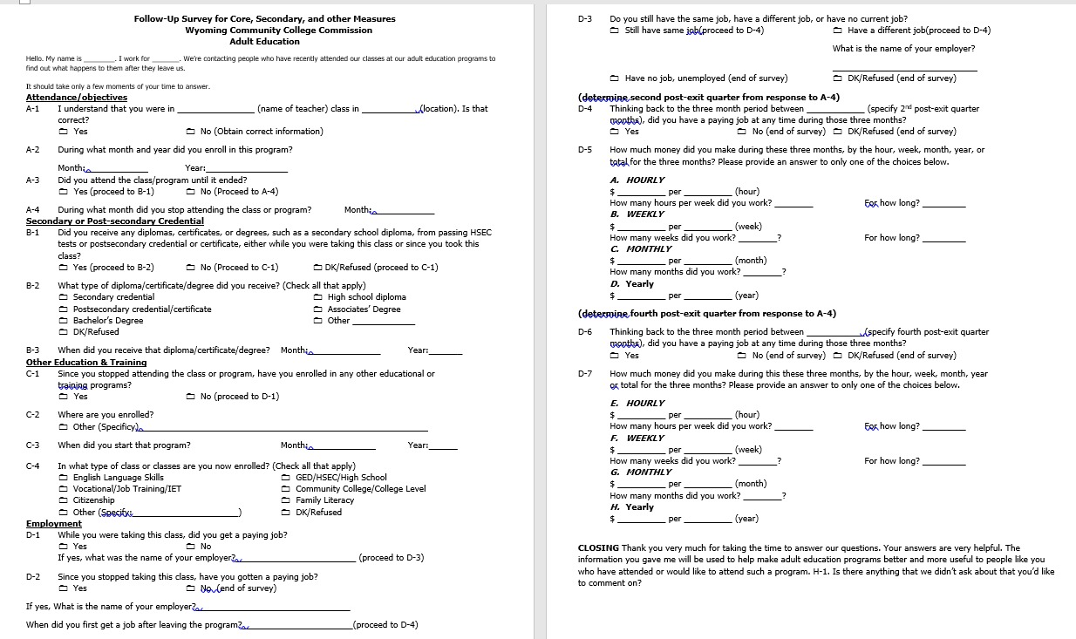
The Survey Instrument
Notes:
The survey instrument is a tool provided by the state to collect data on post-exit indicators.
Conducting a survey is labor intensive. Besides administering the survey, participants must
be located, the survey needs to be explained to them, and their cooperation must be obtained. This
work requires frequent calls to participants and careful recordkeeping. Programs should have sufficient staff and time to conduct the survey.
Like any other data collection effort, staff must follow a uniform set of procedures to collect
data in a valid and reliable manner. Staff conducting the survey must be trained in its administration,
including what to say to participants to introduce the survey and obtain their cooperation, ways to
avoid refusals, how to ask the survey questions, how to record responses, and how to answer
participant questions about the survey. Staff should be thoroughly familiar with all questions and
procedures before beginning.
The validity of a survey depends in part on the response rate—the proportion of people who
respond to the survey out of the total number targeted for the survey. Getting a good response rate is
probably the most difficult part of conducting a survey, and it may be especially hard for adult
education participants because many are transient and may not have telephones or are otherwise
difficult to locate.
To help improve the response rate, it is important that participants know they may be contacted later and asked about their outcomes. Programs should inform participants at program entry about the survey and collect extensive contact information about them, such as addresses and phone numbers of relatives or others who may know the participants’ whereabouts over time. In addition, participants should be encouraged to provide new addresses and phone numbers when they move, and programs should implement procedures to update this information periodically while participants remain enrolled. These procedures can greatly assist in locating participants months later when the survey is conducted.

Slide 35
Surveying for Wages
Notes:
Many students are hesitant or do not want to reveal information about their wages. Whenever you conduct a survey and the student does not reveal his/her salary, programs may enter $1 into the student’s LACES record. By doing this the program is then given credit for meeting the outcome measure of median employment.
The chart shown on the slide is a wage conversion chart which provides local directors on how to convert wages from one unit type to another; although this is done automatically through LACES.

Slide 36

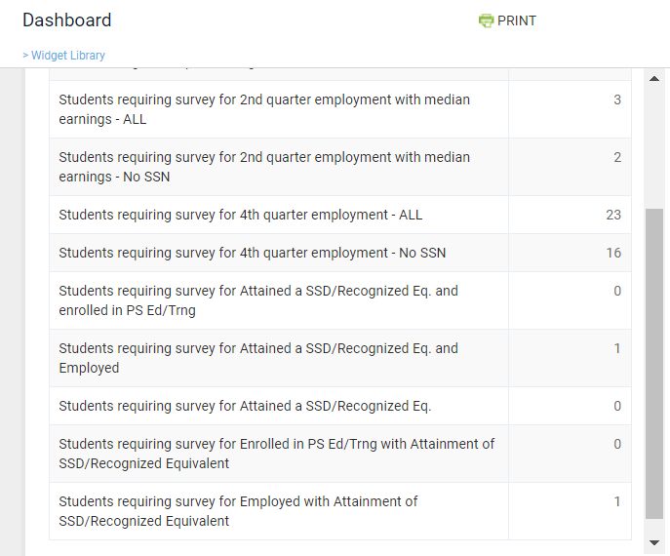
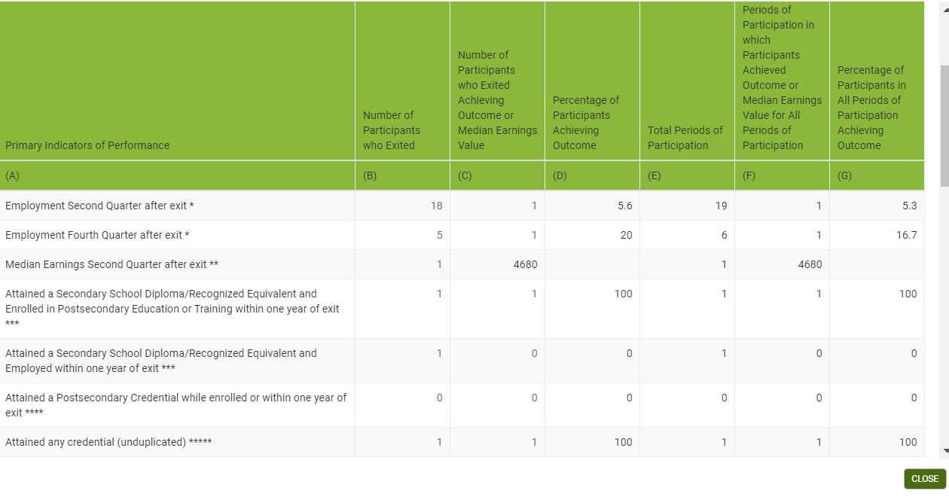
Identifying ‘Who’ Needs to be Surveyed
Notes:
The LACES dashboard will tell you who you need to be doing Survey’s on for the current fiscal year, but information obtained through Table 5 will contain a list of all students who need to have post-exit indicator data collected on. (i.e. on student’s who were exited in the previous fiscal year.)
Programs are to use both the dashboard and Table 5 to make sure all student outcomes are addressed.

Slide 37
Regular data review
Immediate error corrections
Accuracy in entering data
Data Validity
Notes:
An essential feature of the data collection process must be regular and frequent review of data entered into the data system. The data system has pre-programmed error reports that allow for a review of inconsistent, out-of-range, and missing data. Data entry and clerical staff should regularly review these reports and should return them to teachers, intake workers, and clerical staff to clarify problems and obtain the missing data. Corrections should then be sent to data entry staff so they can enter them into the database.
WIOA legislation requires that each State have policies in place to ensure that data contained in reports is valid and reliable. This is fully explained in WY Policy #08142020. Wyoming utilizes a multi-level approach to data validation as shown on the next slide.

Slide 38
Wyoming’s Multi-Leveled Approach to Data Validation
Monthly Desk Monitoring
LACES Data
Fiscal Data
Program Improvement Goals
Measurable
LACES Training
Monthly Updates
Face-to-face and quarterly webinars
Data Dashboards
LACES
WCCC
Site Visits
Comprehensive review
Quarterly Reports
Data
State Data Reviews
Monthly
EOY Reports
Performance data analysis
Successes/challenges
Evaluations & monitoring
Professional development
Use of standards
ECR
Other
Success/challenges
Other
Notes:
Monthly Desk Monitoring - provides an approach for reviewing and tracking program performance by using quantitative data that serves as a supplement to on-site monitoring. Local programs provide data regularly (e.g., monthly) to the state office where state staff can review them t o guide program review activities, inform technical assistance plans, and promote program improvement. Desk monitoring relies primarily on data that programs already collect and report. There are three components to the “Desk Monitoring” instrument: 1) Data from LACES – includes enrollment numbers, MSG, post-test rate, and progress toward meeting the negotiated performance goals. Diagnostic checks are also reported. 2) Financial draws – this includes the amount of the grant, the monthly draws and balances, and t he cost per student. 3) Comments – Directors explain events that may be influencing their data and requests for technical assistance. This monthly report provides local program staff an opportunity to regularly review data and validate demographic information, regularly review their program data (including assessments, attendance, and high school dropout paperwork), and progress toward continuous improvement goals or performance and allows tracking for both local and state staff.
Program Improvement Goals – Local Programs are required to write goals with measurable objectives for program improvement. These goals are to be based on program data which is both qualitative and/or quantitative and an analysis of the cause and effect of strategies implemented within the program. There is a semi-annual report to the state on their progress. Goal(s) may be amended or changed if, by no fault of the program, the goal cannot be met.
LACES Training – Each year the AE program contracts for professional development training from LACES staff. There are three online webinars and one face-to-face training. The training includes beginner and advanced training and covers data input, tables and updates to NRS Tales, error checks and corrections, and data analyses. Written transcripts of the webinars are sent to participants and posted to the WCCC website for future reference. Annually there is a program by program review with special attention paid to local program error patterns, corrections of those errors, and direct and specific remediation for that site.
Data Dashboards – There are two data dashboards: 1) There is a data dashboard in the LACES system. The state and local programs use it to help programs track their performance. The information is also a part of the Comparison of data for the required “Monthly report” which is a review for fiscal and NRS data. 2) Data from the NRS and from High School Equivalency testing results are combined in the Data Hub on the Wyoming Community College Commission (WCCC) website. Data from LACES is entered into tableau software and are used to create tables. These tables are used in the annual “Adult Education Profile” report 3 | P a g e which is distributed to the Workforce Development Council, State Legislature, Wyoming Community College Commissioners, college presidents, and other stakeholders. It is also stored in the State Archives.
Onsite/virtual monitoring visits - Program Monitoring visits review performance data in order to evaluate the effectiveness of programs and to identify areas with potential for improvement. The Protocol is sent in advance of the visit. A virtual notebook is developed by the local director with supporting documentation for each of the sixteen (16) sections to be reviewed. Some sections require comparing original source documents such as Student Intake forms and attendance rosters to the electronic files in LACES. The State conducts a random sample review of five student files and reviews local file information to data found on LACES on multiple topics. Technical assistance is given during the visit or planned for a specific date if more training is required than time allows during the visit. A letter of compliance is sent within 30 days. Any recommendations or findings are addressed in the letter. The program has 30 days to return their steps for corrections of any findings for approval.
Quarterly Reports: Each program submits a quarterly report that provides an opportunity to review programmatic data, successes/challenges, and other state identified topics.
State data reviews: Each month, the State conducts a comprehensive review of: 1) Assessments: where validation checks certify that: a) local programs are using NRS approved assessments b) State assessment policy is being followed 2) Credentials earned: where validation verifies that evidence of the credential is placed into student online LACES files 3) Postsecondary enrollments: where evidence is provided in the student file of enrollments 4) Employment data: is being tracked in accordance with federal mandates 5) Performance data: where validation measures to-date progress of local performance 6) Entry/exit data is being tracked in accordance with federal mandates and that reason for exiting the program is provided for all exited students.
Year end reports- At the end of each fiscal year local providers submit a comprehensive narrative report which reviews various aspects of their program. This may include, but is not exclusively limited to: 1) performance data analysis: providers succinctly describe how program performance was measured against federal negotiated targets for measurable skill gain and outcome measures as well as towards meeting the State requirement of post testing 60% of all eligible participants. 4 | P a g e 2) successes/challenges: providers are given the opportunity to briefly discuss successes/challenges to local programming throughout the year 3) program evaluation and monitoring: providers describe the tools used to evaluate and monitor the local Adult Education program and how evaluation results are used to improve program performance. 4) professional development: providers describe activities/training AE staff participated in to create and support higher accountability and teacher quality. This includes targeted professional development, program goal setting, and LACES data collection trainings. 5) College & Career Readiness Standards: providers discuss how these standards are used in the local program. 6) Essential Components of Reading: providers explain how the Essential Components of Reading are embedded into instructional methodologies and used in the local AE classroom. 7) Other topics, as identified by the State

Slide 39

Data
Dictionary
WY Data Dictionary
Notes:
A data dictionary of terms commonly used by Wyoming’s Adult Education programs is available on the Commission’s website.

Slide 40

State Educational Agency (SEA)
13 Consid-erations
T.A.
Monitoring
Financial
P.D.
Notes:
The Wyoming Community College Commission is the SEA responsible for overseeing all AEFLA funded grants in Wyoming.
This includes, but is not strictly limited to, all 13 of the considerations, fiscal aspects of the grant, the provision of technical assistance (TA), state led professional development (PD) opportunities, and monitoring for compliance.

Slide 41
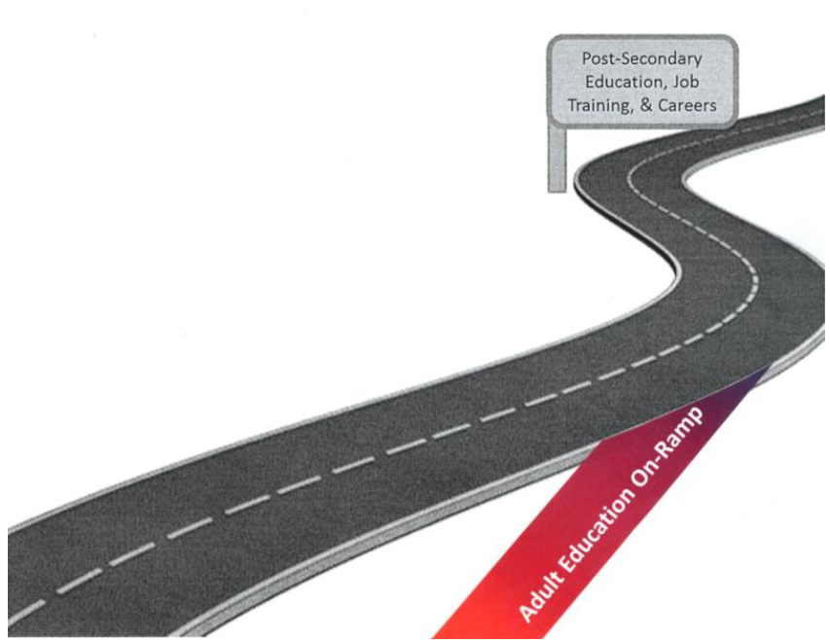
The On-Ramp
Career Pathways
Notes:
Under WIOA, adult education functions as an on-ramp to entry into and success in post-secondary education, job training, and careers. The AE on-ramp has a career pathways focus so that individuals are well prepared to meet the ever changing global, national, state, and regional economic needs.
From high school to higher education reform, people are talking about career pathways. An unprecedented unified letter from 13 federal agencies, the White House National Economic Council and the Office of Management and Budget identifies the problem career pathways are meant to tackle: “Too often, our systems for preparing low-skilled youth and adults with marketable and in-demand skills can be complex and difficult to navigate for students, job seekers, and employers. Career pathways can offer an efficient and customer-centered approach to training and education by connecting the necessary adult basic education, occupational training, postsecondary education, career and academic advising, and supportive services for students to prepare for, obtain, and progress in a career.”
Maria Cancia of US Department of Human Services, Administration for Children and Families recently made both the business case (scarce resources, incredible need) and the human case (people don’t live in ‘programs’ or ‘funding streams’) to call for career pathways to improve the efficiency and effectiveness of our safety net systems which promote self-sufficiency.
The self-sufficiency bar has been raised by global economic forces, and initiatives to improve the educational, economic, and social mobility of individuals in poverty take coordinated, cross-system efforts. Career pathway interventions require an investment in education and training. Educationally focused interventions studied in Washington State’s Tipping Point research clearly tie economic self-sufficiency for low-income low-skill adults to the completion of a postsecondary credential, but persistence and achievement are key considerations for adult workforce development and adult education programming.

Slide 42
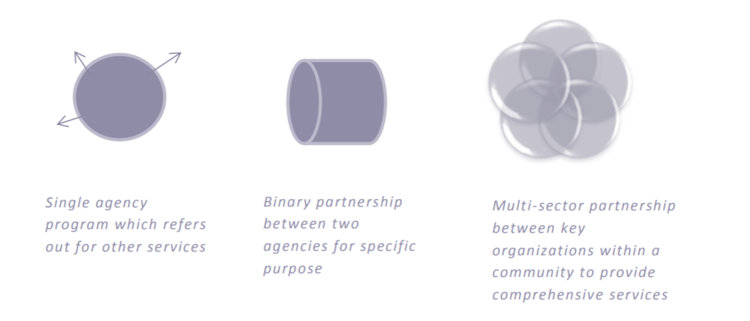
Career Pathways
Notes:
Career pathways, including pathway on-ramp programs, require key community organizations – employers, government agencies, community-based organizations, school systems, postsecondary institutions – in sustained partnership. Practitioners need to be supported to move from a program model, with referral processes or transactional partnerships, to a multisector partnership model in order to achieve the ultimate goal: increased educational and economic mobility for disparately impacted populations.
Adult Education programs cannot develop a CP system in a silo; it takes a lot of coordination between multiple stakeholders for it to be successful. As a new director in Adult Education, you will ‘undoubtedly’ find yourself tasked with:
developing/modifying curricula so that it is contextualized around a career pathway
Creating new partnerships for the development of a CP system
Working with local employers to develop ‘specialized’ programs……and
Most importantly, being innovative to advance the field of Adult Education for your local program

Slide 43

Career Services
Basic Career Services
Individualized Career Services
Follow-up Services
Eligibility determination
Intake, orientation
Initial assessment
Labor exchange services
Referrals
Provision of workforce & labor market information
Education, training, & service performance and cost information
Program performance & accountability requirements / measures
Community service provider information
Information/assistance to file a claim with UI
Eligibility info for training/education program not offered by core partners
Specialized assessments
Employment plans
Counseling
Career planning
Pre-vocational services (soft skill training)
Internships/work experiences
Workforce pre activities
Financial literacy
Job search assistance
ESL & IET
1. Employment follow and services for up to 12 months
Notes:
Helping AE students navigate the Career Pathways on-ramp begins in Wyoming’s Career Services Course. WIOA legislation clearly defines three types of career services that the core partners can offer: Basic Career Services, Individualized Career Services, and Follow-up services
Basic career services must be made available and, at a minimum, must include the following services, as consistent with allowable program activities and Federal cost principles:
(1) Determinations of whether the individual is eligible to receive assistance from the adult, dislocated worker, or youth programs;
(2) Outreach, intake (including worker profiling), and orientation to information and other services available through the one-stop delivery system. For the TANF program, States must provide individuals with the opportunity to initiate an application for TANF assistance and non-assistance benefits and services, which could be implemented through the provision of paper application forms or links to the application Web site;
(3) Initial assessment of skill levels including literacy, numeracy, and English language proficiency, as well as aptitudes, abilities (including skills gaps), and supportive services needs;
(4) Labor exchange services, including -
(i) Job search and placement assistance, and, when needed by an individual, career counseling, including
a)Provision of information on in-demand industry sectors and occupations (as defined in sec. 3(23) of WIOA); and
b)Provision of information on nontraditional employment; and
(ii) Appropriate recruitment and other business services on behalf of employers, including information
and referrals to specialized business services other than those traditionally offered through the one-
stop delivery system;
(5) Provision of referrals to and coordination of activities with other programs and services, including programs and services within the one-stop delivery system and, when appropriate, other workforce development programs;
(6) Provision of workforce and labor market employment statistics information, including the provision of accurate information relating to local, regional, and national labor market areas, including -
(i) Job vacancy listings in labor market areas;
(ii) Information on job skills necessary to obtain the vacant jobs listed; and
(iii) Information relating to local occupations in demand and the earnings, skill requirements, and opportunities for advancement for those jobs;
(7) Provision of performance information and program cost information on eligible providers of education, training, and workforce services by program and type of providers;
(8) Provision of information, in usable and understandable formats and languages, about how the local area is performing on local performance accountability measures, as well as any additional performance information relating to the area's one-stop delivery system;
(9) Provision of information, in usable and understandable formats and languages, relating to the availability of supportive services or assistance, and appropriate referrals to those services and assistance, including: Child care; child support; medical or child health assistance available through the State's Medicaid program and Children's Health Insurance Program; benefits under SNAP; assistance through the earned income tax credit; and assistance under a State program for TANF, and other supportive services and transportation provided through that program;
(10) Provision of information and meaningful assistance to individuals seeking assistance in filing a claim for unemployment compensation.
(i) “Meaningful assistance” means:
a)Providing assistance on-site using staff who are well-trained in unemployment compensation claims filing and the rights and responsibilities of claimants; or
b) Providing assistance by phone or via other technology, as long as the assistance is provided by trained and available staff and within a reasonable time.
(ii) The costs associated in providing this assistance may be paid for by the State's unemployment insurance program, or the WIOA adult or dislocated worker programs, or some combination thereof.
(11) Assistance in establishing eligibility for programs of financial aid assistance for training and education programs not provided under WIOA.
Individualized career services must be made available if determined to be appropriate in order for an individual to obtain or retain employment. These services include the following services, as consistent with program requirements and Federal cost principles:
(1) Comprehensive and specialized assessments of the skill levels and service needs of adults and dislocated
workers, which may include:
(i) Diagnostic testing and use of other assessment tools; and
(ii) In-depth interviewing and evaluation to identify employment barriers and appropriate employment goals
(2) Development of an individual employment plan, to identify the employment goals, appropriate achievement objectives, and appropriate combination of services for the participant to achieve his or her employment goals, including the list of, and information about, the eligible training providers
Group and individual counseling;
Career planning;
(5)Short-term pre-vocational services including development of learning skills, communication skills, interviewing skills, punctuality, personal maintenance skills, and professional conduct services to prepare individuals for unsubsidized employment or training;
(6) Internships and work experiences that are linked to careers (as described in § 680.170 of this chapter);
(7) Workforce preparation activities;
(8) Financial literacy services as described in sec. 129(b)(2)(D) of WIOA and § 681.500 of this chapter;
(9) Out-of-area job search assistance and relocation assistance; and
(10) English language acquisition and integrated education and training programs.
Follow-up services must be provided, as appropriate, including: Counseling regarding the workplace, for participants in adult or dislocated worker workforce investment activities who are placed in unsubsidized employment, for up to 12 months after the first day of employment.

Slide 44

Wyoming’s AE Career Services vs. Training Services
Career Services
Training Services
Combines aspects of basic & individualized
Collaboration between core partners for the delivery of services
Implementation of ‘best practices’ based upon evidence based research methodologies (eg. Brain based learning, participatory learning)
Services paid for using AEFLA funds (e.g. tuition for IET’s, IELCE)
Notes:
The components of Wyoming’s AE career service course were covered in Part One of this training, but this slide provides an overview of the approaches taken by local service providers to meet the WIOA mandate for Career Services and Training Services.
Career Services in AE programs in Wyoming combines various elements of basic and individualized career services as outlined in the previous slide. The delivery of career services quite often is a collaboration between core partners and other community service providers. Adult Education’s delivery of career services is based upon best practices and evidence-based research methodologies, such as brain based learning, mindset, and participatory learning. These methodologies were taught to all AE programs in Wyoming several years ago in what was known as the Align & Redesign project, which was a multi-year initiative to realign and develop a front end course, now named ‘Career Services.’
Training services are defined as any training service that AEFLA funds were used to pay for. This could be for an IET, an IELCE, or something else. Presently, WY program do not offer training services simply because funding is severely limited and there isn’t enough funds available to set aside funds for such things as tuition on an IET.

Slide 45

State Policies
AE Policies
Notes:
All Wyoming Adult Education Policies are available on the Commission’s website at the link shown on the slide.

Slide 46
Professional Development
National/Regional
State
Local
Notes:
Wyoming’s Adult Education programs utilize a three tiered approach to professional development. Local programs are to include professional development on a regular basis that incorporates such topics as TABE and other assessment trainings, new staff training and program orientation, data collection protocols and reporting procedures, dissemination of best practices, and any other local program items.
Note: All new instructors are required to complete the online TABE 11/12 certification program available through the test manufacturers website BEFORE they begin utilizing the assessment with participants. Copies of these earned certificates must be retained by the local program with a copy being sent to the State.
State level trainings include the State Institute, in which attendance by 80% of all local programs is mandated; LACES training for all users, and any other State arranged trainings. Local programs must built into their budget, the costs associated with these trainings whenever State leadership funds are not available/designated.
National/Regional: local programs are allowed to utilize any national level trainings, inclusive of in-person attendance at national or regional conferences, online work through training websites such as LINCS, or through national webinar presentations. The costs associated with these trainings must be built into the local program’s budget.
Local programs are required to have a system in place to identify instructor PD needs as well as efforts to meet these identified needs on a fiscal year basis.

Slide 47
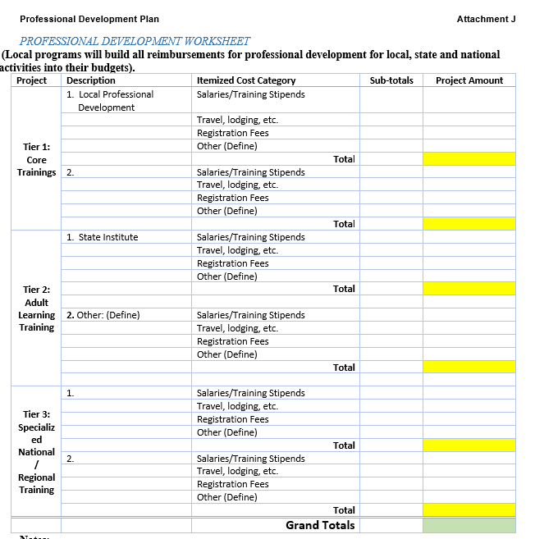
Planning Template for PD
Notes:
Each year the local program must submit a planning template as shown on this slide as part of the budgetary requirement for planning for professional development.

Slide 48
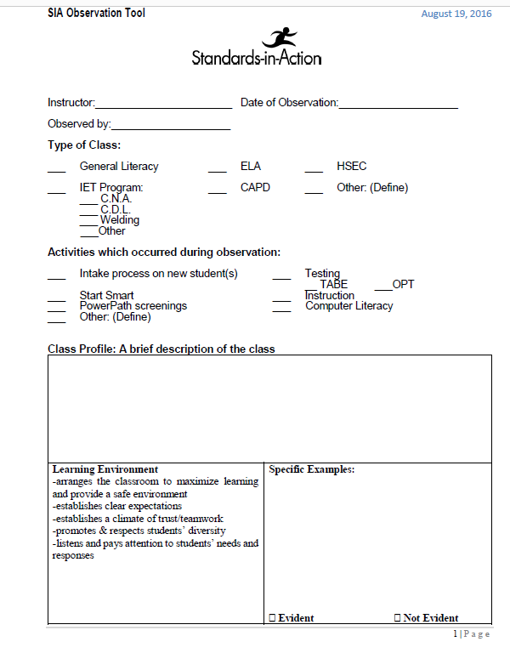
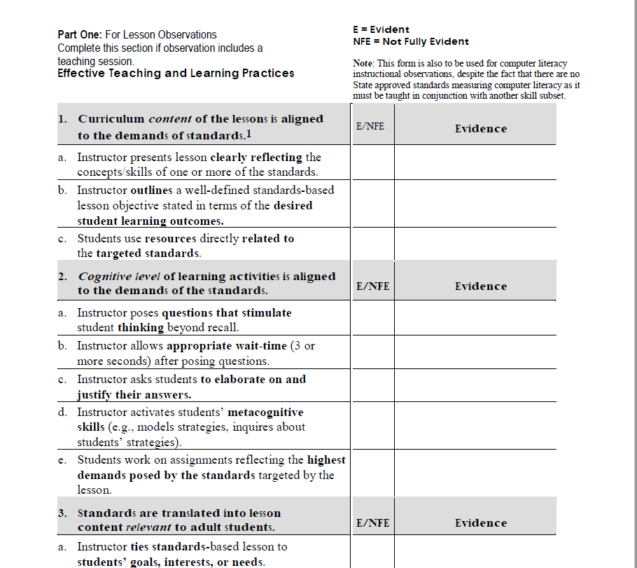
Standards in Action: Teacher Evaluations
Standards are available here.
SIA Checklist is available here.
Notes:
The State of Wyoming has adopted the College and Career Readiness standards and the English Language standards for Adult Education. (Note: These are available on the Commissions website). Because the use of standards in Wyoming’s AE classrooms is so important, local directors are required to utilize the State approved Standards in Action checklist as part of an annual review process on all instructors. This multi-paged document is available on the Commission’s website as well. Copies of completed reviews must be maintained locally in each instructors file and will be subject to State review during site visit virtual monitorings.

Slide 49
Stephen Covey
“Accountability breeds response-ability.”

