Slide 1

New Director Training
Virtual Format

Slide 2

MODULE SIX
For
Compliance to
WIOA
The Classroom

Slide 3

Wyoming’s Adult Education Courses
Notes:
Each AE center in Wyoming is unique and different. Program grant applications specify the plans that a program has and outlines the types of courses and programs that they will offer.

Slide 4
Career Services
CTE Concurrent Enrollments
Workforce Preparation
Corrections
English Language Acquisition
General AE
HSEC
IET
IELCE
Transitions to College
Work Experience
Workplace Literacy
Required at all sites for all students
Bridge Programs
At least 1 must be offered at all sites
Only 1 provider in Wyoming
Offered at all sites in Wyoming
Offered at all sites in Wyoming
Offered in partnership with DWS
Only offered at sites that applied for this
Limited availability in the State
Available at all sites
Similar to Transitions to College
Similar to Bridge Programs
Funding often supported institutionally or through partnerships
Notes:
In order to meet the goals outlined in the Unified State plan and other statewide initiatives, the field of Adult Education began to diversify shortly after the passage of WIOA. Today, Adult Education programs in Wyoming offer a wide variety of course types which include:
Career Services: All Wyoming Adult Education Centers have a Career Services course, but the content may differ depending upon how the program is structured. The primary purpose of this course is not only to provide an orientation to the program, but also an introduction to participatory learning, brain based learning theory, career explorations, and various other components. In most instances, the course is delivered face-to-face, but virtual aspects are now being integrated.
Workplace Literacy: These classes are taught by a local AE center in collaboration with an employer, an employee organization, or a Next Generation Sector Partner at a workplace or an off-site location that is designed to improve the productivity of the workforce.
Workforce Preparation: Local Adult Education centers provide literacy instruction designed to help individuals acquire a combination of basic academic skills and employability skills such as critical thinking skills, digital literacy skills, and self-management skills. These activities include competencies in utilizing resources, using information, working with others, understanding systems, and obtaining skills necessary for successful transition into and completion of postsecondary education or training, or employment. Workforce preparation skills are integrated in the adult basic education and literacy curriculum, therefore, occurring concurrently with adult basic and literacy skills instruction. Teachers integrate technology into lesson plans and all students have access to and use of computers and technology to enhance their learning and digital literacy skills.
Integrated Education and Training (IET): The IET class provides adult education and literacy activities concurrently and contextually with workforce preparation activities and workforce training for a specific occupation or occupational cluster for the purpose of educational and career advancement.
Integrated English Literacy & Civics Education (IELCE): The IELCE is a program of study for English language learners that provides educational opportunities to achieve competency in the English language and acquire the basic and more advanced skills needed to function effectively as parents, workers, and citizens of the United States. Instruction in the IELCE incorporates English as a Second Language (ESL), instruction on the rights and responsibilities of citizenship and civics participation and may also include organized workforce training.
Laramie County Community College’s ACES program is the sole provider of IELCE for the State of Wyoming.
Bridge Programs: Bridge programs are designed to ease the transition to college and support postsecondary success by providing students with the academic skills and social resources needed to succeed in a college environment. Although the content of the course may vary at each center, the objectives are the same.
Transitions to College: Qualified participants may enroll in this course concurrently while enrolled in other Adult Education courses. The course is designed as a general orientation and transition to college program whereby participants begin to explore and understand the college environment, learn to identify and utilize campus & community resources to enhance the academic experience.
General Adult Education: These courses equip students with the skills needed to strengthen reading, writing, mathematics, and digital literacy abilities so that they are prepared to enter postsecondary education and/or the workforce.
High School Equivalency Certificate Preparation (HSEC): In 2014 the State of Wyoming began to provide multiple pathways for individuals needing to earn a high school equivalency certificate. Today, students may choose to study for and take one of two HSEC exams: the 2014 G.E.D.®, or the HiSET. Targeted instruction includes:
Reading and Writing
Social Studies
Science & Mathematics
English Language Acquisition (ELA/ESL: These courses are designed to help eligible individuals who are English language learners achieve competence in reading, writing, speaking, comprehension of the English language, mathematics, and EL Civics so that they are prepared to enter postsecondary and/or the workforce in the United States.
Concurrent Enrollments with CTE/Postsecondary Education: Qualified Adult Education students with a defined career plan may also be permitted to enroll concurrently in a Career and Technical Education (CTE) program of study or into a postsecondary program while completing a course of study in Adult Education. Quite often, local adult education programs in conjunction with their host college are able to provide tuition waivers to help ease the cost of concurrent enrollments.
Work Experience/On-the-Job-Training/Internships/Apprenticeship: In conjunction with the Wyoming Department of Workforce Services, qualified participants can be placed into one of these training programs to develop a deeper understanding of the responsibilities and expectations of a specific career though hands-on-learning. Programming includes resume writing, job interview skill development and the appropriate use of other social capital skills as needed for careers
Corrections Education
Standards based instruction for criminal offenders in correctional institutions and other institutionalized individuals which focuses on academic programs in basic education, special education, English literacy, and secondary school completion.

Slide 5
Recruitment
Advertising
Promoting AE
Notes:
There are numerous strategies that local programs can successfully utilize to recruit students. Although word of mouth plays a large role in successful enrollments, this should not be the primary focus of recruitment for any adult education program in Wyoming.

Slide 6








Get the Word Out!
Coordinate with partner programs & community service providers
School districts
Social media campaigns/websites
Public service announcements
Local publications of key events
Strategic disbursement of brochure in the community
Mass mailings
Notes:
Because Wyoming is so sparsely populated, local programs should use a variety of techniques/strategies to let people know of the services provided by a local AE center.
Partner programs and local community service providers can help recruit and place qualified individuals into adult education programs. Local directors should reach out to these partners through phone calls, in-person visits, emails, etc. to talk about how joint program and co-enrollments could occur. Systems should be put into place to help recruit students concurrently.
School districts, particularly the high school counselors, are another asset available to adult education programs. Informed counselors can provide students who are struggling to complete high school with the high school equivalency option available from a local AE center. Counselors who are able to make this type of referral provide the struggling student with options while also presenting the school district with another way to ‘count’ the student as a successful completion. (which is so important for funding purposes!!)
Technology plays a huge role in the success of a student recruitment campaign. Local programs should use Facebook, Twitter, and other social media platforms as well as websites for recruitment purposes, publication of events, and for student successes!
Public service announcements are another valuable advertising tool available to Wyoming’s AE centers. These free public broadcasts are often able to reach individuals in the remote regions of the State.
Another clever way to obtain free advertising of program successes is to invite key stakeholders, local/regional/state officials to graduations/key events and to publicize these type of events through local media outlets, such as local newspapers, radio stations, etc.
Local programs can also create brochures and distribute them at strategic locations throughout the community.
And finally, the old school method of mass mailings of informational fliers is another option.
Regardless of how you ‘get the word out’, have fun, be creative and innovative because these efforts might just help you reach the person who needs help the most!

Slide 7

WCCC Website
Student home page can be accessed here.
Notes:
In FY 20/21, the SEA created a student friendly website for recruitment, registration, and for the provision of general information regarding Adult Education programs in Wyoming. This website affords students an opportunity to ‘jump start’ the registration process into Adult Education before they contact a local center.

Slide 8
Participant Eligibility
Visa eligibility
Fundable vs non fundable
Participant vs. Reportable Individual
Age Waivers
Notes:
1) Wyoming’s Adult Education programs are not allowed to serve students on an F-1 (Student) or a J-1 (Nanny) visa. This information is asked on the intake form.
2) As mentioned in module three there are two kinds of individuals that local programs must report on: a participant and a reportable individual. In basic terms a participant is someone who has 12 or more hours while a reportable individual has less than 12 hours. Both types of individuals are reportable to the NRS through the reporting tables, but a reportable individual is only reported on Table 2A as a nonfundable student. Participants (fundable students) are reported on all other tables.
3) Adult Education programs across the country are allowed to serve students who are

Slide 9

The Eligible Individual
Does not have a secondary school diploma or its recognized equivalent
Not enrolled in school
Basic skills deficient
16 Yrs Old
Is an English Language Learner
Notes:
WIOA clearly defines who is an ‘eligible’ individual that AE programs are allowed to serve. These are defined on the slide as:
Attained 16 years of age or older
Is not enrolled or required to be enrolled in secondary school under state law AND
Who is:
Basic skills deficient
Does not have a secondary school diploma or its recognized equivalent OR
Is an English Language learner

Slide 10
16/17 YR OLD’S
& the HSE
The Demographics Form
School District Withdrawal Form
Pretest Verification Form
Notes:
In Wyoming, 16 & 17 year old students who want to earn a high school equivalency certificate are required to enroll in an Adult Education program and satisfactorily meet program requirements. This means that they are required to complete what is known as the age waiver application process. This process has three forms that must be completed and submitted to the State BEFORE a student can take a high school equivalency form.
The demographics form is completed by both the student and the parent/guardian except for:
Type of Test: This is to be completed by the instructor before the age waiver is submitted to the State.
CBT=computer based test PBT=paper based test Virtual testing=a virtual test
proctored by the test manufacturer
Test Vendor: In Wyoming, students have the option to take a GED or a HiSET test. The appropriate box must be marked by the instructor before the form is submitted. If the student selects the HiSET test, the ETS ID# must be recorded. This ID# is obtained from the HiSET website once an account is created for the student. Student accounts on this website should NOT be created until the student has completed a program of study and is ready to test.
The school district withdrawal form MUST be completed and uploaded into the student’s LACES account BEFORE the commencement of study. This verifies that the student is not enrolled in school and is, consequently, eligible to be served by an AE program.
The final form is the pretest verification form. This form cannot be completed until the student has successfully completed a program of study AND has passed official practice tests at the ‘well prepared’ levels.
Partial or complete age waiver applications are permissible; however, when partial age waivers are submitted, the student should NOT be given log in credentials to the HiSET website until after the last test is to be taken.
Copies of all age waiver application forms must be retained in the student’s local file folder and are subject to State monitoring.

Slide 11
The Student Intake
Enrollments
Career Services

Slide 12
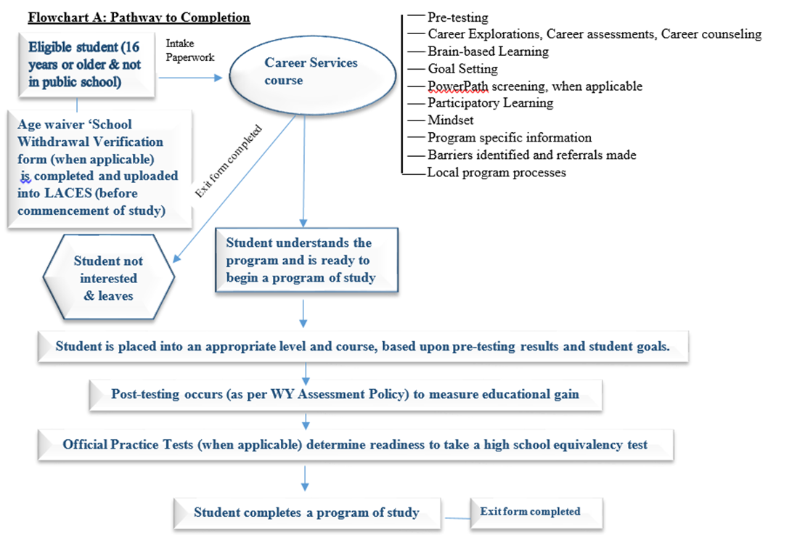
Notes:
The initial process of enrolling a student into an AE program in Wyoming is a multi-faceted processes that encompasses multiple components. Because federal legislation requires that every student, including those who do not fully enter a program of study, be reported, it is vital that instructors, staff, and other stakeholders understand the initial process of recording student information. Flowchart A provides a visual depiction of an intake process.

Slide 13

Postsecondary / Training / Employment
Concurrent enrollments in postsecondary can occur for qualified participants
Adult Secondary Education
(NRS 5 & 6)
Intermediate ABE
(NRS 4)
Beginning/Low ABE
(NRS 2 & 3)
Literacy
(NRS 1)
New Teacher Training Modules are available here.
Notes:
This flow chart demonstrates the Educational Functioning Level (EFL) flow needed to assist students in reaching their personal/academic goals. Both the initial EFL and the student’s goal(s) are established during the Career Service course. The instructor and student must understand this progression or pathway to reach specific goals. Please note that each EFL descriptor is outlined by the National Reporting System (NRS) for the Adult Education and Family Literacy Act (AEFLA) programs across the United States. The NRS provides a comprehensive structure for reporting measurable skill gains and outcome measures for federal reporting purposes. (See https://nrsweb.org/sites/default/files/NRS-TA-Guide82019.pdf)
More detailed information regarding enrollment processes can be found in the State’s New Teacher Training modules found on the link shown on the slide.

Slide 14

The Career Services Course
Purpose:
Serves as the initial introduction and orientation to the program
Notes:
All Wyoming AE programs have a Career Services Course which serves as the initial introduction and orientation to the program.
How the course is delivered to students will depend upon how the program can incorporate its various parts into a local classroom model. Some programs deliver a course individually while others utilize a managed enrollment process. It really doesn’t matter ‘how’ it is delivered, as long as all of the required components are integrated into the course and provided to students.

Slide 15
The Career Services Course
Wyoming Policy on Career Services can be found here.
Formats
Requirements
Online
Telephone communications
Virtually
Face-to-face
A combination of delivery modes
Valid pre-test
Hours must be regular ‘contact’ hours
15 hours maximum
Must complete before beginning a program of study
Notes:
In Wyoming, students must complete a Career Service course before enrollment into any AE program of study. A career service course may be completed online, through telephone communications, virtually, F2F, or though a combination of delivery modes and MUST include a valid assessment for pretest purposes. Instructors must be able to verify participant identity during all aspects of the Career Service Course. All CS hours must be recorded in LACES as regular ‘contact hours’.
The State policy on Career Services Course can be found at the link shown on the slide.

Slide 16
Components of a Career Services Course
Intake Paperwork
The intake form
Goal Sheet
Testing
TABE 11/12 OR
TABE CLAS-E
Career Explorations
College readiness
Soft skills trainings
Pathways Form
Age Waiver
Referrals
Regional/state employment opportunities as identified by Next Gen
Meetings with core partners
PowerPath
Identification of learning challenges
Learning Theories
Brain based learning
Participatory learning
Introduction to use of academic standards in lessons
Learning styles inventories (optional)
Aptitude tests (optional)
Program Specific Topics
Career Assessments
Career Pathways alignment
Career Counseling
WY at Work Registration
Examples include: digital literacy assessments, test anxiety inventory, math anxiety assessment, etc.
Career Services for WY’s AE programs are explained in Policy #03092020 found here.
Notes:
Note: Participatory Learning Strategies are discussed in Module 8.

Slide 17
Certificate
Copy in student folder
Course Evaluation
Copy in student folder
Data used for program improvement
Notes:
Upon completion of a Career Services course students are to be given a certificate of completion AND they will need to complete a course evaluation. A copy of the certificate and course evaluation must be placed in the local students’ file. Program directors should utilize the data collected from the course evaluation for program improvement purposes.

Slide 18

Notes:
Referrals are an important part of an integrated WIOA system in Wyoming. Because of this agencies must track the number of referrals made for each student through a State approved Referral form. Programs are required to report on this on a quarterly basis, so it is important that instructors track this accordingly that all referrals are entered into the LACES database.

Slide 19
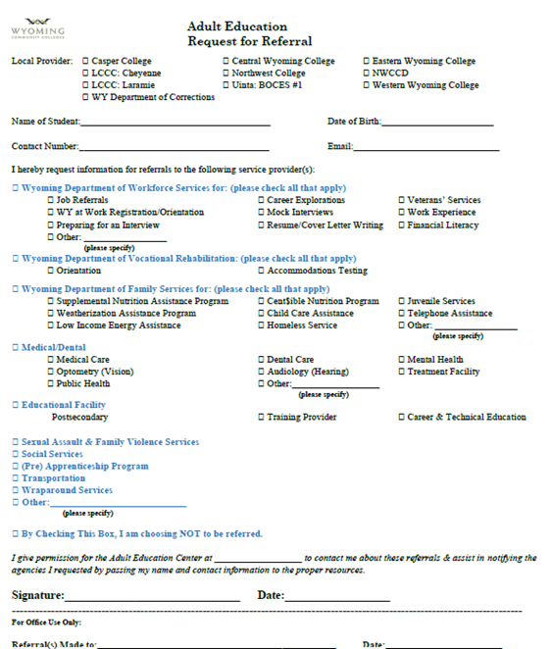







Referrals
Eligibility
Program Requirements
Common Intake
Make Multiple Referrals if Necessary
Evaluate Processes
Maintain Effective Communications
Follow-up
Referral form is available here.
Notes:
Tracking referrals is crucial as it plays a very important part of the MOU the State has for the WIOA Infrastructure Agreement. Section 13 of Attachment A to this Infrastructure Agreement outlines 7 requirements for all core partners, inclusive of Wyoming’s AE programs.
Familiarize themselves with the basic eligibility and participation requirements, as well as with the available services and benefits offered, for each of the Partner Agencies’ and Partners’ programs represented in the Wyoming One-Stop Center network;
2. Develop materials summarizing their program requirements and make them available for Partner Agencies, Partners and customers;
3. Develop and utilize common intake, eligibility determination, assessment, and registration forms;
4. Provide substantive referrals – in accordance with appropriate referral policies – to customers who are eligible for supplemental and complementary services and benefits under Partner Agencies and Partners programs;
5. Regularly evaluate ways to improve the referral process, including the use of customer satisfaction surveys;
6. Commit to robust and ongoing communication required for an effective referral process; and
7. Commit to actively follow-up on the results of referrals and assure that Partner Agencies and Partners resources are being leveraged at an optimal level.
These are federal requirements that all WIOA core partners must report on, both at the federal level as well as at the State level to the Wyoming Workforce Development Council who is the State Workforce Investment Board.
Referrals are initially made during the intake process, but can also occur through a student’s program of study. Instructors should use this form whenever necessary so that student barriers can be more easily eliminated. Copies of the referral form must be maintained in the local student file and the information contained on the referrals must also be entered into the LACES database, so instructors must submit a copy of completed referrals to the local programs’ data entry personnel.

Slide 20
Assessments
NRS Approved
Career Assessments
OPT’s
Local Programs
Notes:
Throughout the academic life of a student there will be numerous tests taken. This is no different for adult education students. For accountability purposes NRS approved assessments are given. Career assessments are given to help student identify a career pathways track. Official practice tests (OPT) are given to determine student readiness to take a high school equivalency exam. And instructor made quizzes/assessments are used in adult education classrooms.
Regardless of the type or purpose of assessment, copies of all assessment materials must be maintained in local student files. Only NRS assessments and OPT results are entered into the LACES database.

Slide 21
NRS Approved Assessments for Wyoming
TABE 11/12 (Adult Education)
Reading
Writing (New 2021)
TABE CLAS-E (ESL)
Reading
Writing
Language
Mathematics
Listening
Speaking
Wyoming Assessment Policy is available here.
Federal Registry of NRS Approved Assessments is available here.
Notes:
The National Reporting System (NRS) must approve all assessments for Adult Education Programs in Wyoming.
Wyoming’s AE programs utilize two distinct assessments. TABE 11/12, for Adult Education students, tests participant levels in reading, writing (new fall 2021), language, and mathematics. TABE 11/12 has five levels and there are two forms for each level. TABE 11 is typically used for pre-testing while TABE 12 is used for post-testing; although this doesn’t always have to be the case.
TABE 11/12 can be given in paper-based form or electronically. Paper-based assessments can be scored electronically or manually. If scored manually, programs will utilize a series of cross-referencing charts provided by the test manufacture to help identify the appropriate EFL for placement into the program. The online TABE and/or paper-based tests scored electronically automatically calculate EFL’s for you.
The State of Wyoming requires that all instructors who give a TABE 11/12 to be certified. This two-part certification process is available on-line at:
https://tabetest.com/tabe-1112-certification-process/
Once completed, instructors are required to print a copy of the end of course certification (for both courses). Copies of these certifications must be kept locally with a copy sent to the State.
As outlined in the State Assessment policy, local directors are required to conduct yearly trainings on utilizing the TABE assessments.
TABE CLAS-E is used with non-native English speaking populations. This assessment tests language abilities in reading, writing, listening, and speaking. As with TABE 11/12, there are alternate forms for each of the four levels.
All pre-testing must be done within the first 12 hours of instruction and MUST be completed during a student’s participation in the Career Services course. Initial pre-tests should be complete battery tests. Post-testing must follow the guidelines outlined in the Wyoming Assessment policy, which receives yearly approval from OCTAE.

Slide 22
Pre/Post Testing
Pretest
Must use locator
Must be done within the first 12 hours (in the Career Service Course)
Post-testing
Must meet minimum hours guidelines for post-testing as outlined in policy
Must use an alternate test form
Results are used to guide instruction
Can be paper-based, CBT, or virtual with appropriate proctoring
Complete battery tests are required (with exceptions)
Accrued hours for post testing include both contact hours & proxy hours

Slide 23
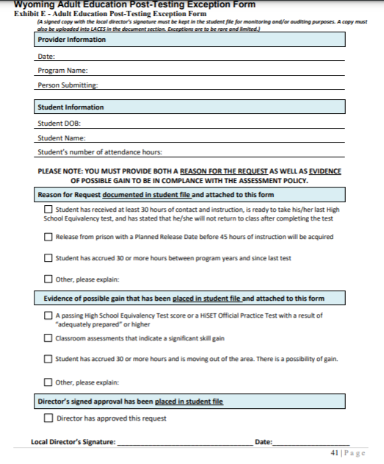
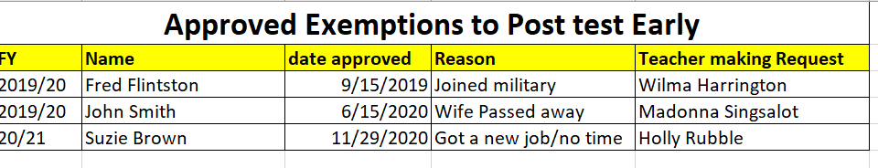
Post-Testing Exception Form
Director Log of Approved Waivers
3%
A copy of the Post-testing Exemption form is found in the Assessment policy here.
Notes:
There are circumstances when it is permissible to posttest a student before the recommended hours of instruction. The length of time between the pre-and post-tests has been established by test publishers in order to allow the test to validly and reliably measure educational gains. When these procedures are not followed correctly or consistently, the determination of educational functioning level is invalid and not comparable across programs or possibly even within programs, making the data validity questionable.
Exceptions to the required minimum number of post-testing hours for TABE are permitted, as long as they are limited, rare, and documented.
▪ The participant is permanently moving out of the area.
▪ The participant is permanently leaving the program AND the instructor has determined that the participant has made sufficient progress to warrant post-testing.
▪ An approved Post-testing Exception for Post-testing is uploaded into LACES
Only 3% of all fundable students at NRS Level 4 can be post-tested using a Post-Testing Exception form as long as they have completed 30 hours of instruction and the student has demonstrated through informal testing protocols an ability to show measurable skill gain.
The State Post-testing Exemption form is shown on the slide and must be approved by the local director BEFORE post testing occurs.
Local directors are also required to maintain a log of post-testing exemptions approved. An example is shown on the screen

Slide 24



Career Assessments
https://www.careeronestop.org/ExploreCareers/Assessments/self-assessments.aspx
https://www.onetonline.org/
Notes:
All participants must be given a career assessment before they complete their Career Services course. There are many career assessments available that local programs can chose from. Local programs are not obligated to utilize a State approved career assessment, but two of the common assessments used around the State include O-Net and Career One Stop.

Slide 25
Official Practice Tests
Free to students when given at an AE center
PPT 6A & PPT 7
OPT 6A, OPT 7, OPT 8, OPT 9, OPT 10
$6 per test cost to students
Online only
Notes:
All HSE students are required to show a ‘readiness’ to test by completing an official practice test (OPT). These are not NRS approved assessments and cannot be utilized for placement into a program of study. Consequently, these tests are NOT to be given to students upon entry into a program, but must be given at a point in a student’s program of study when the instructor believes the student is ready to begin HSE testing. This could be at the end of a managed enrolled class for all subjects or it could be individualized subject by subject. Because every student is different, local programs have the flexibility to give OPT’s at a time that works best for the student.
In Wyoming, students are allowed to choose between either a GED or a HiSET test and there are OPT’s for both assessments. The OPT for the GED is called GED Ready. This test is available on line from the test manufacturer at a cost of $6 per test.
Free online OPT’s (called the FPT) are available from the test manufacturer’s website. These OPT’s are not allowed in Wyoming as they are not secured assessments and cannot be utilized by local centers to determine a student’s readiness to test. Wyoming centers may utilize the tests outlined on the age waiver application: Paid Practice Tests (PPT) PPT 6A and PPT 7. Paid practice tests are purchased from the test manufacturer and are mailed to the local provider in paper-based form. These can be copied and distributed to outreach sites when needed.
Official Practice Tests (OPT): OPT 6A, OPT 7, OPT 8, OPT 9, and OPT 10. As with the PPT, the OPT’s are purchased from the test manufacturer but are not available in paper-based form. These are electronic assessments that are emailed to the local provider; who may make paper-based copies of the assessment.
Local programs purchase these OPT’s from the test manufacturer and consequently, must be budgeted for. Each fall the test manufacturer releases a new test and typically makes an older test obsolete.
HiSET OPT’s are available at each AE center in Wyoming.

Slide 26
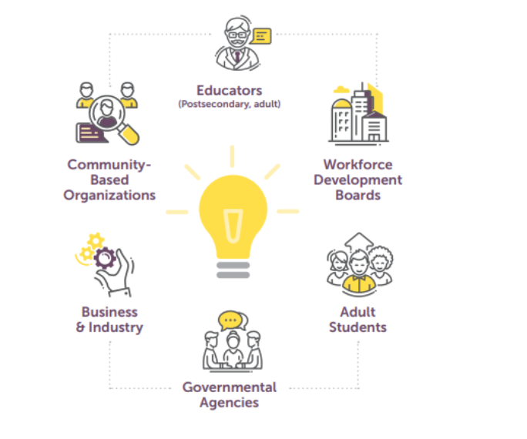
Career Pathways
Notes:
“Career pathways are essential in adult education because of their role in enhancing the workforce skills of adult learners thus aiding in the alleviation of poverty through increased earnings.” (COABE 2018). Students who successfully embark upon and complete a career pathways track are much more employable. To this end, Wyoming’s Adult Education centers have partnered with numerous agencies, businesses, postsecondary education/training centers, and community based organizations to ensure that Adult Education students are provided with the services needed to complete a career pathways track.
One of the beginning steps to developing a career pathways plan for any student is to take a career assessment. It is for this reason, that career assessments are completed before students begin a program of study. Results of career assessments can help the instructor contextualize instruction, when possible, around the students’ identified career choice.

Slide 27
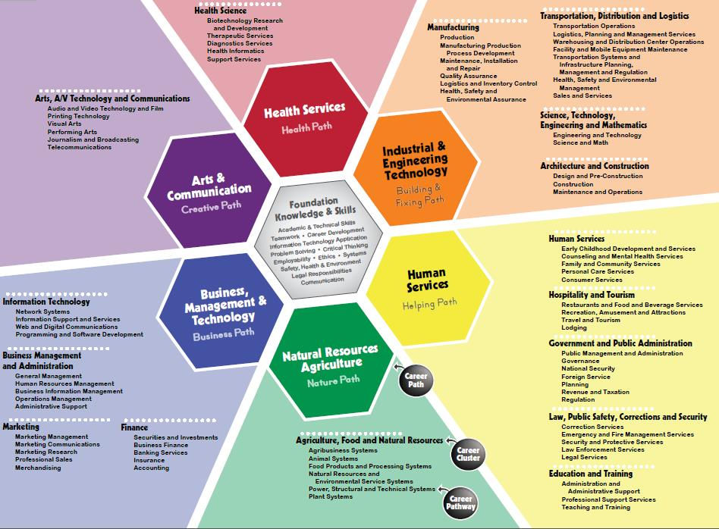
Using Career
Assessment Results
Notes:
Career assessment results are used to place students into one of the career clusters shown on the chart below. These results may become part of a student’s permanent file and may be shared with the Wyoming Department of Workforce Services and/or Vocational Rehabilitation, once appropriate release forms are completed. Students are able to use individualized results to research careers in an identified pathway while teachers tailor instruction around a specific career pathway whenever possible.

Slide 28
Tying Assessment Results to Wyoming’s Job Market
Most In Need
Health Care
Manufacturing
Retail
Construction & the Trades
Hospitality
Wyoming Short-Term Industry & Occupational Projections are available here.
Notes:
It is very helpful to students to learn about regional economic needs for occupations, particularly for those occupations identified in a career assessment. Students need to know whether there is even a need for a profession that they may be interested in pursuing.
Many Adult Education programs have the Wyoming Department of Workforce Service (DWS) present this information to students as part of their Career Service course while other providers have students conduct this research on their own as part of a Career Explorations section to the Career Services course. (Career Explorations are discussed on the next slide).
As a new director in Adult Education it is important for you to know that State short-term job projections are available from DWS on their website.
At present the Wyoming industries most in-need of workers fall into five distinct categories: health care, manufacturing, retail, hospitality & construction and the trades.

Slide 29
Decisions…..Decisions…Decisions
AE Career Services
AE Career Services in Partnership with DWS
During Instruction
AE: Contextualization Around a Career/Cluster
Career Assessment
Portfolio’s
Students Identify Career Pathways Track/Cluster
Opportunities for Concurrent Enrollments in Postsecondary/Training
Occupational Research
Work Experience
Career Planning
Students Provided with Information re: In-Demand Jobs in Wyoming
DWS: Co-enrollment
Training Options
Notes:
Career Explorations involves helping students identify their interests, aptitudes, and educational achievements. Another part of career exploration is having students gather information on different occupations they might want to pursue. This process would include investigating educational requirements, expected salary, and availability of training programs, jobs in the field, etc. for a chosen occupation. In Wyoming, career explorations is part of the Career Service course and includes some or all of the following aspects:
Career assessment
Web-based portfolios
Occupational searches
Identification of training & work requirements
Identification of career plans
Selection of a training options
After completing a career exploration, programs should introduce students to the career pathways model and provide information about career pathways to in-demand jobs for the State of Wyoming. (http://doe.state.wy.us/lmi/projections/2020/Short_term_Occs_2019-21.html)
Information obtained through Career Explorations can help programs contextualize curricula around an identified career and/or career cluster while also presenting opportunities for qualified students to concurrently enroll in CTE programs of study. This can present the student with an opportunity to be ‘fast tracked’ to credential attainment, which in turn can lead to employment in the identified career.
Through partnerships with DWS, AE students can also be placed into work experience programs aligned to a student’s career interest. DWS is also able to help qualified students overcome barriers to employment that may impede student success, such as lack of childcare, transportation, etc.

Slide 30
Career Trainings in Wyoming’s Adult Education Programs
(Pre) apprenticeship
CTE Enrollments
Internships
On-the-Job Trainings
IET’s
Notes:
With the passage of WIOA legislation, Adult Education effectively became a workforce preparation training program. As such, there are now a wide variety of program offerings that can be made to students that are specifically designed around a career. These include, but are not limited to, (pre) apprenticeship programs, concurrent and/or post-exit enrollments in CTE programs of study, internships, on the job trainings, integrated education and training (IET) programs, etc.

Slide 31
Integrated Education & Training (IET)
For Adult Education
Notes:
Integrated Education and Training (IET) models can be a challenge to create, but they are a requirement of all AE programs under WIOA legislation.

Slide 32
IET Defined
“A service approach that provides AE & literacy activities concurrently and contextually with workforce preparation activities and workforce training for a specific occupation or occupational cluster for the purpose of education and career advancement.” (WIOA Section 203(11)

Slide 33

Required Components
Approved AE and literacy activities (Sec 463.30)
Workforce Preparation activities (463.34) AND
Workforce training for a specific occupation/occupational cluster
Notes:
All three must run concurrently.

Slide 34
AE & literacy activities
Adult Education
Literacy
Workplace AE & literacy activities
ELA
IELCE
Workforce prep. activities
Activities/programs to help a student acquire a combination of basic academic skills, critical thinking, digital literacy AND
Workforce training for an occupation/occupational cluster
Family literacy
Workforce preparation activities
IET
Self-management skills, including using resources/information, working with others, understanding systems, skills necessary to transition into employment/postsecondary and other employability skills
Occupational skills training
OJT
Incumbent worker training
Programs that combine workplace training with related instruction (cooperative education programs)
Training programs operated by the private sector
Skill upgrading/retraining
Entrepreneurial training
Customized training
Notes:
Integrated Education and Training (IET) models can be a challenge to create, but they are a requirement of all AE programs under WIOA legislation.

Slide 35
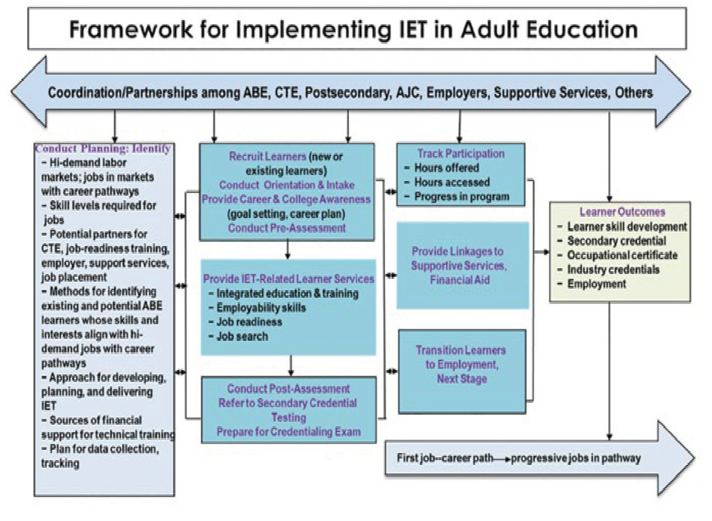
Notes:
As shown in this OCTAE produced framework, partnerships between adult education programs and postsecondary education institutions, occupational training providers, workforce agencies, supportive service agencies, and employers can be instrumental to adult education programs’ delivery of IET services. Workforce and other agencies serving low-skilled, underemployed, or unemployed adults can be sources of clients for IET services, and workforce agencies can provide financial support for technical training. Postsecondary education and occupational training providers can supply staff with the necessary technical skills and credentials for designing and delivering the career and technical education (CTE) training component of an IET program. Human service agencies can provide supportive services such as childcare and transportation to help learners participate in IET programs, and the American Job Centers (AJCs) can assist IET learners in securing employment. Employers can play varied roles in IET services, such as assisting in the development of technical training, providing financial support for training, and hiring adult education learners who complete an IET program.

Slide 36


Exposure to: physical, cognitive & psychosocial job demands / job expectations
Learner skill alignment
Outcomes
Long term pathway
Career
Awareness/ in-demand jobs
Notes:
1) Provide career awareness activities to check that learners are aware of their skills, abilities, and interests AND how the match the in-demand jobs that interest them
2) Expose learners to the physical, cognitive, and psychosocial demands of the job that interest them so that they understand the daily routines of these jobs AND will know what to expect if they are hired
3) Consider the extent to which learners’ skill strengths align with the skills required for the industry sectors or jobs that interest them. Learners should be aware of the skill demands of jobs along their pathway and whether they will need to develop stronger skills to
advance in jobs along their pathway.
4) Provide information about the outcomes from the IET services, such as certificate, and the types of near-term jobs that this credential will enable learners to obtain
5) A final consideration is providing learners with a clear vision of a long-term pathway so that they understand the types of jobs along the pathway, the educational requirements for those jobs, and the local wage rates

Slide 37

Better Together!
Community Colleges (CTE)
Employers & Next Gen
Workforce
Community Service Providers
Notes:
Partnerships are critical to the success of an IET. The aim of IET partnerships is to identify the circumstances when the partnership can be mutually beneficial such as an AE provider in a community college providing training candidates to the college during times when college enrollment in CTE programs is low.
Employers can be brought into an IET in several ways: First, IET credentialed programs of study could be specifically designed to address the needs of local employers, particularly those identified through Next Gen Sector Partnerships. Employers could also be instrumental in providing on the job training, (pre)apprenticeships, internships, etc. They could also be brought into mix in IET program design by promising to hire individuals who complete an IET.
The services offered through DWS could also help in the design of a successful IET. First, funding for the training component could, in some instances, come from DWS for qualified individuals. Second, the workforce preparation component of an IET could be offered entirely by a local workforce and finally, workforce could facilitate job placements for students who complete an IET program of study.
Community Service providers could help learners with such things as childcare, transportation, and other factors that create a barrier to successful completion of an academic program of study.

Slide 38
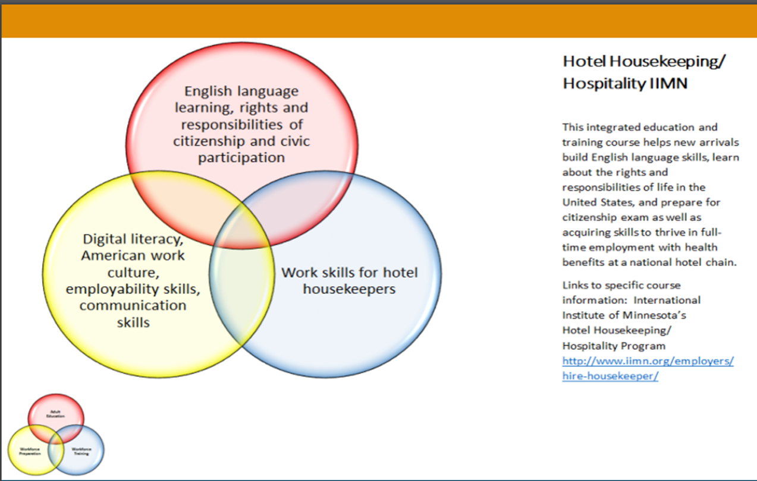
Examples

Slide 39
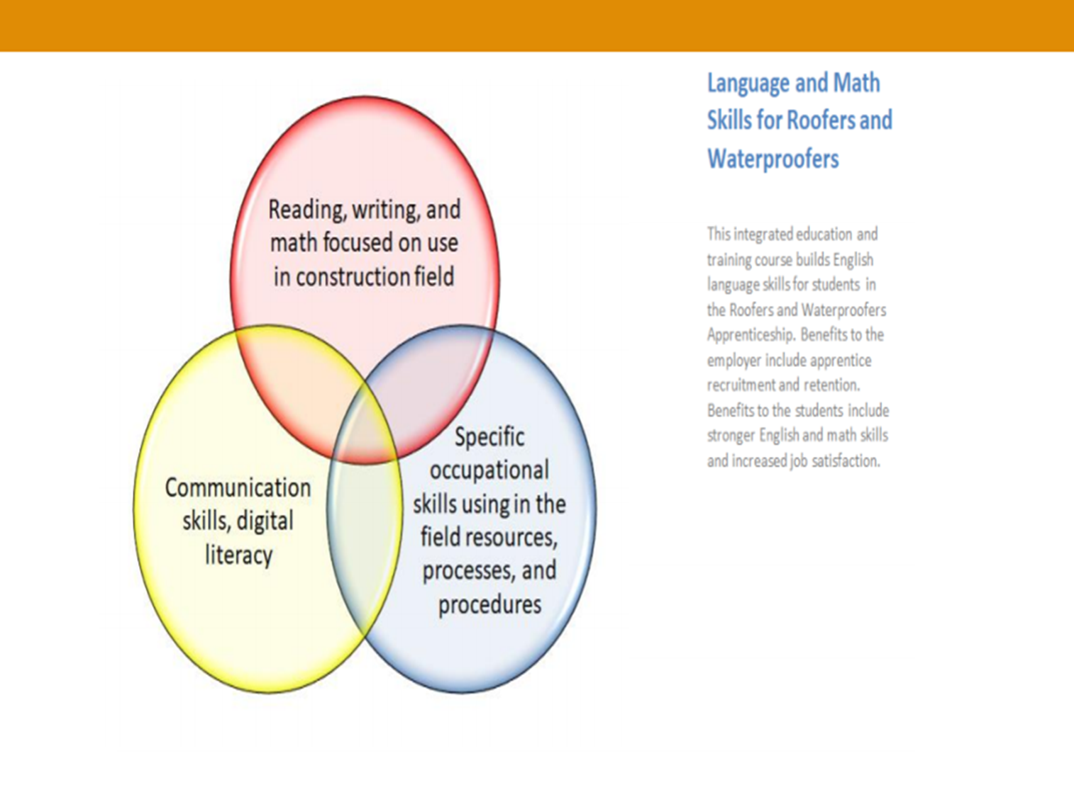
Examples

Slide 40
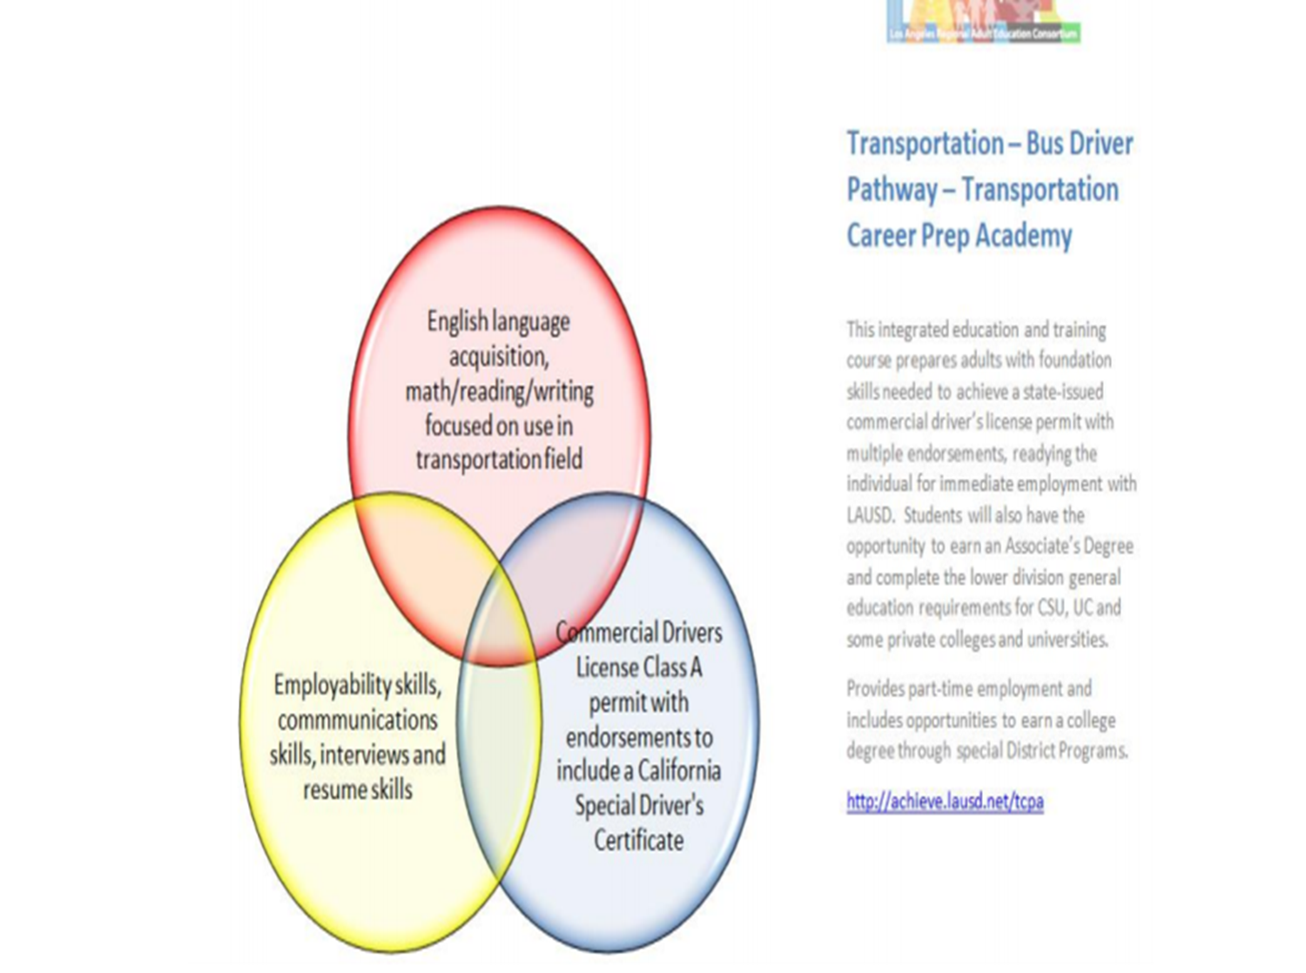
Examples

Slide 41

Training Next Gen State team
WCCC training to Academic VP’s
Workforce Development Council
Unified State Plan

Slide 42

IET Planning Tool

Slide 43
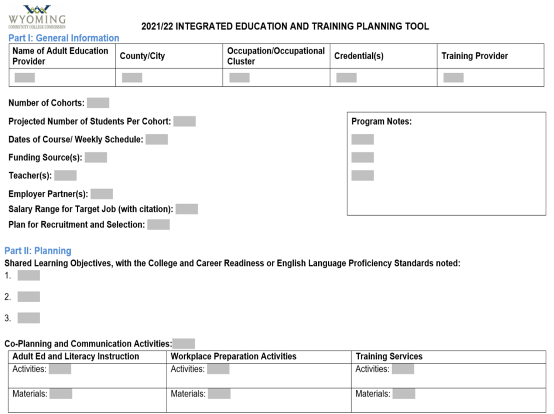
IET Planning Tool
Notes:
Guidance is provided for each item on the planning tool.
IET Defined:
IET is adult education and literacy, workforce preparation, and workforce training “each of sufficient intensity and quality, and based on the most rigorous research available, especially with respect to improving reading, writing, mathematics, and English proficiency of eligible individuals” that “occur simultaneously,” “use occupationally relevant instructional materials,” and are “organized to function cooperatively” with “a single set of learning outcomes” (34 CFR §463.37). IET represents a wide spectrum of services to build foundational, employability, and occupational skills.
Many adult education providers have discovered the power of IET and, through a variety of partnerships, have implemented this strategy in model programs such as: Bridge Programs; Workplace Learning Programs; Pre-Apprenticeship Programs; Integrated English Literacy & Civics Education Programs; Corrections Education Programs; Postsecondary Education Programs; and Out-of-School Youth Programs.
Part I: General Information
Name of Adult Education Provider: The name of the adult education provider which will offer the IET.
County/City: The county or city where the IET will be held.
Occupation/occupational cluster: The occupation or occupational cluster that the students will enter upon the completion of the IET.
Credential(s): The credentials that the students will earn.
Training Provider: Agenc(ies) delivering occupational training.
Number of Cohorts: The number of times that the IET will be offered in one program year.
Projected Number of Students Per Cohort: Total anticipated number of participants per cohort.
Dates of Course/ Weekly Schedule: The full date range of course including exact dates and times; if there is more than one cohort, list the course schedule for each one.
Funding Source(s): The agenc(ies) paying for the IET.
Teacher(s): The names of the adult education instructor and the trainer who will be delivering the content.
Employer Partner(s): The specific employers who are involved in the curriculum or who have agreed to participate in job readiness and placement activities.
Salary Range for Target Job: The local salary range for the occupation/occupational cluster.
Plan for Recruitment and Selection: The plan to recruit and criteria to select the students for the IET.
Program Notes: Additional information (optional).
Part II: Planning
Shared Learning Objectives: The concepts, competencies, and vocabulary that the students will learn across the whole scope of the adult education activities and occupational training activities. Use the CCRS or ELP standards for objectives with academic and literacy activities.
Co-Planning and Communication Activities: The plan for the coordination of instructors before and during the IET program.
Activities and Materials: The specific adult education content, workforce preparation activities, and workforce training competencies and the resources to be used.
DWS already has similar requirements like an IET for Youth.

Slide 44
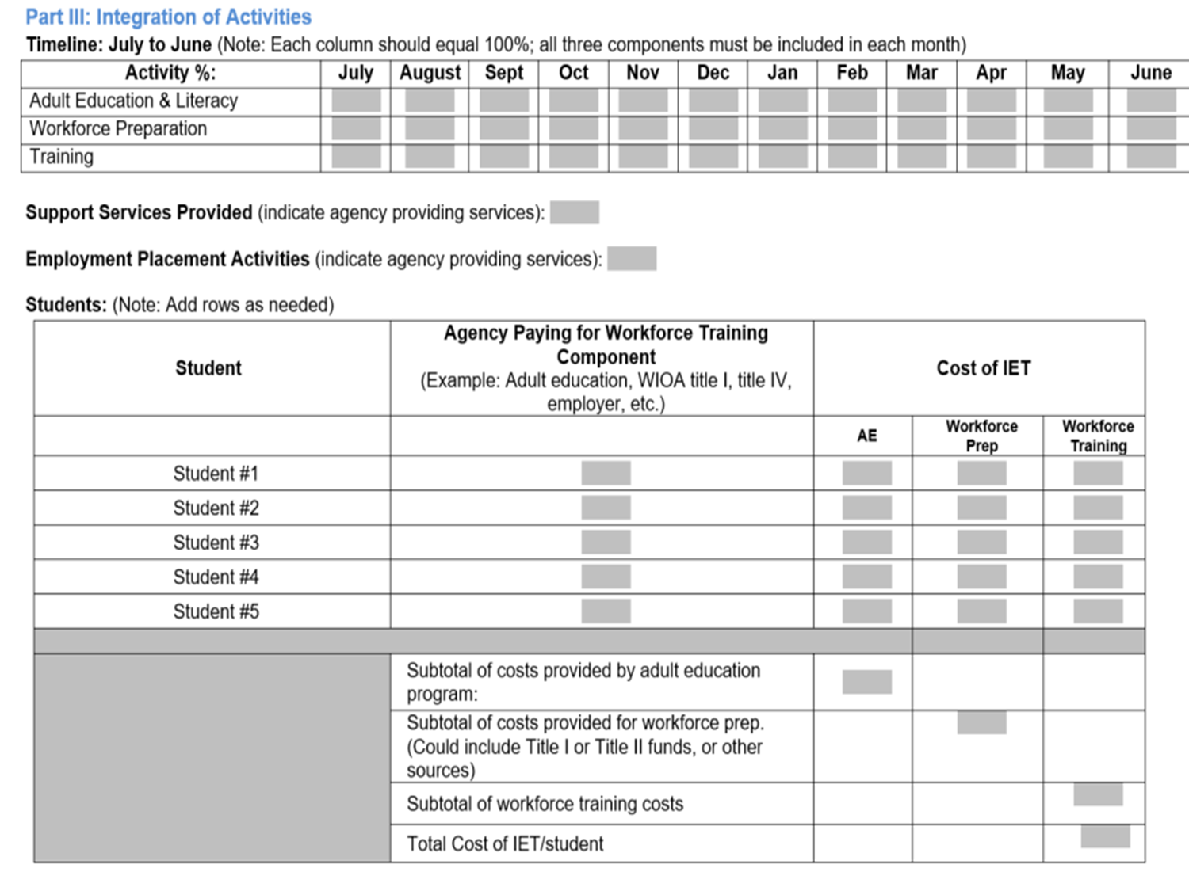
IET Planning Tool
Notes:
Part III: Integration of the Activities
The term “integrated” (§463.37) means services must be provided concurrently and contextually such that:
Within the overall scope of the integrated education and training program, the adult education and literacy activities, workforce preparation activities, and workforce training:
a. are each of sufficient intensity and quality, and based on the most rigorous research available, particularly with respect to improving reading, writing, mathematics, and English proficiency of eligible individuals;
b. occur simultaneously; and
c. use occupationally relevant instructional materials.
The integrated education and training program has a single set of learning objectives that identifies:
a. specific adult education content;
b. workforce preparation activities; and
c. workforce training competencies, and the program activities are organized to function cooperatively
Timeline: The percentage of each of the three components throughout the duration of the IET program. For the duration of the IET, each column must have a percentage greater than zero and each column must equal 100%.
Support Services Provided: The partners and the services to be provided to the IET participants.
Employment Placement Activities: The resources and activities that support employment of participants.
Funding the IET:
Over the past decade, special grants and philanthropic funds have supported the development of IET models, but to bring this innovation to scale, formula funds now need to be directed toward this strategy. Such investments do not constitute one program “raiding” another program's funds. Rather, IET enables joint program models through which each partner brings resources and shares a responsibility for outcomes.
WIOA title II-AEFLA funds, both general program funds and dedicated section 243 funds for Integrated English Literacy and Civics Education, can pay for IET when the adult education program provides the workforce training. Note: title II-AEFLA funds are required to support education below the postsecondary education functioning level, and much workforce training is properly categorized at this pre-college level, even as a recognized postsecondary credential is the educational outcome.
WIOA title I adult and dislocated worker funds can also pay for IET, not only workforce preparation and workforce training but also the adult education and literacy services when offered in an IET model (20 CFR §680.350). For this to happen, the adult education IET programs that provide a “program of training services” (20 CFR §680.420) need to be included on the Eligible Training Provider list (ETPL) (20 CFR §680.410) and the final rule clearly describes how to include title II programs on the ETPL. For Postsecondary Education Programs, partners should leverage the Pell Grant Ability to Benefit option to cover the higher education costs.
Indicate agenc(ies) paying for the workforce training component: The source of funding for the actual workforce occupational training.
Costs of the IET: The cost per student for each portion of the IET. This may include tuition, textbooks, etc.

Slide 45
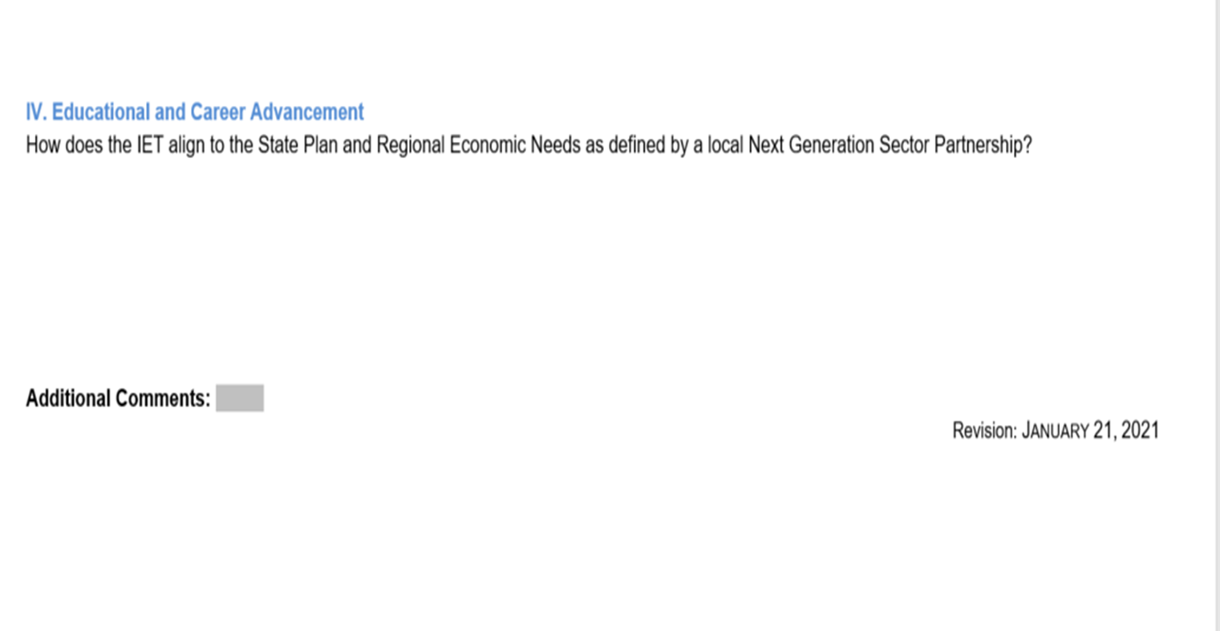
IET Planning Tool

Slide 46
Planning a Lesson
ILM/ILP

Slide 47
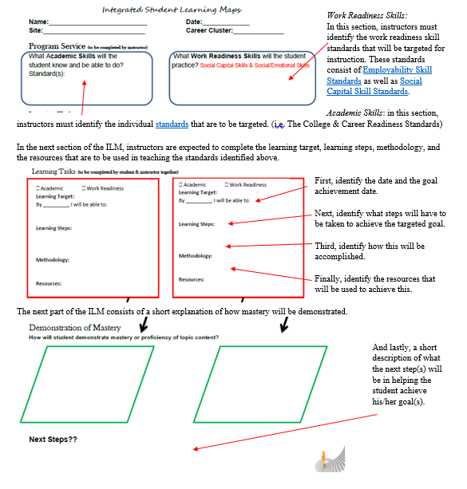
Integrated Learning Maps
Notes:
The purpose of the Integrated Learning Map is to help guide the learning process for an individual student, rather than a lesson plan for a managed enrolled classroom situation. ILM’s provide the tools in which identified standards based goals are set for individual students.

Slide 48
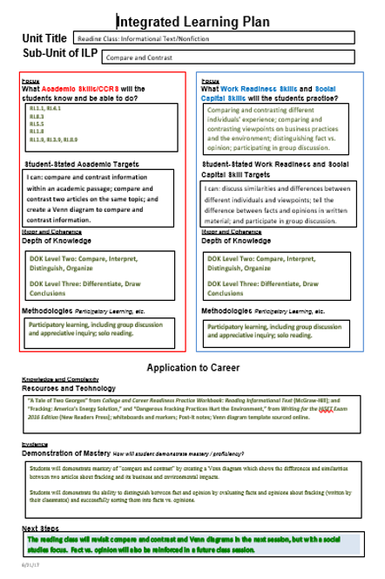
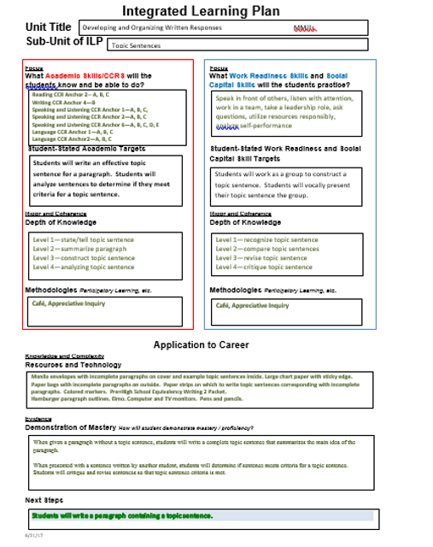
Integrated Learning Plans
Notes:
Adult Education programs which utilize managed enrollment processes typically require instructors to complete Integrated Learning plans, which serve as lesson plans.

Slide 49
Standards
Federal and State

Slide 50
CCRS
(National)
Reading
Writing
Speaking & Listening
Language
Math
Standards available here.
ELP
Note: Corresponds to CCRS
Reading
Writing
Language
Math
Speaking &
Listening
Standards available here.
Employability Skills
(State)
10 Workforce-Based Standards
Standards available here.
Social Capital
Skills
(State)
10 Social Capital Skill Standards for Workforce
Standards available here.
Notes:
The Office of Career, Technical & Adult Education (OCTAE) has established federal level content standards for Adult Basic Education in Mathematics, Reading/Writing, and for ESL. These standards provide a series of objectives, which if attained, will prepare students for work, school, and life in the United States. These standards should be used by instructors as benchmarks to evaluate a student’s achievement/non achievement of goals.
College and Career Readiness Standards for Adult Education can be found at: https://2ky701279qlou23p6256zftv-wpengine.netdna-ssl.com/wp-content/uploads/2018/03/ccrstandardsadulted.pdf
and the ELP standards for use in ESL programs of study are available at:
https://2ky701279qlou23p6256zftv-wpengine.netdna-ssl.com/wp-content/uploads/2021/01/elp-standards-adult-ed.pdf

Slide 51
Essential Components of Reading
WIOA Mandated
Notes:
WIOA focuses on the important role that strong basic skills play in an adults’ ability to attain a secondary school diploma, transition to postsecondary/training, and in securing employment. To this end, the law specifies that ‘the essential components of reading instruction’ be incorporated into instruction. Wyoming’s Adult Education programs are required to incorporate ECR into all subjects. Wyoming Policy #5012020 specifically details local program requirements for ECR.

Slide 52

Essential Components of Reading
Depth and use of appropriate words
Read with efficiency & ease
Process & product of understanding text
Fluency
Vocabulary
Reading Comprehension
Phonemic awareness
Phonics
decoding
Policy #05012020
Alphabetics
Notes:
Federal legislation requires that the ECR be incorporated in AE curricula and that it include:
Phonemic awareness, phonics, vocabulary development, reading fluency and reading comprehension strategies.

Slide 53
Wyoming’s AE Programs
Program Types Available

Slide 54

Meeting the Needs of Wyomingites
Flipped Classroom
Distance Learning
Virtual
Face-to-Face
Hybrid
Notes:
Wyoming’s Adult Education programs currently offer face-to-face classes, hybrid classes, virtual classes, and distance learning programs of study.
Face-to-Face: In person classes are available at all Adult Education centers the State. This traditional type of learning allows for the delivery of instructional material through live interaction between students and the instructor.
Distance Learning: Wyoming’s Adult Education centers incorporate multiple distance learning options for students who are unable to attend the traditional classroom environment. Distance learning (DL) options generally utilize online resources and various other instructional content to help students improve skills in academic areas. Throughout Wyoming, the centers have found that DL to be an effective way to increase access to Adult Education instruction for eligible students. In many cases DL is provided in a ‘blended’ or ‘hybrid’ environment in which a learner has some time in the classroom but also completes work outside of the classroom using DL platforms. This can increase the quality of the DL experience for students by providing them with an opportunity for in-person support and instruction, while also allowing for the flexibility of schedule and location that is the main advantage of distance learning.
Flipped Classroom: Many AE centers in Wyoming use what is commonly known as a ‘flipped classroom’. The concept behind the flipped classroom is to create a teaching model in which videos and/or State approved distance learning curricula replace live classroom interactions, to create valuable time for the students. The content is available at home or anywhere the student chooses to participate. In this way the student is learning for and by themselves, which can lead to higher levels of student engagement with the material. The student can take the teachings into their one-on-one time with the instructors, join a virtual classroom or work with small groups of students. They can choose to watch the videos multiple times, in order to really absorb the lessons and create more face-to-face time as they learn.
Virtual: With the onset of COVID-19, Adult Education classes began teaching utilizing ZOOM, Canvas, and other virtual classroom platforms. As we move towards the future these technologies will be integrated into all Adult Education classrooms so that in the event that society must once again move to a virtual environment students will be well prepared and familiar with how to effectively participate in classes held in a virtual environment.
Hybrid: Adult Educators in Wyoming recognize that there are occasions when students cannot physically be in class. As such, our centers often utilize a combination face to face, distance, and in some cases virtual classes so that the needs of our students can be effectively addressed.

Slide 55
Distance Learning
How it is used in Wyoming
Wyoming’s Distance Learning Policy can be found here.
Notes:
A formal learning activity where students and instructors are separated by geography, time, or both, for the majority of the instructional period. Instruction is provided by:
Computer software, web-based programs, online technology c. Audio/video
Printed materials d. Broadcasts
Wyoming’s Distance Learning policy provides explicit details about how to count hours and the approved materials for distance education in our Adult Education programs of study.

Slide 56
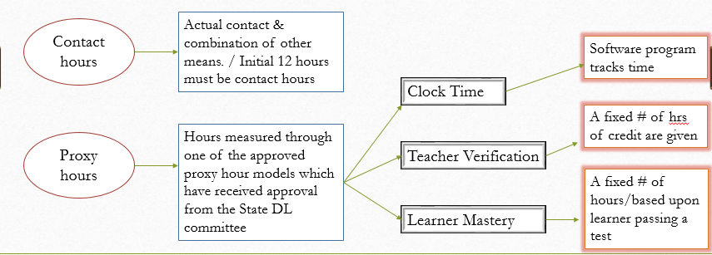
Measuring Hours for Distance Learning
Notes:
OCTAE has approved two types of hours for all AE programs in the US: Contact hours and proxy hours.
Contact hours for distance learns an be a combination of ‘actual contact’ and contract through telephone, video/teleconference, or online communication where learner and program staff interact AND through which learner identity is verifiable. Face-to-face contact time is NOT required to obtain the initial 12 hours of instruction.
Proxy hours are defined in three ways by the NRS: Clock Time, Teacher Verification and Learner Mastery.
Clock time hours are measured by a software program that tracks active learning time.
The teacher verification model assigns a fixed number of hours based upon the instructors’ determination of the extent to which a learner engaged in, or completed an assignment.
Learner mastery assigns a fixed # of hours based upon the learning passing a test at 70% or higher mastery level.

Slide 57
Recording Proxy Hours In LACES
Clock time
Assigns contact hours based on the elapsed time that a participant is connected to, or engaged in, an online or stand-alone software program hat tracks time. The software should disconnect after a preset period of inactivity.
System records number of hours for time on task
Teacher Verification
Assigns a fixed number of hours of credit for each assignment based on teacher determination of the extent to which a participant engaged in, or completed, the assignment
Instructor records hours using State policy guidelines
Learner Mastery
Assigns a fixed number of hours of credit based on the participant passing a test on the content of each lesson. Participants work with the curriculum & materials and, when they feel they have mastered the material, take a test. A high percentage of correct answers (typically 70%) earns the credit hours attached to the material.
Instructor records hours using State policy guidelines
Must be recorded as ‘distance learning hours’
# of hours determined by online platform OR through State policy
Students must have 12 contact hours BEFORE proxy hours can be recorded
Notes:
Initial 12 contact hours can be a combination of actual contact and contract through telephone, video, teleconference, or online communication where student and staff interact and where student identity can be verified.

Slide 58
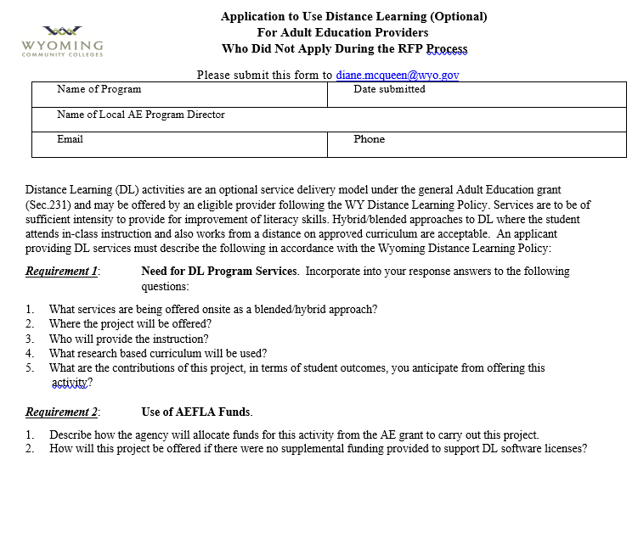
Request to Utilize Distance Learning
Form is available here. (on page 17)
Notes:
Programs that did not indicate a desire to utilize distance learning options during an RFP competition and later decide to implement distance learning must submit a completed application to use Distance Learning in their program. This form is available on the Commission’s website and must be approved BEFORE any distance learning options are made available to students.

Slide 59
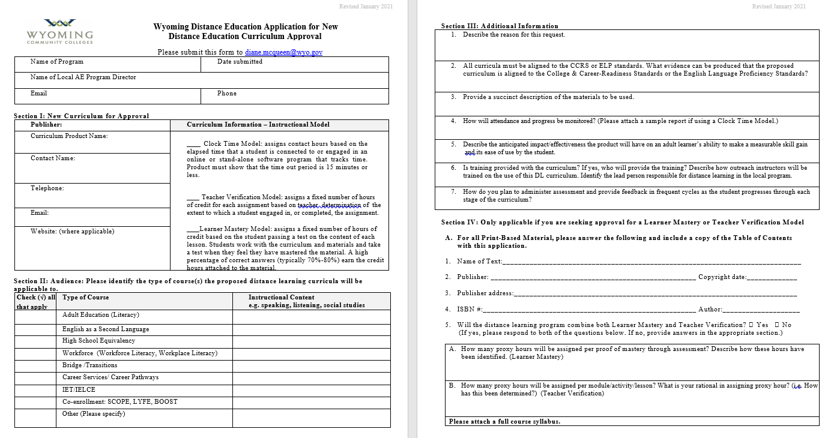
Process to Request New DL Platforms
Form is available here.
Notes:
In addition, because the State recognizes that local providers may find/want to use a new, previously unapproved DL platform, the State has implemented a system in which requests to add a new DL platform can be made by completing a request where the provider identifies:
Identify platform
Name of product
Info about the product
Cost info
Audience platform will be used with (ie. Type of AE class)
Proxy hour information

Slide 60

The Virtual AE Classroom
OCTAE Program
Memorandums are
available here.
Notes:
With the onset of COVID, AE programs across the U.S.A. underwent great transformations. With the closure of virtually all aspects of society, programs needed to come up with ways to continue to reach students with the academic support they needed. Thus the virtual classroom was created.
When the virtual classroom became a reality for Adult Education programs, new accountability rules and regulations came into play, particularly for how to count hours in a virtual classroom. Questions arose about whether the virtual classroom was considered a distance learning classroom or were hours to be recorded as contact hours? OCTAE provided a great amount of support and guidance during these times by providing Program Memorandums 20-3, 20-4, and 20-5.
Virtual classrooms in Wyoming where learner identify is verifiable are NOT considered distance learning classrooms. Distance learning, for Wyoming’s AE programs can only utilize State & OCTAE approved distance learning platforms identified in the State’s distance learning policy.

Slide 61
Measuring Hours for A Virtual Classroom in Wyoming’s AE Programs
Virtual Classroom
Contact hours
Learner identify is verifiable
Proxy Hours
Hrs accrued through State approved DL curricula
Approved Activities
Notes:
The hours measured for a virtual classroom can only be of two types: Contact hours or proxy hours and they MUST be delineated so that both tables 4C and 5A populate correctly.

Slide 62
Persistence & Retention
Why Students Exit
Vary Teaching Strategies/Styles
Convenient Class times
Accommodate Multiple Learning Styles
Utilize
Effective Instructional Practices
Contextualize Instruction
Integrate Digital Literacy & Soft Skills
Use Technology & Media Sources
Teach to Standards
Referrals
Career Pathways
Follow-up
Notes:
Retention of Students
Programs must retain students long enough to see progress, obtain goals, have successes, and achieve outcomes.
Strategies should include:
-offer classes at times that meet students’ needs
-research reasons why students exit your program
-vary teaching strategies & styles
-contextualize instruction whenever possible along student’s identified career track
-accommodate student learning styles
-utilize evidence-based research teaching methodologies in the classroom
-provide standards based educational
-integrate digital literacy and employability skills
-use a career pathways system which provides ample opportunities for career advancement
-utilize technology and media sources
-identify student barriers and make appropriate referrals so that students can be successful
-follow-up with students who are absent for 2-3 weeks

Slide 63
Completing Students
Exiting students
90 day

Slide 64

Exiting a Student
No attendance in 90 days
Leave for other reasons
On day of HSEC completion
Notes:
With the passage of WIOA legislation, how programs exit a student on LACES changed. Students cannot be officially exited from the database until 90 days after the last day of attendance. However, programs should exit students:
1)After 90 days without any attendance
2)On the date that they complete their HSEC
3)On the date that they leave our program (ie. move away, job conflicts death, etc),
Although 90 days may not have passed, exiting the student when it actually occurs helps to maintain clean, accurate and up-to-date data.

Slide 65
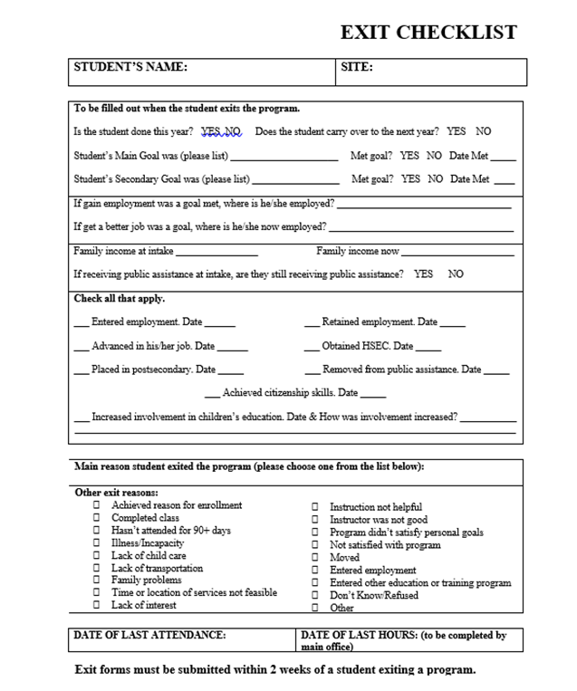

Exiting a Student
Notes:
Each program in Wyoming may utilize a different type of ‘Exit Checklist’, but an example is shown on the slide.
The data collected from an ‘Exit Checklist’ will help the local program ‘close out’ the student and exit the student from the LACES database.
Therefore, it is critical that instructors complete the local exit form whenever a student has left the program and/or has not attended in 90 days or more. Student exit forms must be maintained in a local student file and are subject to monitoring by the State.

Slide 66
Student Efficacy
Recognizing/Celebrating Student Successes

Slide 67
Tuition Waivers/Scholarships
Local AE Programs
Hathaway Scholarship
Graduations
Local program recognition
NAEHS
Local induction ceremonies
Student Success Stories
Community College/Regional Scholarships
Local recognition
State recognition
National recognition
Notes:
Tuition waivers and scholarships can take many forms. In an effort to encourage concurrent enrollments in postsecondary, many local programs in Wyoming offer what is commonly called a ‘tuition waiver’. These waivers typically provide local scholarship funds for Adult Education students who want to pursue post-secondary education. Each program in the State has its own unique system, so instructors are encouraged to discuss this opportunity with the local director.
The Hathaway Scholarship was established to help Wyoming’s students prepare for and pursue their post-secondary education in the state. The scholarship has its roots in Governor Stanley Hathaway’s 1974 decision to create the state of Wyoming Permanent Mineral Trust Fund. The fund’s income would support state government operations – including higher education in Wyoming.
In 2005, state lawmakers created a scholarship fund with a $400 million permanent endowment, whose income funds scholarships for qualified Wyoming high school graduates to attend the University of Wyoming or any of the state’s seven community colleges. They honored Hathaway’s many contributions to the state and accomplishments by naming the scholarship program for him.
The Hathaway Scholarship program has turned Governor Hathaway’s dream of building a better Wyoming into a reality by making attending college possible through merit- and need-based scholarships for qualified Wyoming high school graduates.
Hathaway scholarships are designed to provide an incentive for Wyoming students to prepare for and pursue post-secondary education within the state of Wyoming. The program consists of four separate merit scholarships, each with specific eligibility requirements, and a need-based scholarship for eligible students that supplements the merit awards.
HSEC students can qualify for Hathaway Scholarship dollars if:
1) They initiate the scholarship within two years of their natural graduation date.
2) They receive their HSEC while living in Wyoming and attending a Wyoming high school.
Students cannot initiate the Hathaway Scholarship prior to student’s natural graduation date, unless it has been court ordered to complete a HSEC, the student has been emancipated, is a parent or guardian of a minor, or for other good cause shown as determined by the department.
Student must initiate the Hathaway Scholarship within 4 years of their natural graduation date.
High School Equivalency graduations are held at all programs in the State at various intervals throughout a year. Typically, all students who earn their HSEC are eligible to walk in a formal graduation ceremony sponsored by the local AE program. The local program will notify qualified students of these ceremonies and invite them to participate, if they wish.

Slide 68
—Martin Luther King
“The function of education is to teach one to think intensively and to think critically. Intelligence plus character—that is the goal of true education.”

