Slide 1
New Director Training
Virtual Format

Slide 2
MODULE
FOUR
For
Compliance to
WIOA
Measuring
Performance

Slide 3
The NRS Tables & Measuring Performance
LACES and the NRS Tables
Understanding how data populates to the tables for data validation purposes
Notes:
All NRS tables, except for 2A record participant information on students with 12+ hours. These are known as ‘fundable’ students. The total numbers shown on Tables 1-4 must always match.
Table 2A records participant information on students with less than 12 hours. These are called ‘nonfundable’ students.

Slide 4
NRS Table 1
Participants by Entering Educational Functioning Level, Ethnicity, and Sex

Slide 5
Data collected from WY Intake form
Data collected from student assessments
Notes:
Table one records demographic information by NRS levels for each eligible participant.

Slide 6
NRS Table 2
Participants by Age, Ethnicity, and Sex

Slide 7
Data collected from WY intake form.
Notes:
Table 2 records age, ethnicity and gender of eligible participants.

Slide 8
NRS Table 2A
Reportable Individuals by Age, Ethnicity and Sex

Slide 9
Data collected from WY Intake form
Notes:
Table 2A records demographic data on non-fundable students.

Slide 10
NRS Table 3
Participants by Program Type & Age

Slide 11
Data collected from WY Intake form.
ABE, ASE and ESL are denoted through student assessments.
IET is denoted through course registration.
Notes:
Table 3 records student age ranges by program type.

Slide 12
NRS Table 4
Measurable Skill Gains by Entry Level

Slide 13
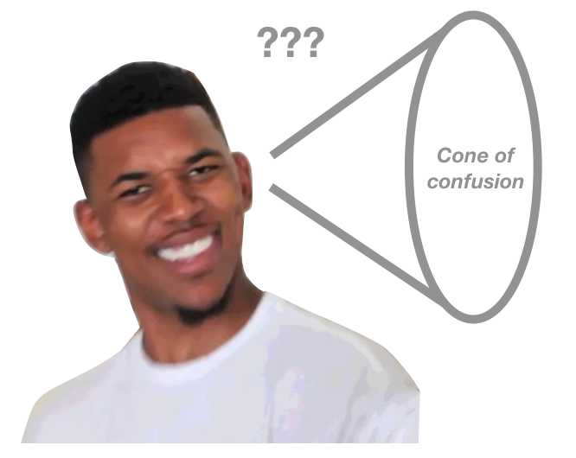
Notes:
Table 4 is one of the most important NRS tables that a program will utilize. It records student data by educational functioning level and measures total hours of attendance, exclusions from performance, MSG and MSG gains by periods of participation while showing the percentage of PoP’s with MSG WITHIN a current fiscal year.
Tables 4 and 5 are perhaps the most challenging to understand, so there are multiple slides presented here which detail additional information.

Slide 14
Table 4 begins by identifying a students EFL level at intake and identifies how many students a program has at each level.
Column C records the number of students excluded from performance for reasons outlined by the NRS.
Column D records the total number of hours students have logged at each level.
Column E measures the number of students who made an EFL gain. Programs must understand that there are numerous ways in which this can be measured. (see subsequent slides)

Slide 15
MSG: Educational Functioning Level (EFL) Gain
GAIN
08/10/20
10/10/20
10/30/20
02/15/21
Pretest
Post-test
4
5
GAIN
Student Exit
Enters Postsecondary
T4,
T11 (IET), T 8 (Fam.Lit) T10 (Corrections)
ONE Period of Participation (PoP)/2 gains=1 MSG
Notes:
As mentioned in the previous unit, there are five ways that MSG can be measured for performance. These measures are reported on multiple NRS tables (T4, T11, T8 and T10) at the end of each fiscal year, but are monitored throughout the year by both the State and the local program. Tables 8, 10, & 11 are subsets of Table 4, so program directors need to monitor all tables on a regular basis to make sure the data makes sense. For instance, if you have a family literacy program then the data is reported on Table 8. This identical data must also be represented on Table 4. The same is true for corrections education (table 10) and for all IET programs (Table 11).
As mentioned on the previous slide, the fifth column on Table 4 records the number of participants who achieve at least one EFL gain. Here EFL gain is measured in two ways.
1) The first way in which gain can be measured is through pre and post testing. In its simplest form this can be understood that a student who enters the program at a level 1 and then takes a post test and scores at a level 2, gain has been achieved. This gain would then be reported on the tables.
2) There is another method in which gain can be recognized…that of entering postsecondary education. This gain can only be recognized if the student enters postsecondary AFTER being exited from Adult Education.
Although these examples may seem to indicate that it is possible to show two gains for the student, this is not always the case as only 1 EFL gain can be measured per each student PoP and that gain will always be the latest gain earned. So in the example represented on the slide, the student who had a continuous program of study would show gain (for reporting purposes) for entering post secondary only (ONE GAIN).

Slide 16
MSG: Educational Functioning Level (EFL) Gain
GAIN
GAIN
08/10/20
10/10/20
10/30/20
02/15/21
04/15/21
Pretest
Post-test
4
5
GAIN
Student Exit
Re-enters AE
Earns HSEC
Enters Postsecondary
ONE PoP/1 GAIN=1 MSG
ONE PoP/2 GAINS=1 MSG
+
PoP #1= 1 MSG
=
2 MSG
PoP #2= 1 MSG
Notes:
It is possible to earn 2 or more MSG’s for a single student, although it is rare that this occurs. Consider, if the same student enters the program, pre and post tests and then exits with a 90 day gap in service and then returns to study after that 90 day period, a second period of participation will occur and the program CAN show MSG EFL Gain for both periods of participation in which GAIN was achieved.
It should also be noted that in order to ‘count’ an MSG for entry into postsecondary, two things must occur in the same fiscal year: the student must have entered and exited an adult education program AND they must have entered postsecondary in that same fiscal year. The entry date into postsecondary must be after the exit date for adult education.

Slide 17
Evidence Required
Pre/post testing Assessment Results
Postsecondary Transcripts
Data match report from NSC or local college
Notes:
Because Adult Education is an accountability system, local programs must maintain evidence of all measurable skill gains. For pre/post testing, that evidence is a copy of the assessment results earned by the student. Accurate data must be entered into the student’s LACES record and a hard copy of assessment results must be maintained in the student’s local file. Assessment results are subject to State monitoring.
There are two types of evidence that can be maintained for entry into postsecondary education; a transcript or information/records obtained through a data match from the National Student Clearinghouse or a local community college showing the student’s name and date of entry into postsecondary/training. Postsecondary documentation is also subject to State monitoring.

Slide 18
Colum F records the number of students at each level who earn an HSEC.
Column G records the number of students at each level wo left the program without showing gain.
Column H records the number of students at each level who are ‘still enrolled’ and haven’t shown gain.
Column I measures the percentage of students who have achieved a gain. (Column E + F/ Column B)
Notes:
Table 4 column F records the number of students at each educational functioning level who have earned a HSEC. Documentation of this achievement must be entered into LACES with a hard copy maintained in the student file. Additional information about this column is explained on the next two slides.
Column G tells you how many students with 12+ hours have left the program without showing gain. Programs need to try to keep this number low as students who do not show gain hurt program performance. This is particularly important to a local program because Wyoming utilizes a performance based funding model in the distribution of grant funds.
Column H shows the total number of students at each level who are still enrolled and haven’t shown gain. Here there could be a couple of reasons why the student hasn’t shown gain. 1) they haven’t reached the minimum hours for testing 2) they’ve tested but didn’t show gain. Programs must monitor this column closely for students who have exceed minimum testing hours and haven’t been tested.
Column I reflects the percentage of students who have shown gain at each level.

Slide 19
MSG: Secondary Diploma/ Equivalent HSEC
GAIN
GAIN
09/15/2020
03/05/2021
08/15/2020
Pretests NRS 4
Exits after a post test at NRS 5
Earns HSEC
T4,
T11
Notes:
Showing MSG gain through the achievement of a high school equivalency certificate can only be ‘counted if the student has completed and passed all sections of a GED or a HiSET examination. Partial scores will not count for MSG achievement.
Students who start the HSEC process in one location in Wyoming and then move can have their scores transferred AND the AE programs who worked with that student will BOTH get the MSG once the student completes the HSEC (as long as the completion is in the same fiscal year).
Unlike EFL, the MSG for HSEC is not necessarily tied to a period of participation BUT rather the fiscal year. Consider the example on the slide. In this example the student does not earn the HSEC until nearly six months after leaving the adult education program. Although the student did have an EFL gain in the fiscal year, THAT gain will not count once the student earns the HSEC in the same fiscal year. Since the HSEC was earned in the same fiscal year as the EFL AND because the HSEC is a higher level gain that occurred after a post test was given, the HSEC would be the successful measure accounted for on the tables.

Slide 20
MSG: Secondary Diploma/ Equivalent HSEC
GAIN
GAIN
09/15/2020
10/05/2021
08/15/2020
Pretests NRS 4
Earns HSEC
Post tests at NRS 5 and is exited
Notes:
One very important factor to remember with the MSG for HSEC is that only the most recently earned gain can be recognized. So if a student earns the HSE credential before showing gain through post testing, the HSEC credential will NOT count on Table 4.

Slide 21
Evidence Required
Copy of Credential
HSEC Transcripts
Notes:
Once a student earns a high school equivalency credential it is the local program’s responsibility to enter that data into the student’s LACES record AND to upload either a copy of the credential earned or a copy of the HSEC transcripts into the student’s LACES record. Hard copies of either the credential or transcripts must be maintained in the student’s local file as these documents are subject to State review.

Slide 22
Multiple PoP’s per student are possible
EFL gain as measured by pre/post testing OR entry into postsecondary
High school equivalency credential was earned
Should strive to match federally negotiated targets at each level!
Notes:
Table 4 column J records the total number of PoP’s at each educational functioning level. If a student has multiple PoP’s this is recording here for reporting purposes.
Column K will show the total number of PoPs where students had at least 1 EFL gain. Remember EFL gain can be reflected by pre/post testing OR by entry into post secondary.
Column L reflects the total number of PoPs where students earned an HSEC.
Column M is perhaps one of the most important columns on Table 4 as it shows the percentage of PoPs with MSG. Programs must strive to meet federally negotiated targets at EACH level. (See module 3)
Programs MUST maintain evidence of how all MSG’s for TABLE 4 was documented. This evidence must be recorded into LACES with hard copies maintained in student files. These documents are subject to State monitoring.

Slide 23
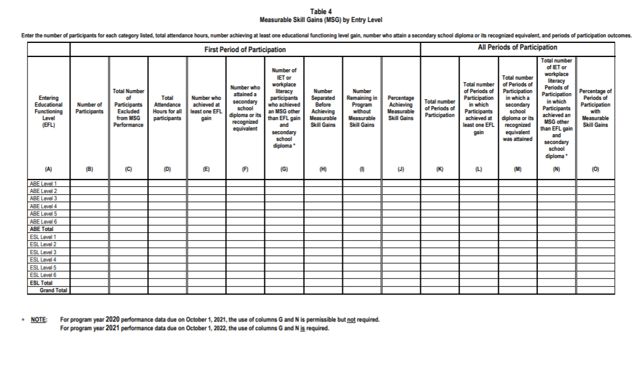
Notes:
In FY 20/21 the NRS made a change to several tables used by AE programs around the country. The first table affected by this change is Table 4. It is anticipated that these revisions will yield more accurate reporting of participants served in the adult education program.
Table 4 “Measurable Skill Gains by Entry Level” – In response to public comments, the NRS added two new columns (G and N) to report additional types of MSG outcomes for participants in Integrated Education and Training (IET) or Workplace Literacy programs.
Column G is the number of IET or workplace literacy participants who achieved an MSG via Secondary or Postsecondary Transcript, Progress Toward Milestones, or Passing Technical/Occupational
Skills Exam.

Slide 24
MSG: Progress Towards Milestones
Completing an internship/apprenticeship
Completing an OJT
T 4, 4B, 4C
Notes:
This MSG records the number of participants who demonstrated satisfactory or better progress report, towards established milestones, such as completion of on-the-job training (OJT) or completion of one year of an apprenticeship program or similar milestones, from an employer or training provider who is providing training.

Slide 25
Evidence Required
Letter from Employer/DWS confirming completion of OJT
Documentation confirming completion of internship/apprenticeship
Pay stubs/statement of earnings

Slide 26
MSG: Passing Technical / Occupational Knowledge Based Exam
Notes:
This MSG records the number of participants who successfully passed an exam that is required for a particular occupation or attained progress in technical or occupational skills as evidenced by trade-related benchmarks such as knowledge-based exams.

Slide 27
Evidence Required
Copy of licensure earned
Letter from employer/trainer confirming passing of a technical exam

Slide 28
NRS Table 4A
Educational Function Level Gain

Slide 29
Table 4A is a subset of Table 4
Columns A-F measure MSG: EFL gains by subject
Columns G-H are not used in Wyoming
Column I: records the number of students who have exited Adult Education AND have entered postsecondary in the same fiscal year
Column J: depicts the percentage of students at each level who have obtained MSG: EFL through entry into postsecondary.
Notes:
Table 4A is a subset of Table 4. This table records the number of EFL gains earned by subject at each level AND also records the number of MSG: EFL gains earned at each level by entry into postsecondary.

Slide 30
NRS Table 4B
Educational Functioning Level Gain & Attendance for Pre and Post-tested Participants

Slide 31
Table 4B is a subset of Table 4
Measures EFL gains and attendance hours on students who were given a pre & a post test ONLY.
Notes:
Table 4B is also a subset of Table 4. It measures attendance and EFL level gains for those students who were given both a pre and a post test. Students who were not post tested are not represented on this table.

Slide 32
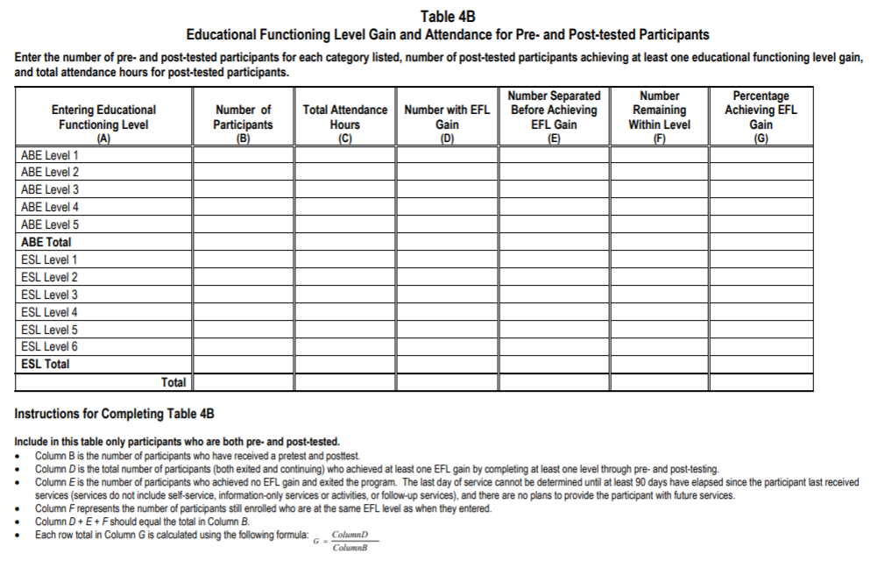
Notes:
The NRS also updated this table if FY 20/21, although the revision was only to include an instruction for Column B.

Slide 33
NRS Table 4C
Measurable Skill Gains by Entry for Participants in Distance Education

Slide 34
Table 4C is a subset of Table 4
Data only populates if students at each EFL have recorded 51% or more of their attendance hours as distance learning.
WY Distance Learning Policy is available here.
Notes:
Table 4C is another table which is a subset of Table 4, but measures MSG gains for students in Distance Education. Student data ONLY populates to this table if 51% or more of their attendance hours are recorded as distance learning hours. If a student had 49% or less of their attendance hours recorded as distance learning, they are considered traditional learners and all of their data will be shown only on Table 4. This designation is determined at the end of a fiscal year once all hours of instruction have been entered into LACES.
(See policy #01202020R)

Slide 35
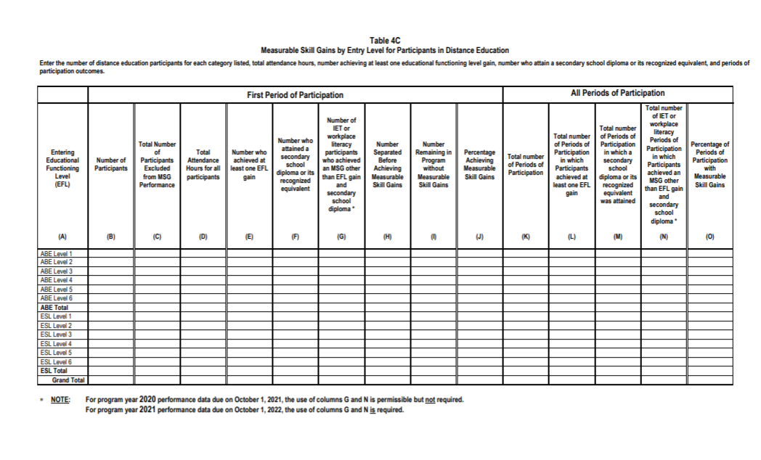
Notes:
Table 4C is the third table in which the NRS made updates to in FY 20/21.
Revisions to Table 4c “Measurable Skill Gains by Entry Level for Participants in Distance Education” – In response to public comments, the NRS added two new columns (G and N) to report additional types of MSG outcomes for participants in IET or Workplace Literacy programs. For program year 2020 performance data due on October 1, 2021, the use of columns G and N is permissible but not required. For program year 2021 performance data due on October 1, 2022, the use of columns G and N is required.

Slide 36
NRS Table 5
Primary Indicators of Performance
Notes:
Understanding how the data populates Table 5, when to do follow-up, and where to enter the data is
extremely important. Table 5 tracks:
Employment in the second quarter after exit
Employment in the fourth quarter after exit
Median earnings in the second quarter after exit
Attainment of a secondary school diploma/recognized equivalent AND enrollment in postsecondary/training within one year after exit
Attainment of a secondary school diploma/recognized equivalent AND employed within one year of exit
Attainment of a postsecondary credential while enrolled OR within one year of exit
Attained any credential.

Slide 37
Notes:
Table 5 represents the primary indicators of performance on outcome measures and utilizes data from the PREVIOUS fiscal year AND has specific dates tied to employment outcome measures. Because of this, Table 5 can be very difficult to understand.
First, it is important to remember that when using LACES to pull up Table 5 data, you must pull up ALL students, not students in the current fiscal year.
Second, Correctional students and institutionalized students do not populate Table 5, but will instead populate
Table 10, which is a similar outcomes table only populated by NRS participants in correctional or
institutional programs. Correctional students must have a Release Date entered into the Demographics
tab>Corrections panel to populate Table 10.
To help the new director understand this table each of the next few slides reviews how data on each line item/column populates to Table 5.

Slide 38
Employment Data
Local Program Follow Up
State Data Match
Surveying
Students with no SSN & Special Populations
Wyoming policy on data collection and follow-up can be found here.
Notes:
The State data matches employment records for most students with a SSN who have exited Adult Education programs in Wyoming for the 2nd and 4th quarter after exit. Eligible records are submitted to Wyoming’s UI division and the national State Wage Interchange System (SWIS). Employment data matches are typically conducted quarterly. Median earnings are also data matched through social security numbers.
Local programs are required to collect employment data on students with no social security numbers and those special populations outlined in WY policy #08112020R. (this includes self-employed individuals, farmers/ranchers, railroad employees, federal and military employees). This data must be collected through surveying which was explained in module 3.
Table 5 is Period of Participation based and students required 2nd and 4th quarter follow-up for employment outcomes for EACH period of participation.

Slide 39
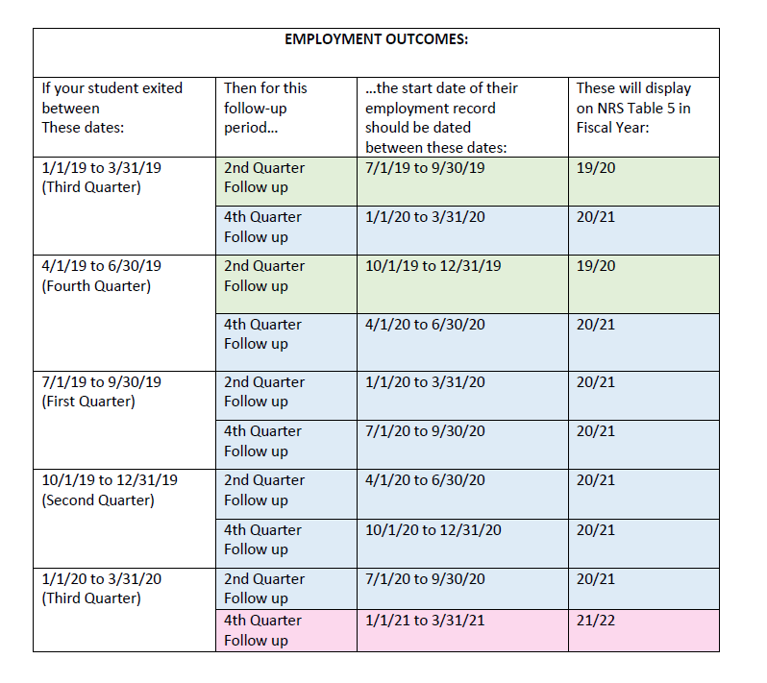
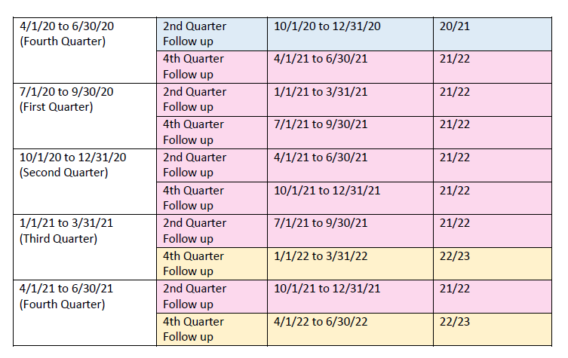
Employment Data: Dates for Surveying (FY 20/21-21/22)
Notes:
For ALL of these outcomes, Table 5 has a delay in the reporting period time, and the majority of the data
displayed will be for students who were NRS participants in the prior fiscal year. Students only populate
Table 5 if they were NRS participants and had an exit in the reportable time frame, as defined by having
no attendance hours for 90 or more days and no scheduled services.

Slide 40
Employment Second Quarter After Exit
Column B
# of students exited in previous fiscal year
Column C
# of students employed
Median earnings: during 2nd quarter after exit
Column D
SUCCESS
Column G
Column E
Column F
Excludes corrections
Median Earnings=# of students who WERE employed in the 2nd quarter after exit
Total number of PoPs
Total # of PoP’s in which there were successful outcome measures
Performance tied to federal negotiated targets
Percentage of students who met the outcome measure.
Median earnings: Average salary of employed students during their 2nd quarter after exit
Additional information on surveying/collecting & entering data into LACES for employment outcomes can be found here.
Notes:
Table 5 Column B (Number of Participants who Exited {with evidence indicating inclusion in this
outcome}) will populate with all non-correctional/institutional NRS participants who exited
between 7-1-19 to 6-30-20, (for FY 20/21 Reporting) regardless of Employment Status.
Table 5 Column B for Median Earnings is the total number of students who were exited during the previous program year AND who were employed in the 2nd quarter after exit.
Table 5 Column C (Number of Participants who Exited Achieving Outcome or Median Earnings Value) will
populate with students from Column B who have evidence of employment indicated in their
record, either through data match import from the state, or manual follow-up by the local
program. This data must have accurate date information reflecting the correct follow-up quarter
aligning with the student exit. Programs must carefully monitoring the numbers shown in both columns C, F & G as low numbers will hurt state and local program performance.
Table 5 Column D is the percentage of students who successfully achieved the outcome measure.
Table 5 Column E shows the total number of PoP’s in which records must be collected on.
Table 5 Column F depicts the total number of PoP’s in which there were outcome measure success noted.
For median earnings represents the average salaries earned by participants in the 2nd quarter after exit.
Column G: Percentage of participants who met the outcome measure. Programs must strive to meet the federally negotiated targets for each of the outcome measures found on Table 5.
Note: To conduct surveying follow-ups, local program can use several different methods for identifying who needs to be surveyed as available in LACES. Follow-up should be done at least quarterly. The Dashboard Student Alerts display students who exited two quarters ago, but the alert will update with a new list of students at the start of each new quarter on 7-1, 10-1, 1-1, and 4-1. Students will remain on the Alert as requiring survey until they show a positive outcome (have an Employed record with a Start Date in the correct quarter of follow-up) or until the new quarter begins.

Slide 41
Employment Fourth Quarter After Exit
Column B
# of students exited in previous fiscal year
Column C
# of students employed
Column D
SUCCESS
Column G
Column E
Column F
Excludes corrections
Median Earnings NOT recorded
Total number of PoPs
Total # of PoP’s in which there were successful outcome measures
Performance tied to federal negotiated targets
Percentage of students who met the outcome measure.
Median earnings: Average salary of employed students during their 2nd quarter after exit
Additional information on surveying/collecting & entering data into LACES for employment outcomes can be found here.
Notes:
In 2020/2021, Column B (Number of Participants who Exited {with evidence indicating inclusion
in this outcome}) will populate with all non-correctional/institutional NRS participants who exited
the program between 1-1-19 to 12-31-19, regardless of Employment Status. All other information for 4th quarter follow-up would be the same as 2nd quarter follow-up, with the following exceptions:
• You do not need to collect median earnings in the 4th quarter follow-up
• Use the 4th quarter follow-up rows instead of the 2nd quarter rows
• The provided follow-up quarter date chart contains the corresponding follow-up quarter for both 2nd
and 4th quarter follow-up
Follow-up should be done at least quarterly. The LACES Dashboard Student Alerts display students who exited
four quarters ago, but the alert will update with a new list of students at the start of each new quarter on
7-1, 10-1, 1-1, and 4-1. Students will remain on the Alert as requiring survey until they show a positive
outcome (have an Employed record with a Start Date in the correct quarter of follow-up) or until the new
quarter begins.

Slide 42
Survey
Evidence Required
Employment data match report

Slide 43
Attained Secondary school Diploma or Recognized HS Equivalency AND Enrolled in PS/Training within One Year of Exit
Not have already earned an HSEC/HS diploma at the time of entry into the program AND
To populate this outcome, exited students must:
‘Evidence’ of Completing HSEC in previous FY
Were at a 9th grade level equivalent or higher, as indicated by assessment or class enrollment into 9+
Enrolled into PS/training within one year of exiting AE. (PS enroll-ment date must be after exit date from AE)
Tables 5, 8, 9, 10, & 11
Notes:
This outcome is not tracking attainment of a secondary school diploma or recognized equivalent by itself
but will count the combined outcome when accompanied by enrollment in postsecondary education or
training (or employment, discussed below). The data collected for this outcome measure populates multiple tables: T5, 8,9,10 & 11.
For the 2020/2021 FY, Column B (Number of Participants who Exited will populate with all non-correctional/institutional NRS participants who:
Exited the program between 1-1-19 to 12-31-19
AND
did not already have a secondary school diploma or recognized equivalent at the time of entry into the program, based on the Highest Education Level Completed at Entry field
AND
Were at a 9th grade level equivalent or higher, as indicated by assessment or by receiving instruction at 9th grade level or higher. This would be indicated one of the following ways:
1) Assessment Educational Functioning Level in all subject areas in which they have a valid assessment within the period of participation/fiscal year is ABE L5 or ABE L6
OR
2) Enrollment in a LACES class for which the checkbox indicator of “9th grade level or higher” is checked/displays True or Yes.
To conduct follow-up for this educational outcome, you can use several different methods available in
LACES. Follow-up is only required annually, but you can conduct surveys as often as you feel is appropriate.
The Dashboard contains a Widget called Student Alerts, which you can add to the LACES Dashboard by clicking
on the Widget Library and clicking on the Student Alerts. The Student Alerts widget has several rows
relevant to the combined Attained a Secondary School Diploma/Recognized Equivalent and Enrolled in
Postsecondary Education or Training within one year of exit -or- Employed within one year of exits rows.

Slide 44
Evidence Required
Copy of Credential
HSEC Transcripts
Postsecondary transcripts or Report from NSC/Community College showing enrollment
Notes:
Local providers are required to conduct data matches for postsecondary credentials as follows:
Through the National Student Clearinghouse at least three times per year (in October to capture fall enrollments; in February to capture spring enrollments and in June to capture summer and/or any late students registrations which were not picked up by a previous data match.
Because non-credit training /workforce courses are not tracked through the National Student Clearinghouse or through the State’s database system, local programs are required to data match eligible student records at the local community college at least three times per year following the timeline outlined above.

Slide 45
Attained a Secondary School Diploma/Recognized Equivalent and Employed within one year of exit
Column B
Must be exited
Did not have a HS diploma upon entry
Columns C & D (Participants Achieving Outcome)
Evidence of credential required AND
Evidence of employment
Columns F (Total PoP’s where outcome measure achieved)
Same evidence required
Were enrolled in a class at 9th grade or higher (through enrollment or assessment)
Column G (Percentage of Participants in all PoP’s achieving outcome)
Programs must strive to meet federal targets
Notes:
This outcome has all the same requirements as Attained a Secondary School Diploma/Recognized Equivalent and Enrolled in PS Education/Training within one year of exit.
For the 2020/2021 FY, Column B (Number of Participants who Exited {with evidence indicating inclusion in this outcome}) will populate with all non-correctional/institutional NRS participants who:
Exited the program between 1-1-19 to 12-31-19
AND
Did not already have a secondary school diploma or recognized equivalent at the time of entry into the program, based on the Highest Education Level Completed at Entry field
AND
Were at a 9th grade level equivalent or higher, as indicated by assessment or by receiving instruction at 9th grade level or higher. This would be indicated one of the following ways:
1) Assessment Educational Functioning Level in all subject areas in which they have a valid assessment within the period of participation/fiscal year is ABE L5 or ABE L6
OR
2) Enrollment in a LACES class for which the checkbox indicator of “9th grade level or higher” is checked/displays True or Yes.
Educational outcome confirmation data for this outcome is added as a two-step process. First, the student must show evidence of attainment of the secondary school diploma/recognized equivalent. This is evidenced when the state does the data match or through HSE integration and does not get manually entered at the program level. With the attainment of the secondary school diploma/recognized equivalent entered, you can then proceed to enter the additional information for the employment, based on the instructions provided above in the section related to employment outcomes. You do not need to survey separately for employment for this outcome if you have already surveyed for the employment in the 2nd or 4th quarter outcomes.

Slide 46
Evidence Required
Copy of Credential
HSEC Transcripts
Employment data match report OR Survey

Slide 47
Attained PS Credential while Enrolled OR within One Year
To Correctly Populate to the Tables…..
Populates: Tables 5, 8, 9, 10, 11
Education>Postsecondary Ed/Training Panel
Postsecondary Institution Type: (select from dropdown)
Enroll Date (while enrolled in AE or within 1 calendar year of exit)
Exit Date: (date of exit from PS/Training program)
Credential Attainment: (name of credential earned)
Date earned: (date in which the credential was earned)
Show enrollment in PS/Training under PS Education/Training Tab in LACES
Have an IETP enrollment with the IETP/Credential Indicator
Must have ‘Evidence’ of Credential Earned
Notes:
The data collected from this outcome measure populates the tables shown on the slide.
For the 20/21 FY, Column B (Number of Participants who Exited {with evidence indicating inclusion in this outcome}) will populate with all non-correctional/institutional NRS participants who:
Exited the program between 1-1-19 to 12-31-19
AND
Have a class enrollment with IETP/Credential indicated
OR
Show evidence of co-enrollment in adult education and postsecondary education programs with an exit date indicating completion of the program.
To populate this outcome, students must have one of the following two criteria:
Have an IETP enrollment in the reporting period with the IETP/Credential indicator OR
Show enrollment is PS/Training as indicated in the Education tab
Because tracking this outcome measure is very complicated, it is vital that correct data entry is done.

Slide 48
Evidence Required
Copy of PS/Training Credential
Postsecondary Transcripts
Employment data match report OR Survey

Slide 49
Attained Any Credential
Table 5 Criteria
Showing Attainment on LACES
‘Evidence’ of passing HSE in the Assessments tab or Education tab>diploma/credentials panel
OR
‘Evidence’ of attainment of a PS credential under the PS/Training Panel
Enroll date (while enrolled in AE or within 1 yr of exit)
Credential Attainment (name of credential earned)
Earned date (must be after enroll date but within one year of exiting AE)
Participants must have been enrolled in a 9+ class or have TABE 11/12 scores at NRS levels 5/6
Notes:
To populate this outcome, NRS participants must meet the following criteria:
Were at a 9th + as indicated by assessment or by enrollment into 9+ class OR
Received a post secondary/training credential within one year of exiting an AE program.

Slide 50
Evidence Required
Copy of PS/Training Credential
Postsecondary Transcripts
Copy of HSEC credential/transcript

Slide 51
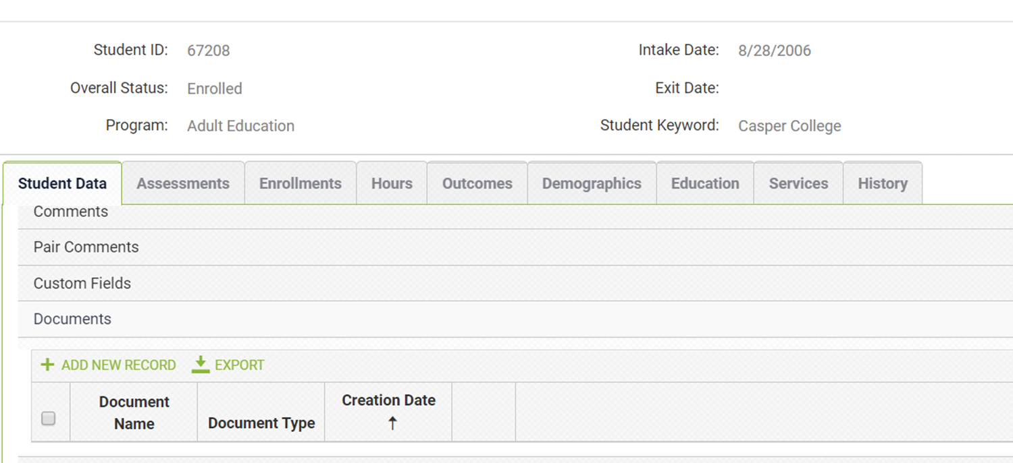
Evidence: Uploading credentials / transcripts / documents
HSEC
Work-based credentials
Bring Your ‘A’ game
Post-secondary/training credentials
IET/IELCE credentials
Notes:
Students who earn a credential of any sort must have a copy uploaded into their LACES student file. This information should be accessible from both the database as well as in the local file.

Slide 52
Credential Attainment
Table 5
Click here to obtain a copy of policy #09302020 on Credential Attainment in Wyoming.
Notes:
It can be difficult to understand what is meant by ‘Credential Attainment.” This challenge stems primarily from two areas of confusion: What is meant by a credential and How can a credential be earned? Because of this confusion, the State has implemented policy #09302020 to explain credential attainment in Wyomig.

Slide 53
What it is not?
Unallowable
Unallowable Examples
Work readiness certificates
General certificates that are not specifically aligned to an identified career track
Certs earned for Microsoft products
Certs earned for Adobe products
Industrial Safety certifications
CPR

Slide 54
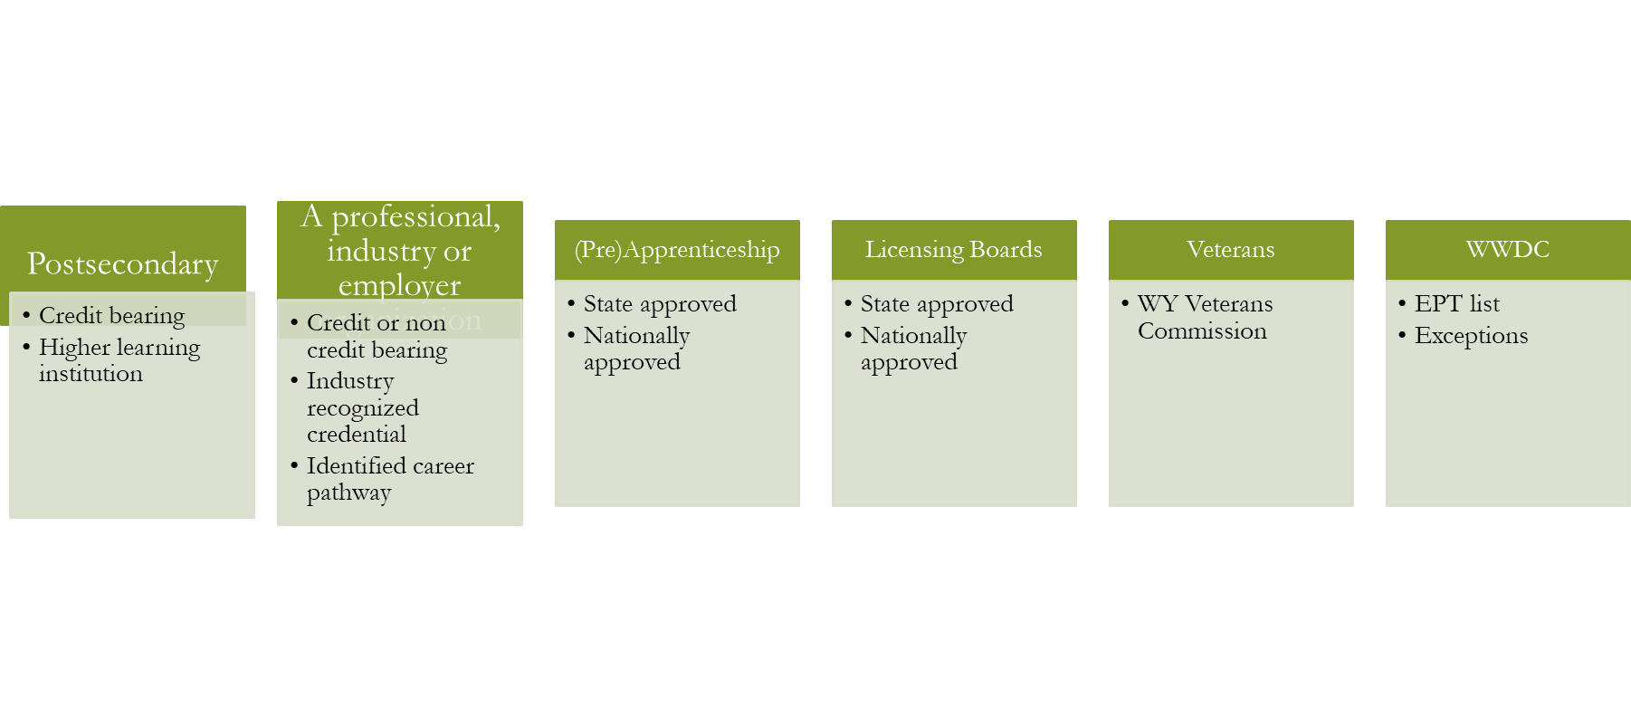
The Postsecondary/Training Credential
Notes:
These credentials are industry based credentials along an identified career track and can take multiple forms.
A postsecondary/training credential can be earned from any credit bearing program of study from an approved institution of higher learning.
A credential can also be earned through a professional, industry, or employer organization, such as The National Institute for Metalworking Skills, Inc. Sun Certified Java Programmer, etc). These programs of study can be for credit of non-credit bearing BUT must lead to an industry recognized credential along an identified career path.
Approved (pre)apprenticeship credentials can only be earned through those recognized by the State’s apprenticeship program found at (http://buildourwyoming.org) OR through a nationally recognized apprenticeship program as outlined at https://www.apprenticeship.gov.
Credentials earned through either a State or a national licensing board are approved.
Credentials earned through the Wyoming Veterans Commission are approved.
Wyoming’s sole Workforce Board, the Wyoming Workforce Development Council, has also prepared a list of Eligible Training Providers for Wyoming for credential attainment. However, it should be noted that not all credentials found on this list are approved for AE. Exceptions are noted in the WY AE policy.

Slide 55
The Secondary School or Recognized Equivalent Credential in Wyoming
Notes:
Receipt of a secondary school diploma or recognized equivalent during the FY of participation (Table 4) or within one year after exiting the program (Table 5).
Students who enroll in an AE program, exit and return to HS AND earn a diploma within one year of exiting AE can be included on Table 4 (if within the same fiscal year) and Table 5 for the following year

Slide 56
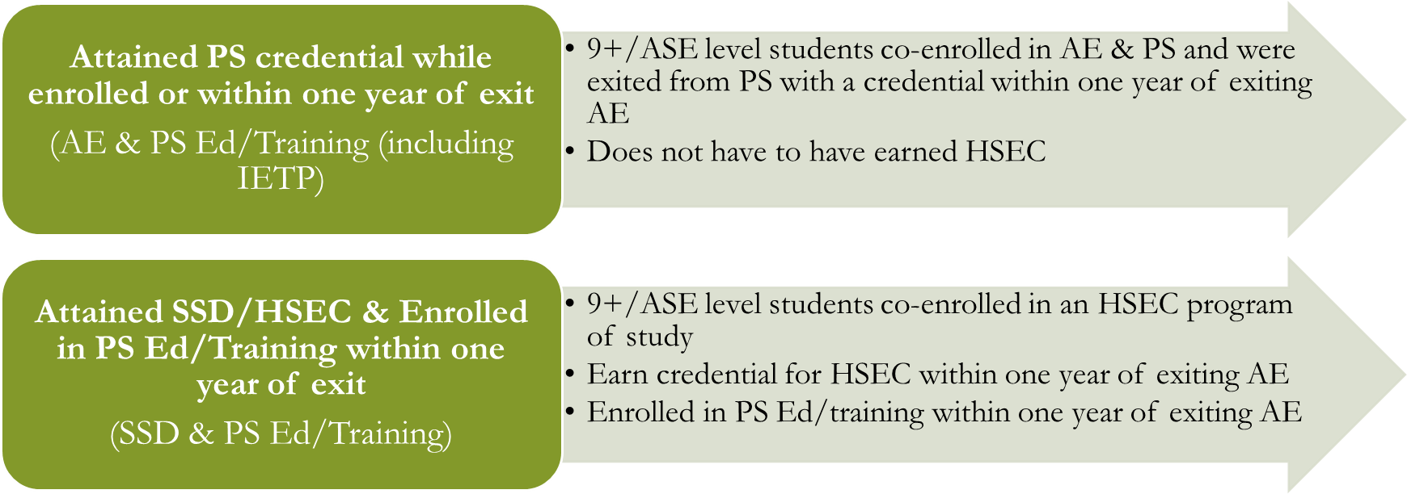
Credential Attainment: Co-Enrollment
Notes:
Students can also be included in the Credential Attainment measure for Table 5 if they are co-enrolled in AE and PS education/training (including IETP) AND earn an industry recognized credential within on year of exiting AE.
For the Attained SSD and enrolled in PS Education/training, participants can be counted for outcome measures on Table 5 if they earn their HSEC/SSD and complete a PS Ed/training program within one year of exiting AE.

Slide 57
Table 5A
Primary Indicators of Performance for Participants in Distance Education
Notes:
A subset of Table 5

Slide 58
A subset of Table 5
Distance learners
Notes:
Table 5A is a subset of Table 5 for those learners with 51% of attendance hours recorded as distance learning.

Slide 59
Table 6
Participant Status & Program Enrollment

Slide 60
Data collected from WY Intake form
Data collected from program identification of type of program enrollment on LACES.

Slide 61
Table 8 (Optional)
Outcomes for Participants in Family Literacy Programs

Slide 62
Page One
Same as Table 4 MSG’s
Same as Table 5 post exit outcome measures
Notes:
Only programs who have a family literacy program will have numbers populating to this optional table.

Slide 63
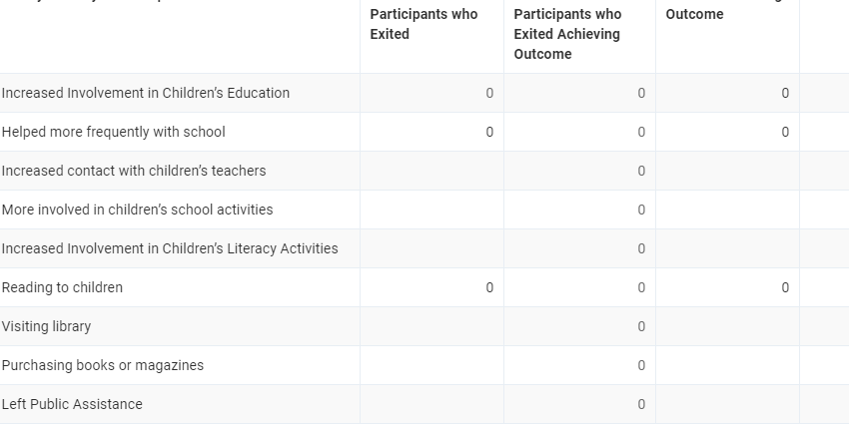
Page Two
Reporting measures specific to Family Literacy Programs

Slide 64
Table 9
Outcome Achievement for Participants in Integrated English Literacy & Civics Education (IELCE)

Slide 65
Page One
Same as Table 4 MSG’s
Same as Table 5 post exit outcome measures
Notes:
Table 9 is only for those programs which have an approved IELCE program of study.

Slide 66
Page Two
Optional reporting measures for IELCE

Slide 67
Outcome Measures for IELCE (Table 9)
Achieved Citizenship Skills/Voted or Registered to Vote
Increased Involvement in Community Activities
Can be tracked for any student who indicates having this as a goal BUT
Is required to be tracked for IELCE students
Can be tracked for any student who indicates having this as a goal BUT
Is required to be tracked for IELCE students
Must have ‘Evidence’ of achieving citizenship/Voting/Registered to Vote.

Slide 68
Table 10
Outcome Achievements for Participants in Correctional Education Programs

Slide 69
Same as Table 4 MSG’s
Table 5 outcome measures for corrections are not tracked in Wyoming as DOC students are incarcerated for long lengths of time.
Notes:
Table 10 is only for those programs which have an approved corrections education program.

Slide 70
Table 11
Outcome Achievement for Participants in Integrated Education & Training Programs

Slide 71
Page One
MSG’s as tracked on Table 4

Slide 72
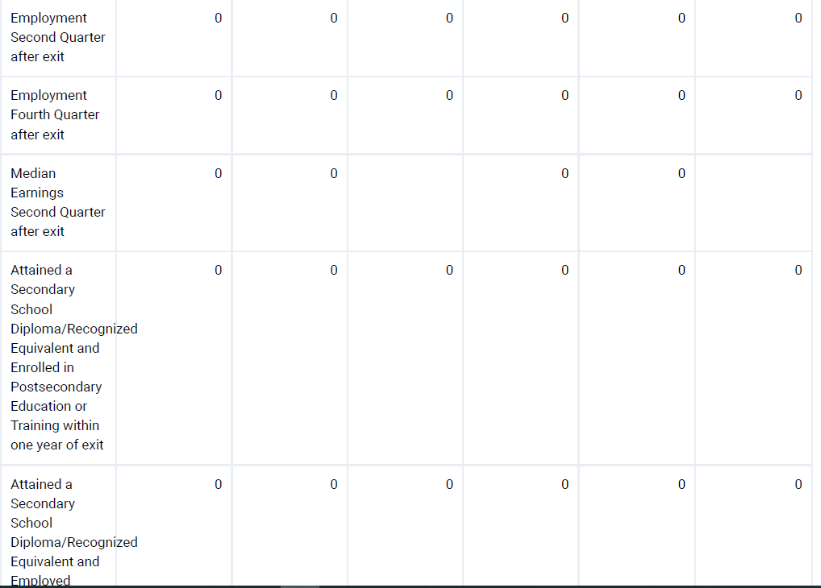
Page Two
Post exit outcome measures as tracked on Table 5

Slide 73
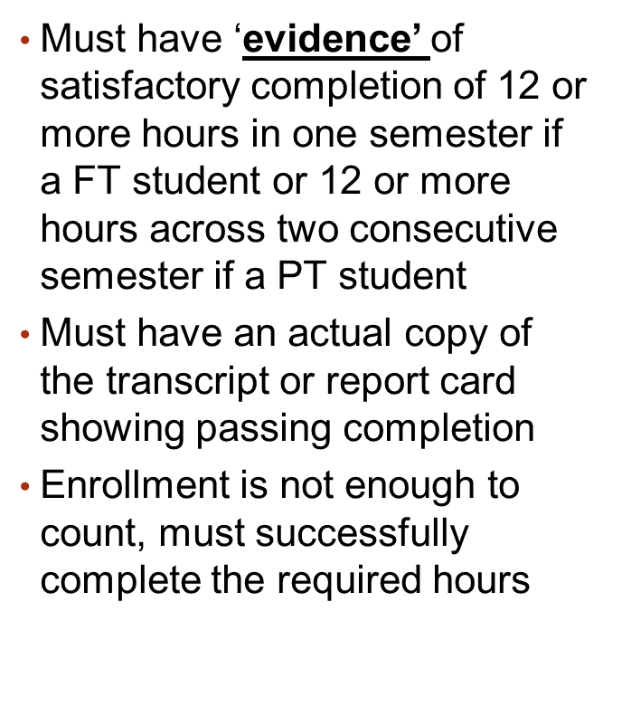
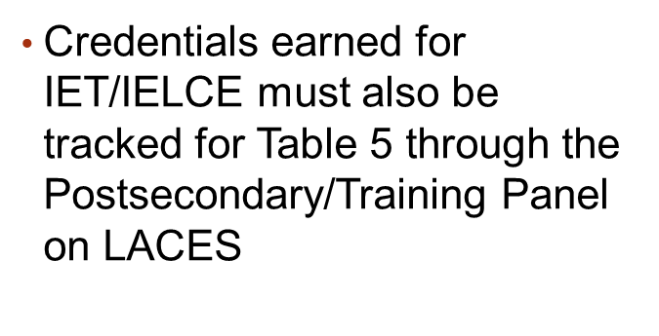
Notes:
Table 11 records

Slide 74
Other MSG’s for IET Participants (Table 11)
Passing Technical/Occupational Skills Exam
On the Job training
Internship, apprenticeship, job shadowing
Employment
Passing a technical/occupational skills exam OR digital literacy exam OR any exam intended to demonstrate competency in a technical/occupation skill(s)
Earning of a certificate, credential, license that would require an exam to obtain the certificate
Successfully completing a class or prerequisite class that must be completed in order to allow the student to continue in a program that will result in a certification, credential, or license
Must have ‘Evidence’ of one of the above through notes or evaluations from employer or training provider or copies of a job offer or contract or actual pay stub
Must have ‘Evidence’ of passing scores on exam, certificate/credential or license obtained, or completion of the class/prerequisite class.

Slide 75
Referrals & Professional Development
LACES Tracking

Slide 76
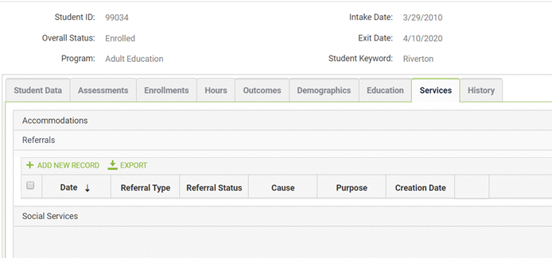
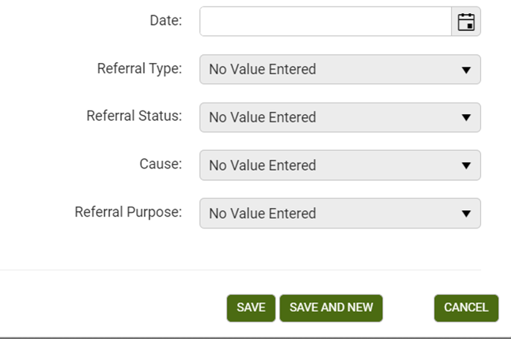
Tracking Referrals on LACES
Notes:
All Referrals are tracked on each student’s LACES record with a hard copy of the referral maintained in the student’s local file.
To record a referral on LACES, open up the student record and click on the tab entitled: Services
Under Referrals select: ‘Add New Record;
Date: Date referral was made
Referral Type: Select the appropriate type of referral made/received from the dropdown list.
Referral Status: Select if it was a referral the local program made ‘TO’ an external agency or if the referral was received ‘FROM’ another agency.
Once completed, click ‘save’.
All referrals made should be recorded under these tabs. A paper-based referral form should be available in the student’s folder and may be uploaded into the LACES online record under the Documents tab.

Slide 77
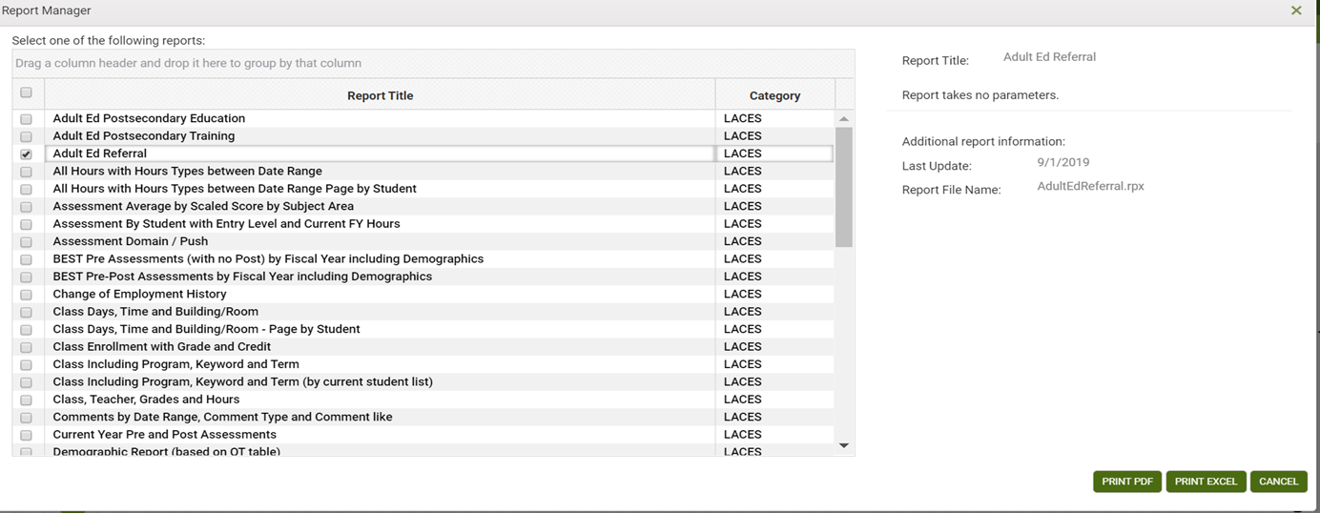
LACES Referral Report
Notes:
To run a report that shows you the referrals being tracked by the local program, click on ‘Reports’ and check the box in front of ‘Adult Ed Referral’. This will provide local programs with a list of all referrals made/received.

Slide 78
Tracking PD on LACES
Easy way for local provider to track PD hours by instructor
LACES has the ability to run a PD report for directors to monitor PD hours for entire program
FY 2020/21 transition year: FY 2021/22 will be State policy to track PD hours (WIOA Leadership
Notes:
Beginning in FY 21/22, all local programs in Wyoming must begin to track staff professional development through LACES.

Slide 79
—Ron Garan
“Open collaboration encourages greater accountability, which in turn fosters trust.”

