Slide 1
New Director Training
Virtual Format

Slide 2
MODULE
EIGHT
Staff &
Professional
Development
For
Compliance to
WIOA

Slide 3
Quality Staff
Notes:
WIOA §231(e)(9) requires that “providers activities are delivered by well-trained instructors, counselors, and administrators who meet any minimum qualifications stabled by the State, where applicable, and who have access to high quality professional development, including through electronic means.”
It is for this reason that the State has adopted a Three Tiered Approach to Professional Development.

Slide 4
Notes:
Teaching and learning that meets the expectations of college- and career-ready standards is challenging, intellectually
demanding work. High-quality instructional materials are one essential resource for bringing the standards to life. However, teacher professional learning is essential to success—for planning instruction that translates the learning expectations into rich learning experiences for students, and for using student learning data to continuously improve practice.

Slide 5
Tier 1
Tier 2
Tier 3
Local Trainings
State Trainings
Regional / National Trainings
Notes:
Local trainings can include in-service, meetings with staff, etc. on topics related to program improvement, program performance or any other topic of relevance to the local program.
State sponsored trainings include the State institute, LACES trainings, and any other specialized trainings deemed necessary by the State.
Regional and national trainings can include participation/enrollment in LINCS courses, COABE, MPAEA conferences, NRS trainings, and/or any other trainings that a staff member may be interested in pursuing.
Planning for all three levels must occur and is part of the budgetary process described in the previous unit.

Slide 6
To access the LINCS website, please click here.
Notes:
Through the LINCS Community of Practice, self-paced ONLINE courses, and searchable resources, adult education practitioners nationwide harness the power of collaboration and sharing to improve educational outcomes.
The LINCS network, supported by OCTAE, is a free resource available to all AE instructors. As courses are completed, instructors are required to submit copies of earned certificates to the program director who must retain a copy in the local instructors’ file. These are subject to audit by the State. Once a certificate is completed the information must also be entered into LACES.

Slide 7
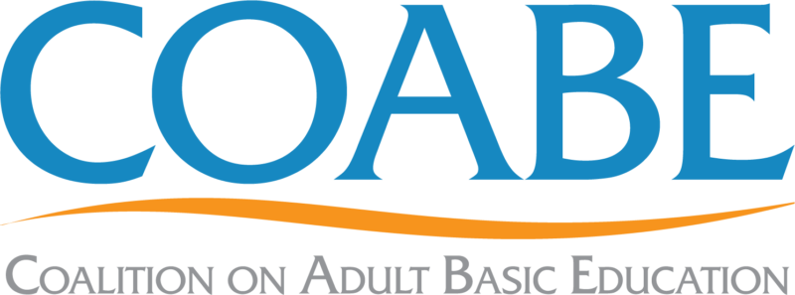
To access the COABE website, please click here.
Notes:
COABE is a national coalition for Adult Education that promotes, advocates, and conducts literacy and lifelong education efforts. Throughout the year, COABE sponsors webinars and trainings on various topics that are considered free resource to all individuals with a membership. Resources available from COABE include lesson plans, videos, apps, conference presentations, and various other professional development resources. The COABE yearly conference is one that many Adult Education staff look forward to as it presents opportunities to connect with other Adult Education staff throughout the country while learning about promising practices taking place in other AE programs. Participation in this conference is typically grant or institutionally funded and is planned for through the 3-tier planning tool that directors use for budgeting purposes.
Because the State believes that engagement with COABE is truly beneficial, the State pays the yearly membership fee for all AE instructors & directors in Wyoming.

Slide 8
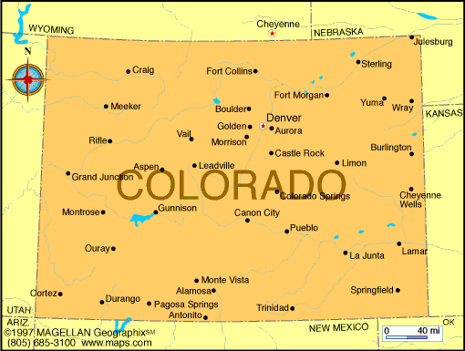
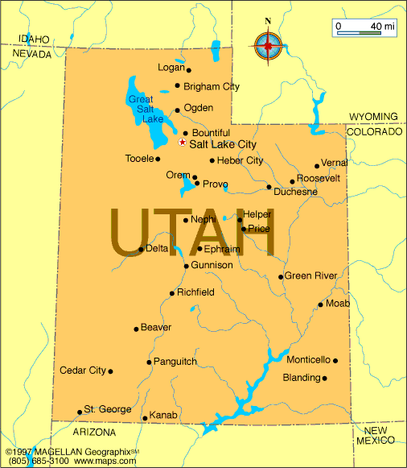
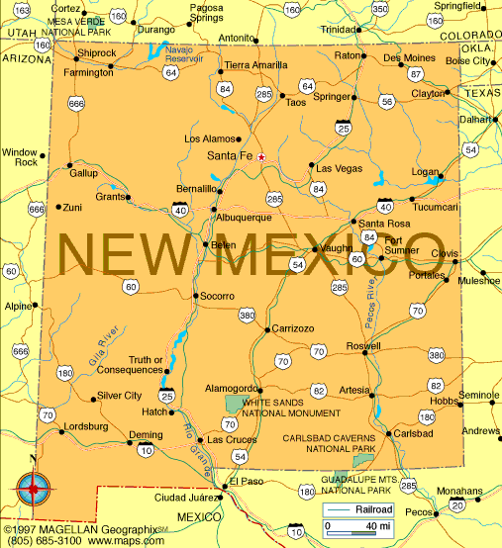
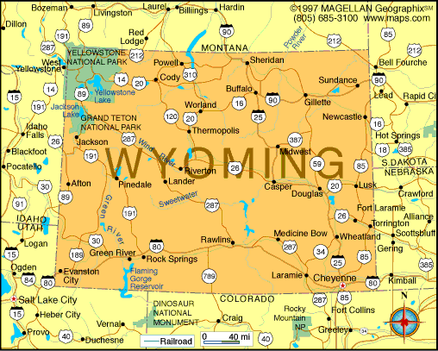
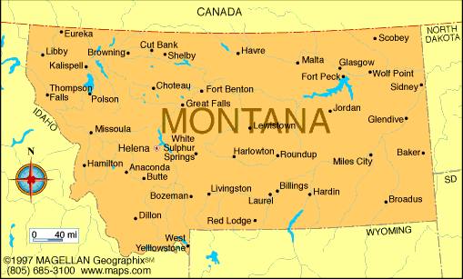
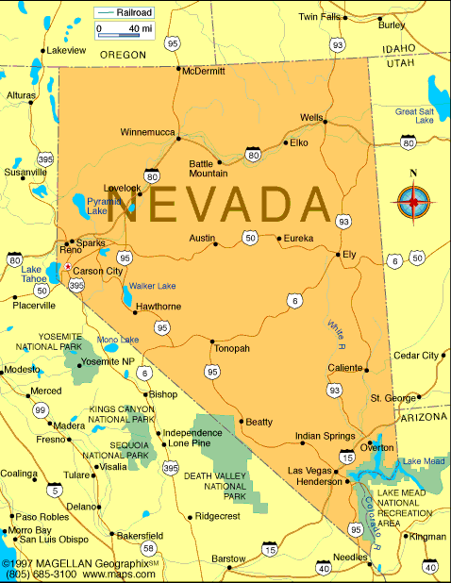
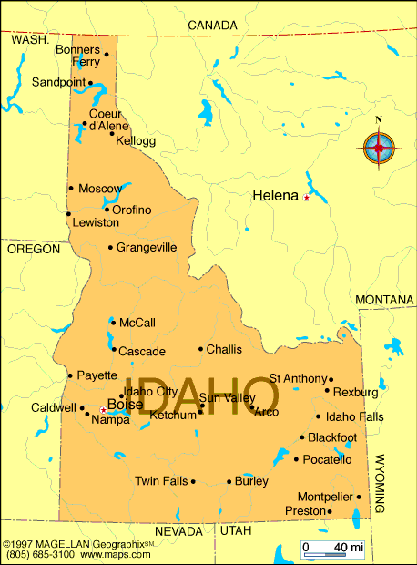
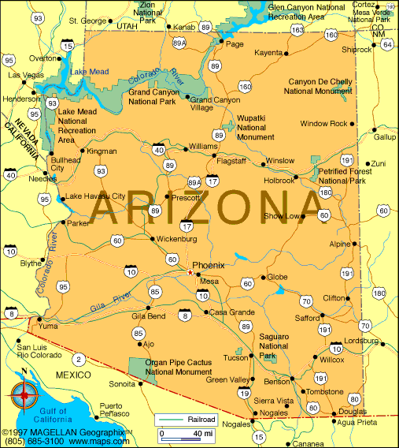
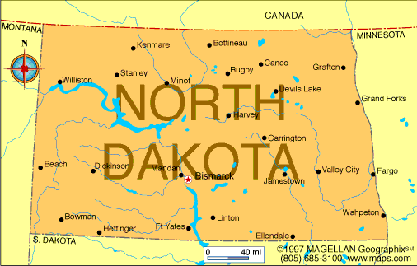
To access the MPAEA website, please click here.
Notes:
The Mountain Plains Adult Education Association serves members in a nine-state region. The original charter and founding policies were developed in 1945. The four original states were Colorado, New Mexico, Utah and Wyoming. In 1961, Arizona, Idaho and Nevada joined. Montana became the eighth state in 1988. North Dakota became the ninth state in 2014.
The Mission of the Mountain Plains Adult Education Association (MPAEA) is to support and promote lifelong learning in the Mountain Plains Region (Arizona, Colorado, Idaho, Montana, Nevada, New Mexico, North Dakota, Utah, Wyoming, and beyond). In order to achieve its mission, the association:
Promotes and provides professional development opportunities for adult educators,
Publishes and distributes relevant information about lifelong learning
Supports and strengthens member associations within the states of the region
Like COABE, MPAEA sponsors a yearly conference that is well attended by Wyoming’s AE professionals. Participation in this conference is typically grant funded and is planned for through the 3-tier planning tool that directors use for budgeting purposes.
Membership in MPAEA is either paid directly by the staff member or through grant funds awarded to the local program.

Slide 9
To access the WyLLA website, please click here.
Notes:
The Wyoming Lifelong Learning Association is the one organization in the state for those involved in lifelong learning. The association brings together a diverse array of people which enables one to be exposed to a variety of resources via the networking process among the membership.
This networking is important in a state such as Wyoming where many in the field of lifelong learning are somewhat isolated and feel they are "all alone out there".
The Association provides an annual conference for the sharing of ideas and new trends in the field. There is also a newsletter published four times per year to assist you to keep the membership up to date with what is going on in Wyoming regarding lifelong learning.
The Association's annual conference focuses on new trends and in-service education. It also provides a forum to promote networking within a social setting.
In order to achieve these goals, WyLLA promotes and develops lifelong learning in the State of Wyoming by affording opportunities for professional and non-professional adult educators to enhance their competencies. The Association gathers and then disseminates pertinent information about lifelong learning at the annual conference and through the publishing of the WyLLA newsletter four times a year. The www.wylla.org website is updated regularly and provides a way to pose questions, exchange ideas, and provide information to members.
Each AE center in the State has representatives who sit on the WyLLA board as WyLLA is the professional development ‘arm’ for Adult Education programs in Wyoming.
WyLLA membership is typically budgeted for by the local AE program through grant or institutionally funded dollars.

Slide 10
State Supported Trainings
Distance Learning/Software
DiplomaSender
Other Trainings as Needed
Summer Institute
NRS Trainings
LACES
Testing

Slide 11
LACES Trainings
State Contract
Allows for ‘one’ onsite training and 6 webinars per year
On-site training typically coincides with the Summer Institute
Mandatory attendance for all directors & data people
Each program has an EOY review with LACES
Notes:
Wyoming’s AE programs utilize LACES as the database for collecting data and for reporting purposes. It is the responsibility of the local program to train staff on how to enter and access relevant information from this database. The State also provides local programs with multiple LACES trainings throughout the year at no cost to the program. These trainings include at least one face-to-face meeting and multiple mini-webinars. In addition, at the end of the year each local provider receives a one-on-one review with the LACES trainer to review end of year program data for accuracy and validity.
In addition, should a local program need specialized LACES training, this is also available but the cost of this type of training is the responsibility of the local program.

Slide 12
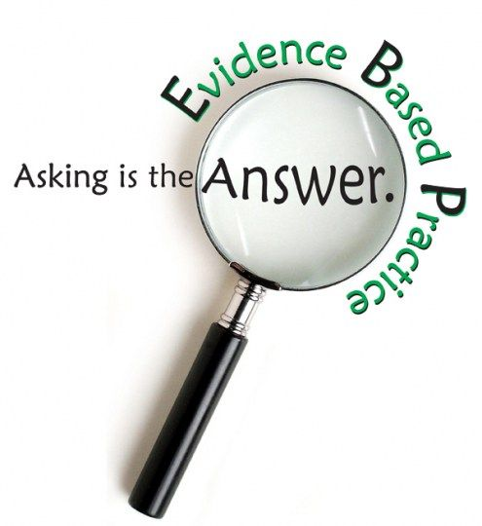
Adult Education
Instructional Practices
Notes:
WIOA mandates that all AE programs in the United States utilize research and evidenced based instructional practices in the classroom. Representatives examples of some of the most commonly used practices for Adult Education classrooms in Wyoming are found on subsequent slides.

Slide 13
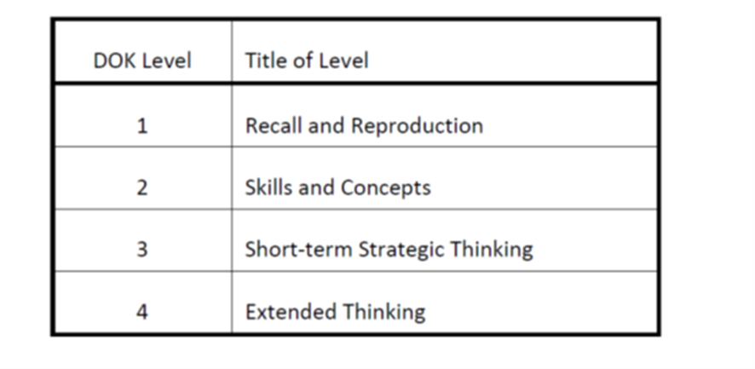
Webb’s DOK
Notes:
Webb (1997) developed a process and criteria for systematically analyzing the alignment between standards and standardized assessments. Since then the process and criteria have demonstrated application to reviewing curricular alignment as well. This body of work offers the Depth of Knowledge (DOK) model employed to analyze the cognitive expectation demanded by standards, curricular activities and assessment tasks (Webb, 1997). The model is based upon the assumption that curricular elements may all be categorized based upon the cognitive demands required to produce an acceptable response. Each grouping of tasks reflects a different level of cognitive expectation, or depth of knowledge, required to complete the task. It should be noted that the term knowledge, as it is used here, is intended to broadly encompass all forms of knowledge (i.e. procedural, declarative, etc.). The table shown on the slide reflects an adapted version of the model.

Slide 14
Notes:
Level 1-Recall & Reproduction
Curricular elements that fall into this category involve basic tasks that require students to recall or reproduce knowledge and/or skills. The subject matter content at this particular level usually involves working with facts, terms and/or properties of objects. It may also involve use of simple procedures and/or formulas. There is little transformation or extended processing of the target knowledge required by the tasks that fall into this category. Key words that often denote this particular level include: list, identify and define. A student answering a Level 1 item either knows the answer or does not; that is, the answer does not need to be “figured out” or “solved.”
Level 2-Working with Skills and Concepts
Level 2 includes the engagement of some mental processing beyond recalling or reproducing a response. This level generally requires students to contrast or compare people, places, events and concepts; convert information from one form to another; classify or sort items into meaningful categories ; describe or explain issues and problems, patterns , cause and effect, significance or impact, relationships, points of view or processes. A Level 2 “describe or explain” would require students to go beyond a description or explanation of recalled information to describe or explain a result or “how” or “why.” The learner should make use of information in a context different from the one in which it was learned.
Elements found in a curriculum that fall in this category involve working with or applying skills and/or concepts to tasks related to the field of study in a laboratory setting. The subject matter content at this particular level usually involves working with a set of principles, categories, heuristics, and protocols. At this level students are asked to transform/process target knowledge before responding. Example mental processes that often denote this particular level include: summarize, estimate, organize, classify, and infer.
Level 3-Short-term Strategic Thinking
Items falling into this category demand a short-term use of higher order thinking processes, such as analysis and evaluation, to solve real-world problems with predictable outcomes. Stating one’s reasoning is a key marker of tasks that fall into this particular category. The expectation established for tasks at this level tends to require coordination of knowledge and skill from multiple subject-matter areas to carry out processes and reach a solution in a project-based setting. Key processes that often denote this particular level include: analyze, explain and support with evidence, generalize, and create.
Level 4-Extended Strategic Thinking
Curricular elements assigned to this level demand extended use of higher order thinking processes such as synthesis, reflection, assessment and adjustment of plans over time. Students are engaged in conducting investigations to solve real-world problems with unpredictable outcomes. Employing and sustaining strategic thinking processes over a longer period of time to solve the problem is a key feature of curricular objectives that are assigned to this level. Key strategic thinking processes that denote this particular level include: synthesize, reflect, conduct, and manage.

Slide 15
Participatory Learning Strategies
Circle
Speaking & setting intention, speaking in a group, active listening, taking turns, getting/giving support
World Cafe
Collaboration, working in a team, llisteing to and discussing diverse ideas & opinions, building a collective model, managing time, taking a leadership role, self advocacy, putting abstract ideas into a visual model, active listening, peer learning & coaching.
Open Space
Leadership, asking questions, offering something of interest to others, active listening, asking for help and offering help, diagramming/summarizing a conversation
Appreciative Inquiry
Looking for the positive, managing negative situations from a strengths-based, positive view, viewing life, people, & daily situations from a positive vantage point.
ProAction Cafe
Creating hospitable space, focusing on the host's questions/challenges, asking questions but not offering answers or solutions, encouraging each person's contribution, creating mind maps/web of a conversation, and listening together for patterns, insights, and deeper questions
To learn more about Participatory Learning Strategies (The Art of Hosting), please watch the informational videos available here.
Notes:
All local programs in Wyoming utilize participatory learning strategies in their classrooms. These are first introduced to students in the Career Services courses.
Participatory learning encompasses a range of techniques and methods for facilitating and enabling students to come together in groups (usually small groups) to share knowledge and ideas, discuss, debate and deliberate, analyze and critique, and construct and create knowledge and theory.
Dr. Laura Weisel introduced participatory learning strategies into Adult Education programs several years ago and after an intensive amount of training, participatory learning in some form is used throughout all Adult Education programs in the State of Wyoming. Participatory learning is important as each method has the development of social capital skills embedded within them.
In education, social capital skills are the key to success. Stephen Black, a professor and researcher in Sydney, Australia in his presentation on Social Capital Skills in Education, states, “It’s the relationships people have, the groups they belong to, the networks they link into, the contacts they’ve got. It’s about the trust they have in others. It’s also how they interact with these other people—how they present themselves. This may be related to their confidence and to their skills.”
In the graph shown on the slide, each of the Participatory Learning strategies have been viewed from the social skills imbedded in their process.

Slide 16
Notes:
The Art of Hosting (AOH) processes were originally a set of individual methods and practices that, in combination with one another, have been successful in engaging individuals to work together in dialogue on social and organizational issues. Each of the participatory processes has its own author who has published books or manuals describing their approaches to engaging individuals to work collaboratively with peers and constituent groups. The five core participatory methods of AOH are: The Circle, The Café, Open Space, Appreciative Inquiry, and ProAction Café. Each of these learning methodologies are discussed on these slides.
The first method is known as the ‘Circle’.

Slide 17
Notes:
The World Café is a method for creating a collaborative learning conversation around questions that matter by innovating instruction in the classroom. Café is ideal for administrators to develop collaboration and co-creation with faculty, boards, and community partners.

Slide 18
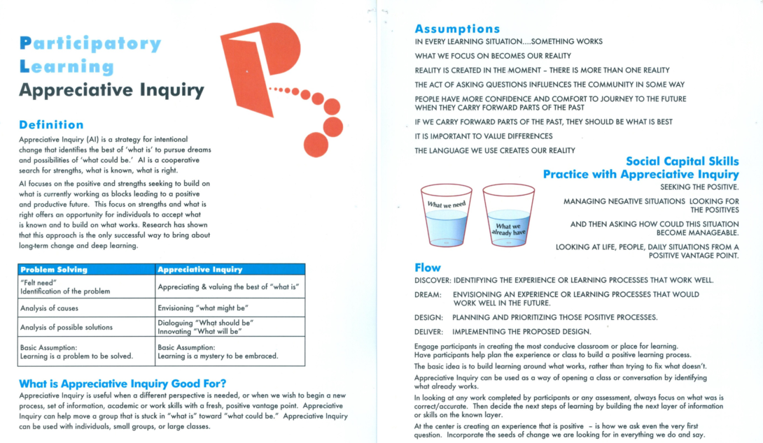
Notes:
Appreciative Inquiry is a strategy for intentional change that identifies the best of ‘what is’ to pursue dreams and possibilities of ‘what could be’. It is a cooperative search for strengths, what is known, and what is right. Appreciative Inquiry focuses on the positive and strengths seeking to build on what is currently working as blocks leading to a positive and productive future.

Slide 19
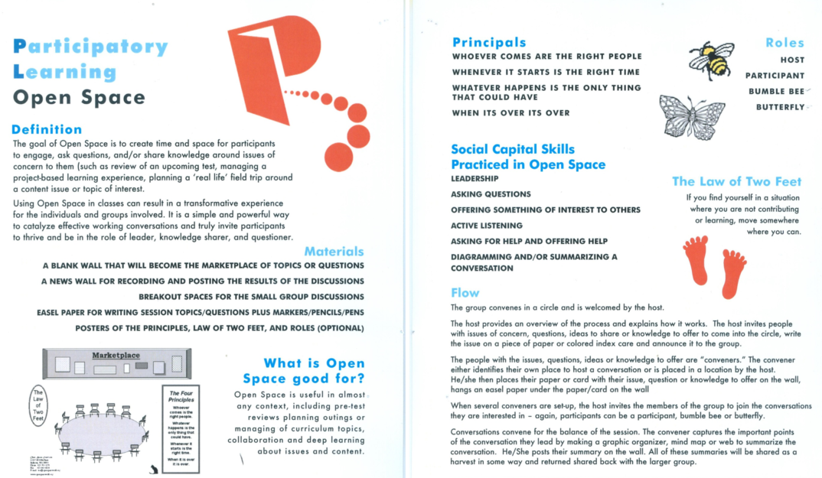
Notes:
The goal of Open Space is to create time and space for participants to engage, ask questions, and/or share knowledge around issues of concern to them. Using Open Space in classes can result in a transformative experience for the individuals and groups involved. It is a simple and powerful way to catalyze effective working conversations and truly invite participants to thrive and be in the role of leader, knowledge sharer, and questioner.

Slide 20
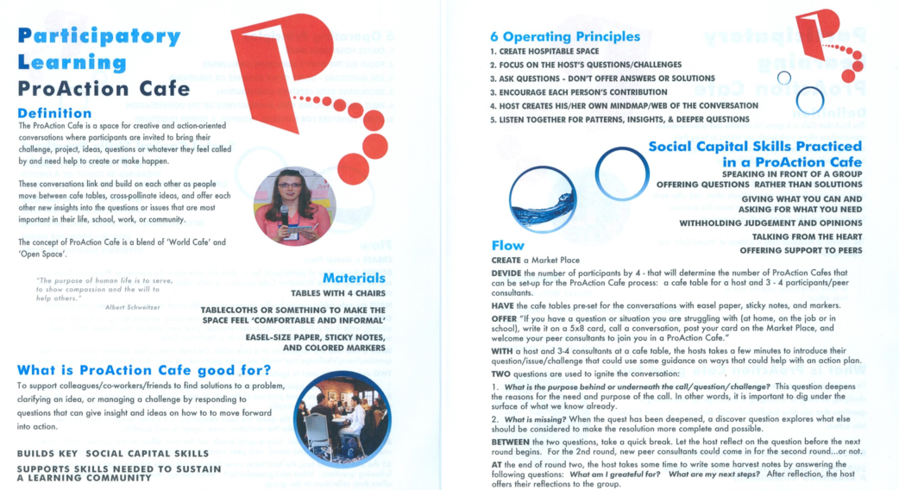
Notes:
The ProAction Café is a space for creative and action-oriented conversations where participants are invited to bring their challenge, project, ideas, questions or whatever they feel called by and need help to create of make happen.

Slide 21
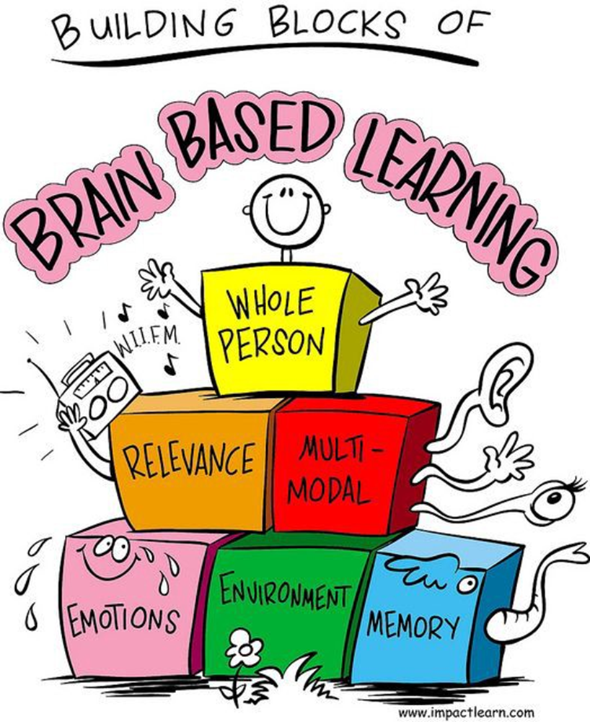
Notes:
Brain-based learning refers to teaching methods, lesson designs, and school programs that are based on the latest scientific research about how the brain learns, including such factors as cognitive development—how students learn differently as they age, grow, and mature socially, emotionally, and cognitively.
Brain-based learning plays a large role in the Career Services courses in Wyoming. To learn more about this theory, please refer to New Teacher Training Module 6.

Slide 22
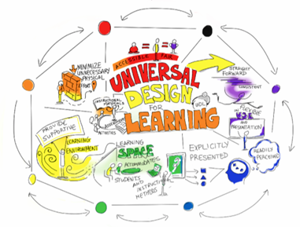
(https://udlguidelines.cast.org/)
Notes:
UDL is an approach to curriculum design that can help teachers customize curriculum to serve all learners, regardless of ability, disability, age, gender, or cultural and linguistic background. UDL provides a blueprint for designing strategies, materials, assessments, and tools to reach and teach students with diverse needs.
About UDL
Universal design for learning (UDL) is a set of principles for designing curriculum that provides all individuals with equal opportunities to learn. UDL is de-signed to serve all learners, regardless of ability, disability, age, gender, or cultural and linguistic back-ground. UDL provides a blueprint for designing goals, methods, materials, and assessments, to reach all students including those with diverse needs. Grounded in research of learner differences and effective instructional settings, UDL principles call for varied and flexible ways to
Present or access information, concepts, and ideas (the "what" of learning),
Plan and execute learning tasks (the "how" of learning), and
Get engaged--and stay engaged--in learning (the "why" of learning)
UDL is different from other approaches to curriculum design in that educators begin the design process expecting the curriculum to be used by a diverse set of students with varying skills and abilities.
UDL is an approach to learning that addresses and redresses the primary barrier to learning: inflexible, one-size-fits-all curricula that raise unintentional barriers. Learners with disabilities are the most vulnerable to such barriers, but many students without disabilities also find that curricula are poorly designed to meet their learning needs. UDL helps meet the challenges of diversity by recommending the use of flexible instructional materials, techniques, and strategies that empower educators to meet students' di-verse needs. A universally designed curriculum is shaped from the outset to meet the needs of the greatest number of users, making costly, time-consuming, and after-the-fact changes to the curriculum unnecessary.
Note: Additional information about all learning theories discussed on these slides can be found in New Teacher Training Module 6.

Slide 23
SELF Regulated Learning (SRL)
Model Examples
Provide Ongoing Support
Empower Students
Motivitate
Self-efficacy
Encourage
More information about SRL can be found here.
Notes:
Self-regulated Learning (SRL) refers to one’s ability to understand and control one’s learning behaviors. In order for the learner to do this, he or she must set goals, select the strategies to achieve the goals and monitor progress toward the goals. A key element is not to simply relay content or problem-solving techniques, but to explicitly teach students ‘how’ to learn. Being explicit about how to use different learning strategies will help students develop a suite of tools they can draw from as they work through a program of study.
Model examples of your own thought process, narrating as you explain how to solve problems. (Zumbrunn et.al, 2011)
Provide ongoing support. Students in an unfamiliar discipline are unlikely to know which strategies to use, and they may lose interest or motivation if not coached and encouraged (Zimmerman 2002).
Ultimately, migrate toward empowering students to become their own managers. In time they will develop the capacity to self-regulate (Zimmerman, 2002).
Many students, particularly those who are the first in their families to attend college, are motivated to master skills that will help them in a career. Point out that self-regulated learning is essential for learning new skills or concepts in the workplace. Motivation and self-satisfaction improve when students have success with the use of effective learning techniques (Zimmerman, 2002; Zumbrunn et al., 2011). Promote students’ positive self-perceptions of competence and motivational beliefs. You cannot underestimate the power of belief.
Self-efficacy has been defined as "beliefs about [learners] capabilities to exercise control over their own level of functioning and over events that affect their lives" (Bandura, 1993, p. 118). Perceptions of self-efficacy are critical.
Students' perceptions of self-efficacy influence the goals they set, their commitment to those goals, and the learning strategies employed. Low perceptions of self-efficacy undermine students' willingness to invest effort in tasks.
Turning students on to their own capacity to believe in themselves is an incredibly powerful teaching tool. Our students are going to have to put in a lot of effort to improve their writing and other basic skills – help them understand the value of that effort and supply some new self-talk scripts.
Encourage students to ask for help when they need it. Strive to create a two-way, open dialog.

Slide 24
Teacher Dependent
Content
Process
Product
Learner-Dependent
Interest
Profile
Readiness
Notes:
Differentiating instruction is defined as the planning and delivery of classroom instruction that considers the varied levels of readiness, learning needs, and interests of each student in the class. Instructors practice this by using a range of routines and tools to engage learners at varying levels of readiness in multiple ways and by offering students options for demonstrating their understanding and mastery of the material.
Differentiating instruction encompasses an instructors’ response to learner differences by adapting curriculum and instruction on six dimensions:
Teacher-dependent:
Content: Ideas to consider for adapting the content, or the ‘what’ of the lesson should include:
Change lesson complexity; Utilize multiple resources: narrative, informational, multi-media, expert/guest speakers; Lesson context: Classrooms, programs, communities, virtual
Process: Ideas to consider for adapting the process, or the ‘how’ of a lesson should include: Change how you direct instruction: whole group, small group, individual; Chunk and compress material; Change how you structure cooperative activities: Be flexible, change classroom groupings and peer activities; Change the way you structure inquiry. Use problem-based learning, service learning, performance, etc.
Product: Ideas to consider for adapting the product, or the ‘result’ of a lesson should include: Expect student work that reflects multiple intelligences; Assess completeness through various means: portfolios, rubrics, peer reviews, performance, etc.
Learner-dependent:
Interest: What are your student's interests? Find out by using journals, informal conversations/ice breakers, sharing opportunities with the whole class, community events
Profile-Ideas to consider for accommodating learning profiles (strengths, weaknesses, gaps) by identifying:
disability screening results: know how to accommodate learning & attention difficulties, cultural & linguistic factors, health & wellness factors, age & years of school setting, past educational and academic experiences
Readiness: Beyond test scores, what do you know about your learner’s readiness as evidenced by past educational achievement, background knowledge, self-efficacy (how do they attribute success & effort)

Slide 25
Dissemination of
Best Practices
Notes:
WIOA Section 242 (C) requires that local programs develop, replicate and disseminate information on best practices and innovations such as:
The identification of effective strategies for working with adults with learning disabilities and with adults who are English language learners
Integrated education and training programs
Workplace adult education and literacy activities
Postsecondary education and training programs
Because of this local instructors are expected to share promising practices at conferences (state, regional or national), through publications or other means. During monthly director’s meetings, local directors are also afforded the opportunity to share promising practices that are occurring in their site. In addition, once per quarter all local directors and workforce managers throughout the State meet virtually in what is called a ‘Meet and Greet’ to share promising practices that are occurring in the region.

Slide 26
Standards in Action Checklist

Slide 27
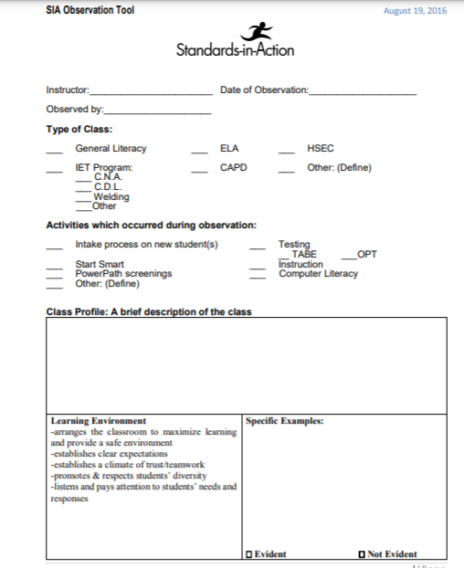
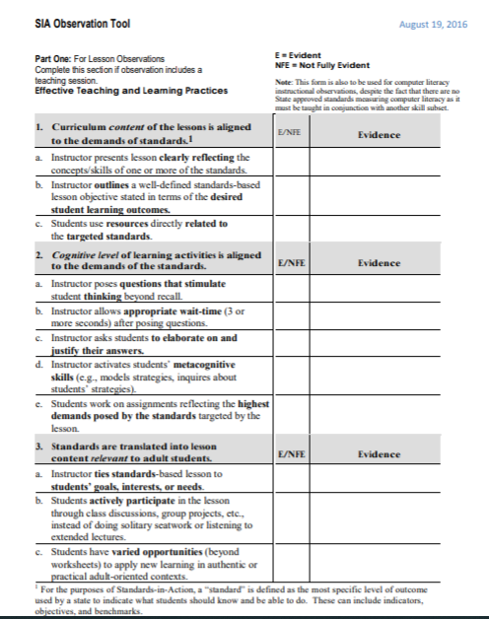
A copy of the SIA checklist is available here.
Notes:
The SIA checklist is a required observational tool that must be used by all AE programs in Wyoming. Local directors are required to observe each instructor’s lesson at least once per year utilizing this multi-paged form. Copies of the completed review are to be maintained in each instructor’s local file and these are subject to State review through the monitoring process. A copy of the SIA checklist is available on the Commission’s website.

Slide 28
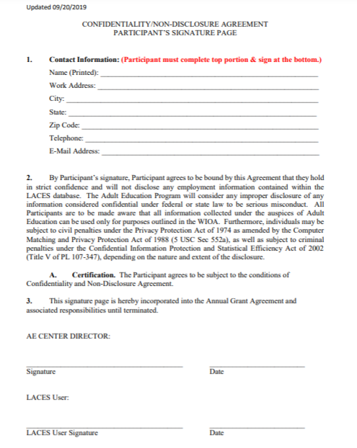
Notes:
All LACES users in Wyoming are required to complete and submit to the State a copy of Confidentiality Agreement. The signed original must be retained locally and is submit to State monitoring.

Slide 29
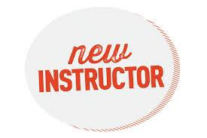
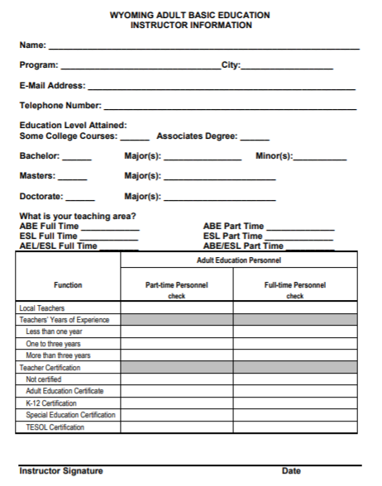
Notes:
As part of the competitive grant competition, local providers are required to submit a completed Instructor Information form for each instructor employed by the program. Thereafter, new instructors are required to complete the form as well. All completed forms must be submitted to the State with hard copies being maintained locally as these are submit to State monitoring.

Slide 30
The Commission Website
Student website
Curricula: various subjects, thematic, contextualized
Forms used in WY’s AE programs
The drawdown portal
Professional development
LACES trainings, new instructor training modules, NRS trainings and more
Reporting, Resources, & Reapplication
WIOA Information, State Plan, OCTAE Memorandums, and more
Demographics & Performance Dashboard
AE State Policies
COVID Related Information
When in doubt, ask!!
Notes:
The Adult Education section of the Commission’s website provides local directors, instructors, and students with a wealth of information about programs in Wyoming. Some of the topics available through this website are shown on the slide.

Slide 31
Samples of Program Assessments
Notes:
The last slides in this unit are samples of optional forms that programs may use and are available from the Commission’s website.

Slide 32
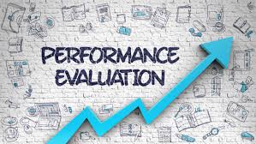
Instructor Self-Evaluations

Slide 33
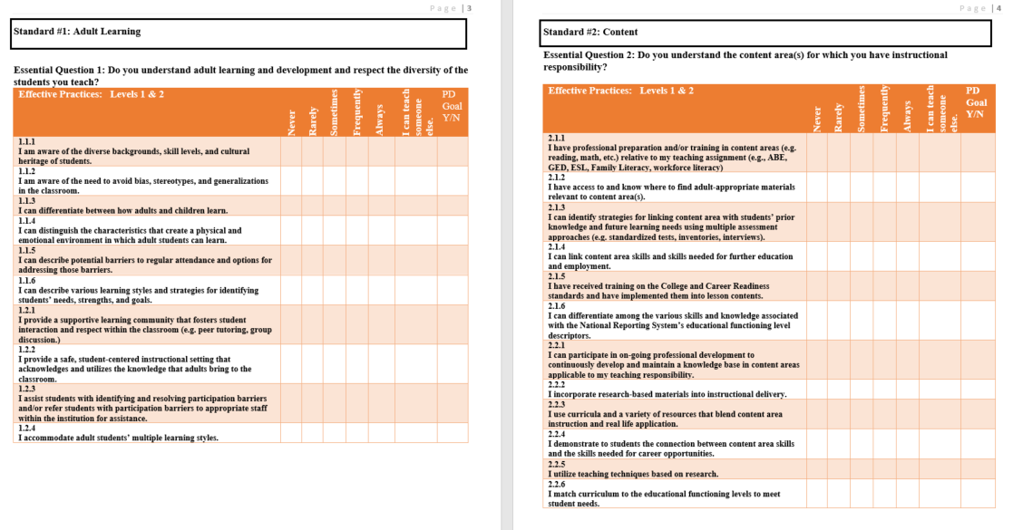
Levels 1 & 2 Self-Assessment
A copy of the full assessment can be found here.
Notes:
This self-assessment, Levels 1 & 2, is designed for relatively new instructors—those with up to two-three years of Basic Skills teaching experience.
The self-assessment instrument addresses core knowledge and skills that Basic Skills instructors need for effective performance. It is not intended to be all-inclusive. After instructor’s feel comfortable with their performance in all of the Level 1 & 2 practices, the program manager will want to progress the instructor to the next level form: Levels 3 & 4, which provides a continuum to higher-level teaching practices.

Slide 34
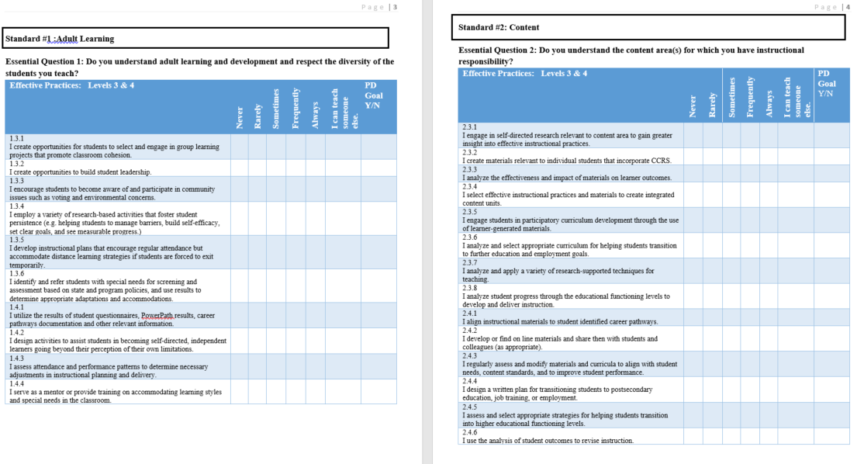
Levels 3 & 4 Self-Assessment
A copy of the full assessment can be found here.
Notes:
This self-assessment: Levels 3 & 4, is designed for instructors who have been teaching in the Basic Skills program for more than two years.
This self-assessment instrument builds upon the skills and knowledge addressed in the Level 1 & 2 assessment, which covered core knowledge and skills that Basic Skills instructors need for effective performance.
This instrument is not intended to be all-inclusive. It will, however, give you a good idea of critical competencies needed for effective instructional delivery as instructors expand their skills in the Basic Skills program

Slide 35
Notes:
The final program evaluative tool looks at the quality of the program manager and gives instructors an opportunity to evaluate their local director. This is an optional tool that programs can utilize as it can help facilitate and identify areas in the program which need to be addressed for program improvement.

Slide 36
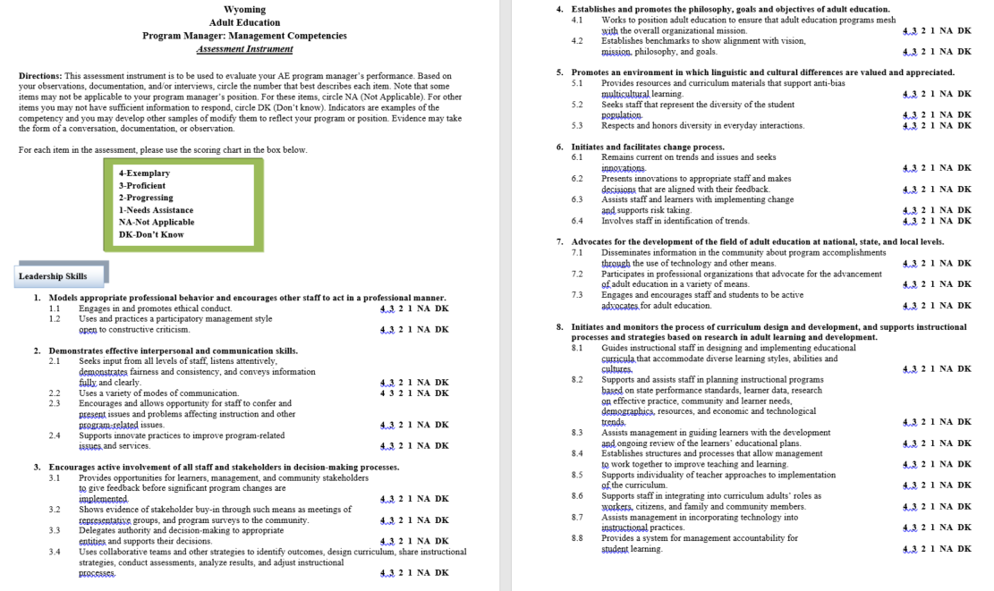
A copy of the full assessment can be found here.
Notes:
This assessment instrument can be used to provide instructors with an opportunity to review the local program manager’s competencies.

Slide 37
—Jane Goodall
“What you do makes a difference, and you have to decide what kind of difference you want to make.”

